Slide 1

Leadership
TFTD 3

Slide 2
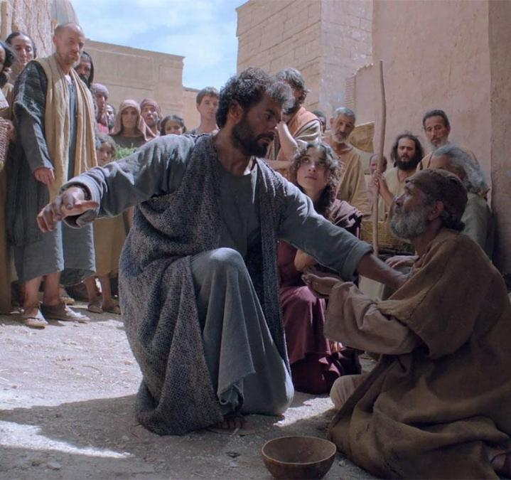
Peter – Leadership through humility
What can we learn from Peter?
Peter's transformation is particularly powerful because he did not begin as a perfect leader. He was passionate and courageous, but he could also be impulsive and fearful. Through his relationship with Jesus, his failures and his restoration, he grew into a leader who guided and encouraged the early Church.
His life teaches us that:
Humility is self-awareness: recognising your weaknesses without allowing them to define you.
Humility is teachability: being willing to receive correction and grow.
Humility is service: using your position to care for others rather than elevate yourself.
Humility is dependence on God: recognising that leadership is not simply about your own ability, but about God's grace and guidance.
Ultimately, Peter demonstrates that you do not have to be a perfect person to become an effective leader. You must be willing to learn, be corrected, take responsibility and allow God to transform you.
His life reminds us that the strongest leaders are not necessarily those who never fall, but those who are humble enough to get back up, learn from their experiences and continue serving others

Slide 3
THE CHRISTIAN PERSPETIVE
Peter executed leadership through humility. In 1 Peter 5:6 the Bible says 'So humble yourselves under the mighty power of God, and at the right time he will lift you up in honour.'
Peter instructed the elders of the early Church to shepherd God's people willingly, not for selfish gain or by dominating those entrusted to their care. Instead, they were to lead by example.
He also encouraged believers to clothe themselves with humility.
Leadership lesson: Peter understood that leadership is a responsibility to care for others, not an opportunity to feel superior to them. Humble leaders influence through their character, service and example rather than relying on their title or position.

Slide 4
REFLECTION QUESTIONS
1. When you make a mistake at school or with your friends, do you admit it or try to hide it? Why?
2. Peter made a big mistake when he denied knowing Jesus, but Jesus forgave him. What does this teach us about second chances?
3. Have you ever found it difficult to say sorry because of pride? Why can apologising be difficult, and what does it show about us when we do?
4. If someone in your class makes a mistake, should they be given another chance to be a leader? Why or why not?
5. How can you hold your friends accountable when they do something wrong without judging them or making them feel worse?

Slide 5

CHALLENGE
What are some practical ways student leaders at SSSO, such as Faith Ambassadors, Prefects and Head of Choir, can serve others and demonstrate humility in their roles?

Slide 6

PRAYER
Heavenly Father,
Thank You for the example of Peter and for showing us that we don't have to be perfect to be used by You. Help us to learn from our mistakes, to be willing to apologise when we are wrong, and to accept correction with humble hearts.
Lord, help us to be leaders who serve others rather than seek recognition for ourselves. Whether we are Faith Ambassadors, Prefects, members of the choir or simply leading by example, help us to reflect Your love through our words and actions.
Give us the courage to stand up for what is right, the humility to admit when we are wrong, and the compassion to give others the opportunity to learn and grow.
Help us to remember that leadership is not about being better than others, but about using the gifts You have given us to make a positive difference.
In Jesus' name, Amen.

