Slide 1

Leadership
TFTD 2

Slide 2
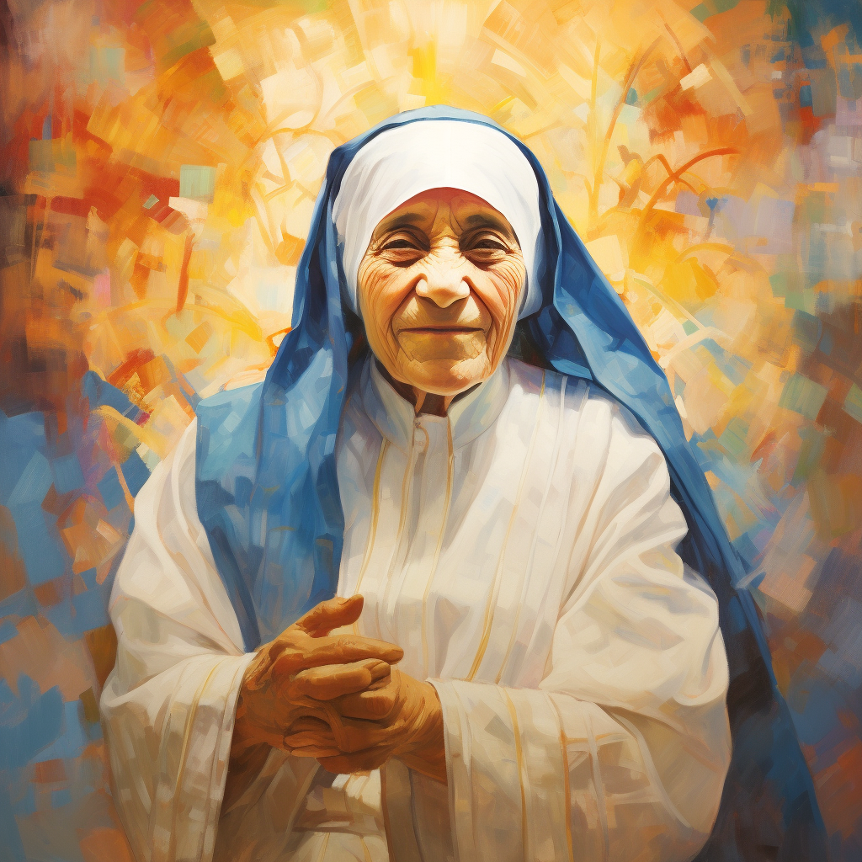
St Teresa of Calcutta — Leadership through compassion
St Teresa of Calcutta, widely known as Mother Teresa, was a Catholic religious sister who dedicated her life to serving people living in poverty, particularly those who were sick, homeless or neglected. She founded the Missionaries of Charity in 1950.

Slide 3
How did she demonstrate leadership?
Leading by example: She did not simply encourage others to help those in need; she personally served them.
Compassion and empathy: She recognised the dignity of every person, regardless of their circumstances.
Commitment to a vision: She built an organisation around serving the poorest and most vulnerable, inspiring others to join her mission.
Putting others first: Her example demonstrates that leadership involves sacrifice and a willingness to meet the needs of others.

Slide 4
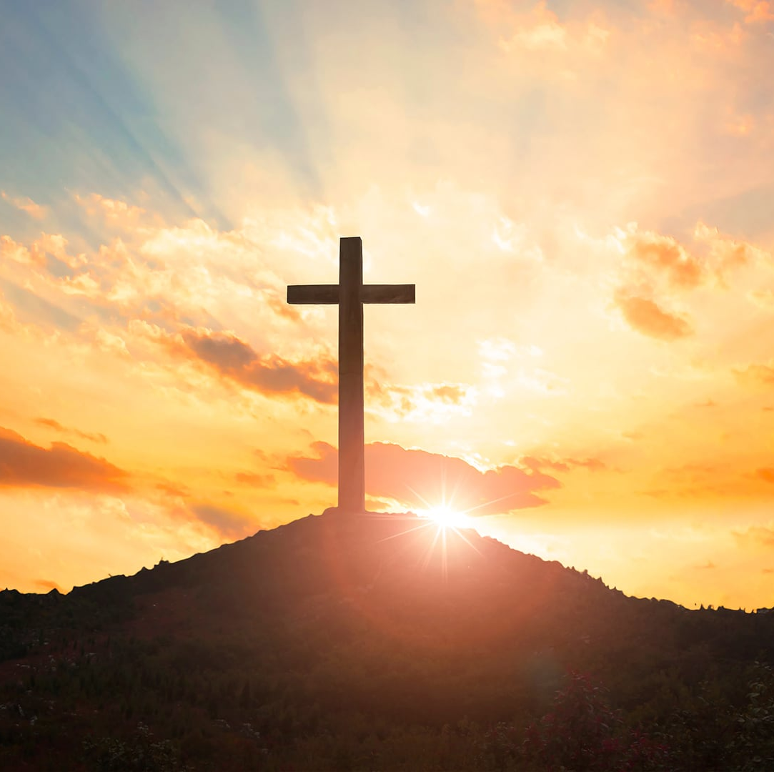
THE CHRISTIAN PERSPECTIVE
1 Timothy 4:12 says “Set an example for the believers in speech, in conduct, in love, in faith and in purity.”
This scripture reminds us that Christian leadership means leading by example and showing compassion through our words, actions and love for others. Jesus calls us to treat people with kindness, show patience when others are struggling and care for those who may feel overlooked. True compassionate leadership means reflecting the love of Christ in how we treat others, not just in what we say, but in what we do.

Slide 5
LET'S REFLECT
What does it mean to lead through compassion?
Do we sometimes seek recognition for what we do rather than serving others out of love?
How can we ensure that the people we lead feel valued, included and supported?
Why is compassion an important part of leadership?

Slide 6

CHALLENGE
How will you show compassion to others when you're in a position of leadership?

Slide 7

PRAYER
Heavenly Father,
Thank You for teaching us through Your Word the importance of leading by example. Help us to show compassion, kindness and love through our words and actions. Give us eyes to see those who are struggling, hearts that are willing to care, and the patience to treat everyone with understanding and respect.
Help us to reflect the character of Jesus in the way we lead and remind us that true leadership is not about being above others, but about showing Your love to others.
In Jesus’ name, Amen.

