Slide 1

Leadership
TFTD 1

Slide 2
What does it mean to lead like A Saint?
All Saints’ Day provides an opportunity to reflect on the kind of leaders we are called to be. The saints were not all leaders in the conventional sense, nor were they perfect people. However, their lives demonstrate that authentic Christian leadership is rooted in faith, humility, service, courage and love.
Their example challenges us to look beyond titles and positions and consider the impact we have on others. Whether we lead a team, a church community, a family or an organisation, we can learn from the saints that leadership is not simply about directing others; it is about setting an example, making sacrifices and helping others flourish.

Slide 3
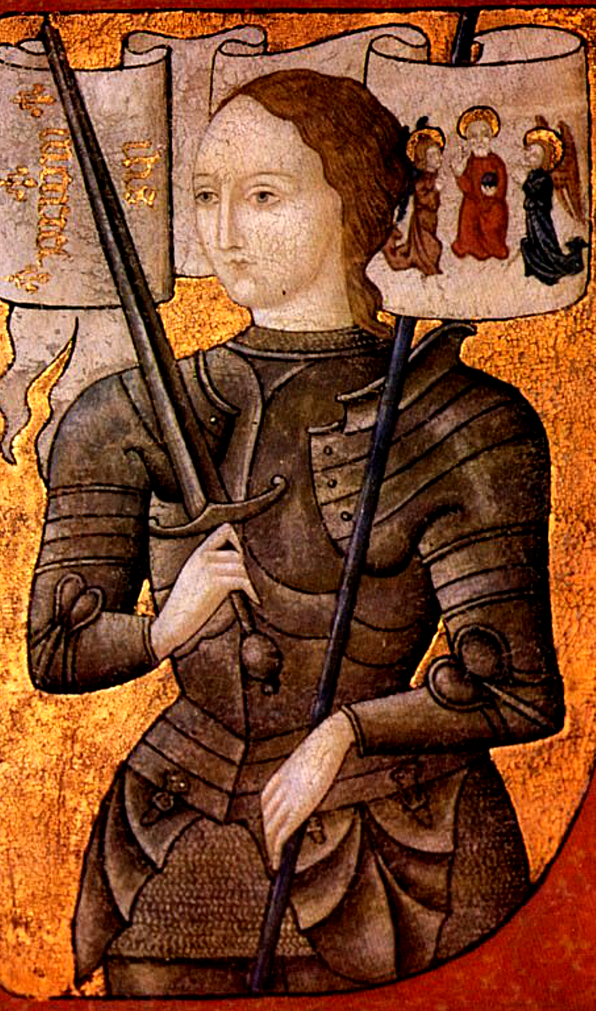
St Joan of Arc — Leadership through courage and conviction
Who was she?
St Joan of Arc was a young French woman who lived during the Hundred Years’ War. Believing she had a religious calling, she persuaded French leaders to allow her to support their military campaign. She became a symbol of courage and national resistance, was captured and executed in 1431, and was later canonised in 1920.

Slide 4
How did she demonstrate leadership?
Courage in adversity: Despite her young age and the dangers she faced, she stepped forward to pursue what she believed was her calling.
Confidence in her convictions: She remained committed to her beliefs even when challenged by powerful people.
Inspiring others: Her determination helped inspire French troops during a difficult period of the war.
Taking initiative: She did not wait for someone else to act; she took responsibility and pursued what she believed needed to be done.

Slide 5
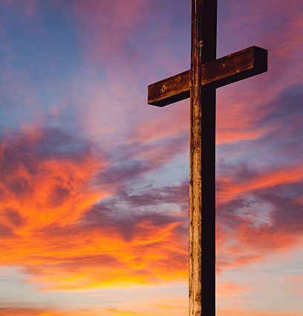
THE CHRISTIAN PERSPECTIVE
Christian courage is not the absence of fear; it is the willingness to trust God when the way ahead is uncertain. Throughout Scripture, God calls people to step beyond their comfort zones and act in faith. Moses, Esther, the apostles and many others faced circumstances that demanded courage and trust in God.
St Joan's life invites us to reflect on what it means to stand firm in our Christian convictions. In our own lives, this may mean speaking up when someone is treated unfairly, refusing to participate in wrongdoing or making a difficult decision because it is the right thing to do.
However, Christian courage must be accompanied by humility, wisdom and discernment. We should not assume that every strong personal conviction automatically represents God's will. Prayer, Scripture and wise counsel help us discern how best to act.
“Set an example for the believers in speech, in conduct, in love, in faith and in purity.”
1 Timothy 4:12

Slide 6
LET'S REFLECT
What attributes do you feel make a good leader?
What can we learn about St Joan about leadership?
Why is courage import as a leader?
How can you show leadership qualities at SSSO?
Who around you would you describe as courageous?

Slide 7
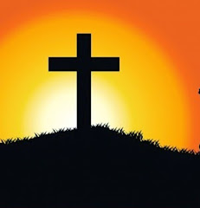
PRAYER
Heavenly Father,
Thank You for giving us the opportunity to lead. Please give us the courage to stand up for what is right, even when it is difficult or unpopular. Help us to speak with confidence, make wise decisions and remain faithful to You when we face challenges.
Give us the strength to step outside our comfort zones, the boldness to use our voices to make a difference, and the humility to seek Your guidance when we are uncertain.
Help us not to be led by fear, but to trust in You and lead with integrity, wisdom and love.
In Jesus’ name, Amen.

