Slide 1
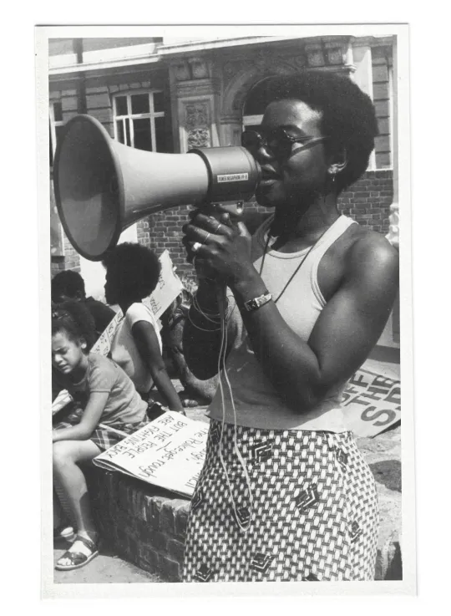
TFTD 1: BLACK HISTORY MONTH
The Story of
Olive Morris
Born in 1952 • died in 1979.
  Jamaican-born British activist who moved to Brixton, London, as a child.
  Dedicated her life to fighting racism, sexism, housing inequality, police brutality, and discrimination.
  Key member of the British Black Panther Movement and co-founder of the Brixton Black Women's Group and the Organisation of Women of African and Asian Descent (OWAAD)

Slide 2
BLACK HISTORY MONTH
The Story of
Olive Morris
Key Achievements
  Challenged police racism after experiencing police violence in 1969.
  Campaigned for better housing and helped lead Brixton's squatting movement, advocating that housing is a basic right.
  Created spaces for Black women to organise and have their voices heard in political and feminist movements.
  Connected local struggles in Britain with international anti-racism and anti-colonial movements.

Slide 3
BLACK HISTORY MONTH
The Story of
Olive Morris
Legacy
  Died from cancer in 1979 at just 27 years old, but left a lasting impact on Black British history.
  Remembered as a pioneer of Black feminism and community activism.
  Olive Morris House in Lambeth and the Remembering Olive Collective help preserve her legacy.

Slide 4
BLACK HISTORY MONTH
The Story of
Olive Morris
Why She Matters Today
  "Leadership is not measured by the length of a life, but by the impact it makes."
  Olive Morris showed how courage, community action, and determination can challenge injustice and inspire future generations.

Slide 5
BLACK HISTORY MONTH
Christian Perspective:
Faith in Action
"Speak up for those who cannot speak for themselves, for the rights of all who are destitute." - Proverbs 31:8
As Christians, we are called to stand against injustice and treat every person with dignity and respect because all people are made in the image of God. Olive Morris's commitment to challenging racism, inequality, and exclusion reflects the Christian values of courage, justice, and service to others.

Slide 6
BLACK HISTORY MONTH
Reflecting on
Olive Morris’s Legacy
  Why is it important for people to challenge unfair treatment, even when it is difficult?
  Olive Morris believed that knowledge is a powerful tool for change. How can education help tackle inequality today?
  Why do you think Black women's voices were often overlooked in both political and feminist movements?

Slide 7
BLACK HISTORY MONTH
Closing
Prayer
Heavenly Father,
Thank you for the example of Olive Morris and all those who have had the courage to stand against injustice and inequality. Help us to see the value in every person, remembering that we are all made in your image.
Give us the courage to do what is right, the wisdom to learn from one another, and the compassion to support those whose voices are not always heard. Help us to be people of kindness, respect, and justice in our school, our community, and beyond.
May our words and actions reflect your love and help create a world where everyone is treated with dignity and fairness.
Amen

