Slide 1

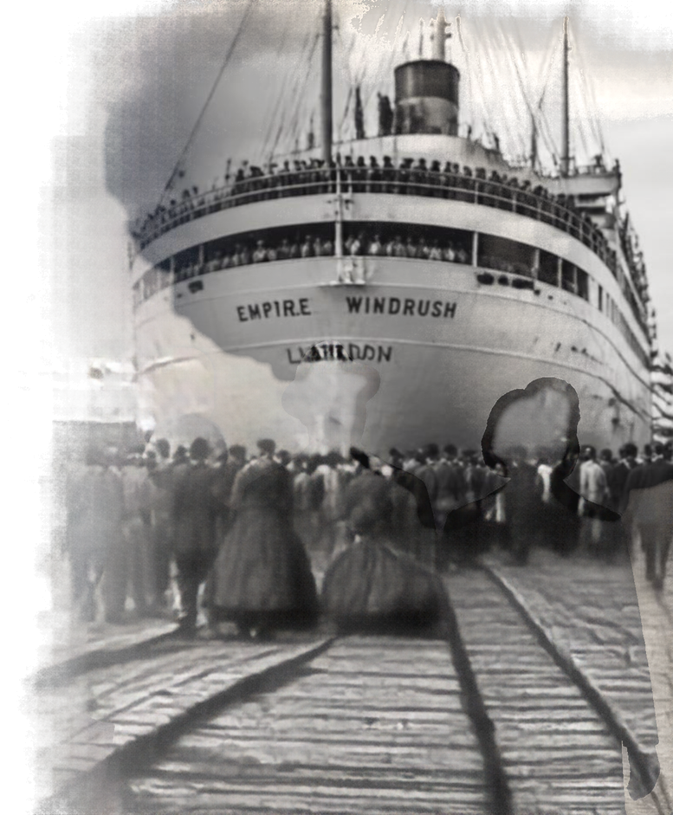
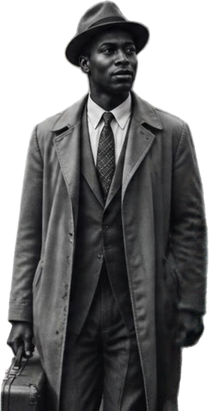
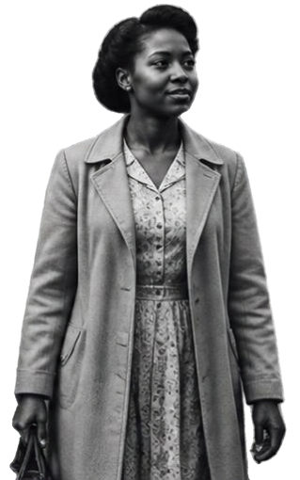
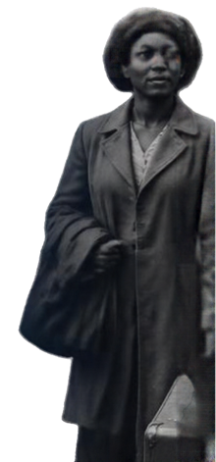
THE WINDRUSH GENERATION:
NEXT DOOR HEROES
AND HEROINES
The Ordinary People
from the Caribbean
Who Built Modern Britain
TFD 3 Windrush W/C 12 October 26

Slide 2

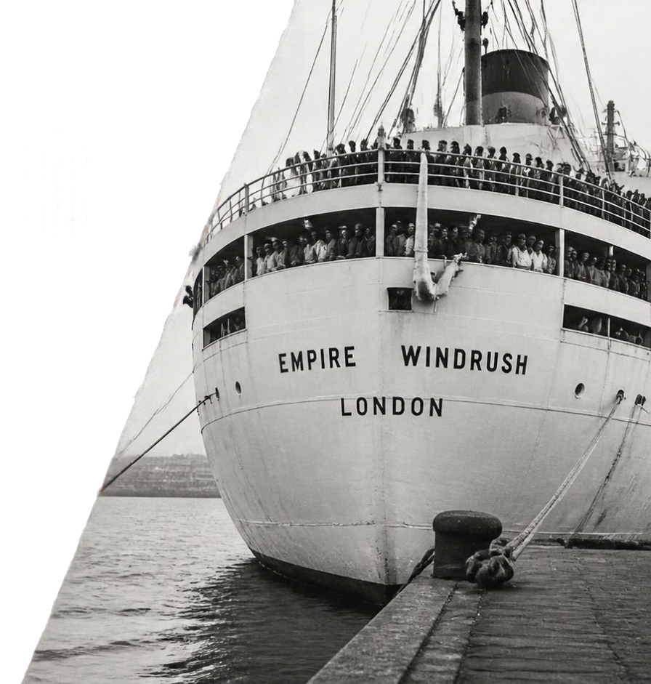

WHO WERE THE
WINDRUSH GENERATION – AND WHY THEY MATTER
They arrived to help rebuild a nation in need.
They strengthened the NHS, London Transport, our schools and our industries.
They faced racism, yet they persevered.
They are neighbours, parents and community builders whose legacy lives on.
An essential part of British history.

Slide 3
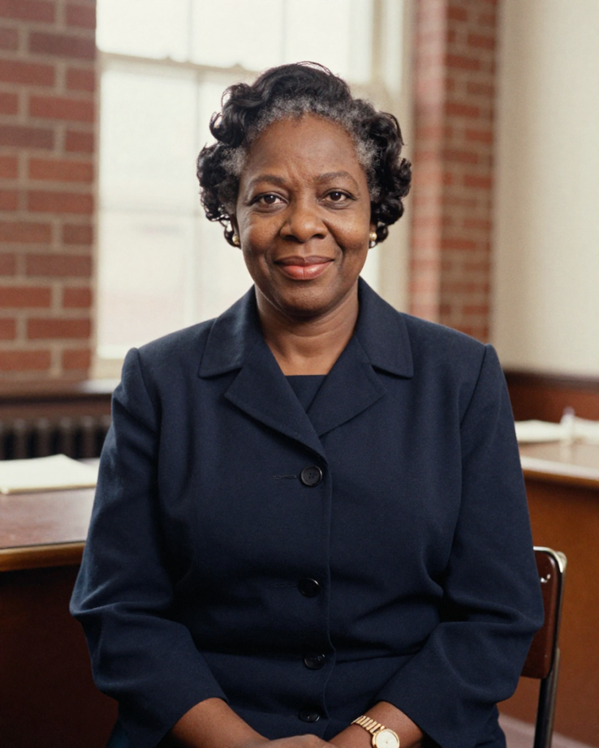
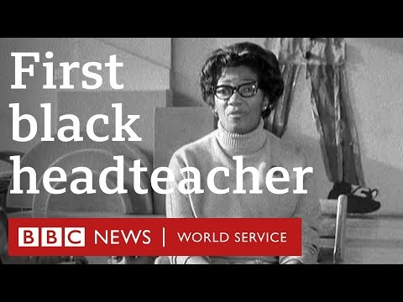
Yvonne Conolly:
Britain's First Black Headteacher
A Pioneer in Education
Yvonne Conolly trained as a primary teacher in Jamaica before coming to Britain in 1963.
In 1969, she became headteacher of Ringcross Primary School in Holloway, London, becoming Britain's first Black headteacher.
She faced racist hostility receiving regular threats on her life and at one point needed a police escort. In addition she was under pressure from the Black community to speak out for Black students misdiagnosed as having SEN. She remained resilient and dedicated to her pupils and community , serving for more than 40 years in education.
Watch Yvonne Conolly speak about her journey:
REFLECTION
Which teachers have had the greatest influence on you?
How can you pass this forward?
youtube.com/watch?v=WBeZigeTL4g
Notes:
youtube.com/watch?v=WBeZigeTL4g

Slide 4



A CHRISTIAN PERSPECTIVE
FAITH IN ACTION, HOPE FOR OUR COMMUNITIES
SERVICE
Following Jesus by serving others with dedication and hard work.
COURAGE
Facing challenges and discrimination with faith, hope and strength.
DIGNITY
Seeing every person as made in God’s image, worthy of respect.
JUSTICE
Speaking up for fairness
GALATIANS 3:28
Our faith calls us.
Their story inspires us.
Ordinary people built modern Britain.
MATTHEW 25:40
“...you are all one in Jesus Christ”
‘Truly, I say to you, as you did it to one of the least of these my brothers, you did it to me.’”

Slide 5

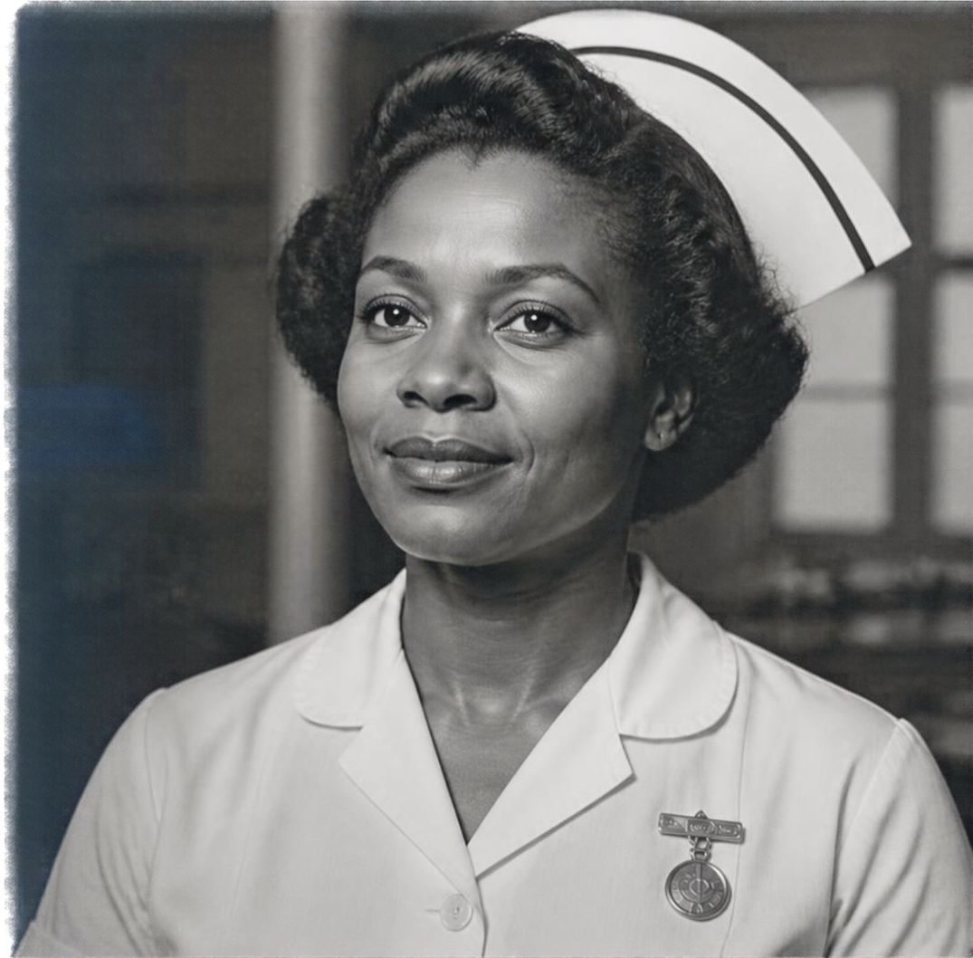
REFLECTION
What does the phrase “next door heroes and heroines” mean to you?
Why are nursing, transport, teaching
and factory work important to a country?
What can we learn from people who contributed despite unfair treatment?
Who are the ordinary heroes and heorines in our school?
How can we make sure every contribution is recognised and respected?

Slide 6



REFLECTION
How can we develop the resilience that the Windrush generation showed?
How important is reslience to success in life?
How can we repect and acknowledge the contributions of people doing ordinary jobs around us such as cleaning, serving food and driving buses?
What lessons can we learn from the Windrush Generation’s story ?
Make a commitment to contribute

Slide 7
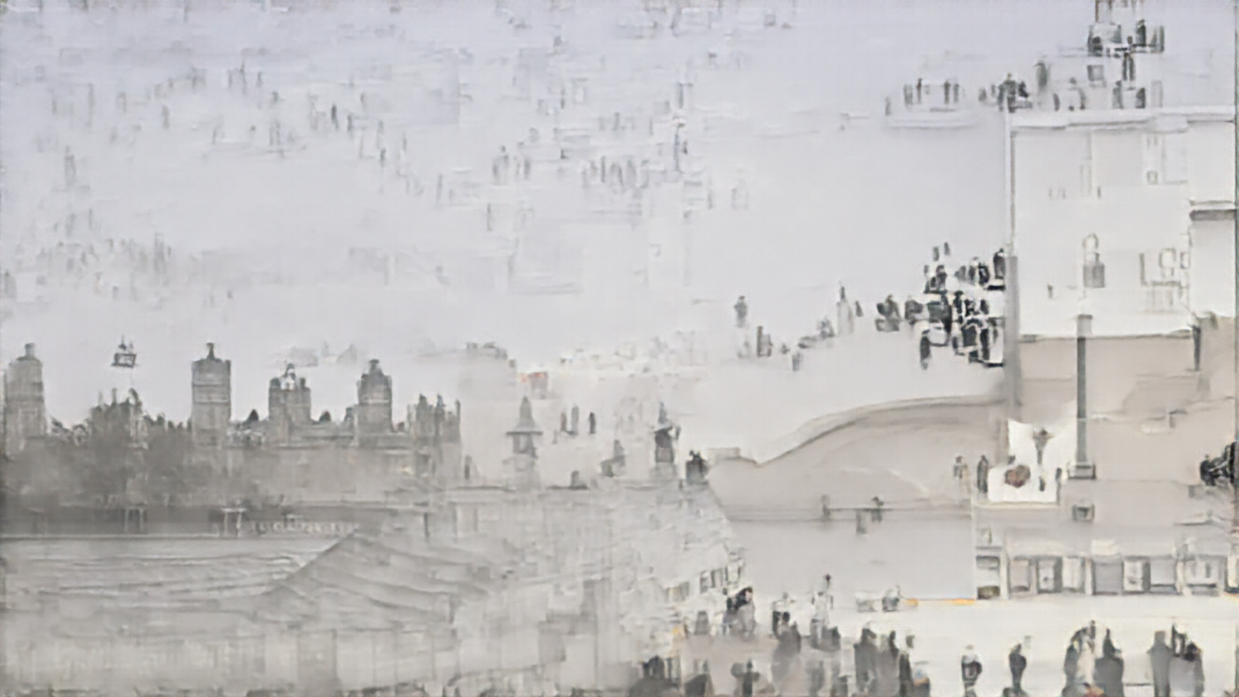


A PRAYER FOR
COURAGE, KINDNESS AND COMMUNITY
Dear Lord, Thank you for the courage, resilence, skill and service of the Windrush Generation.
We remember the nurses, transport workers, teachers and factory workers who rebuilt Britain after the war.
Give us courage to face the unknown and cope with hostility as they did.
Fill our hearts with kindness to welcome and include all people.
Grant us wisdom to learn from history and to respect and value everyone’s contribution. Amen.

