Slide 1

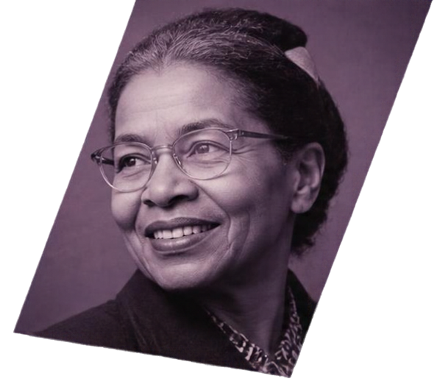
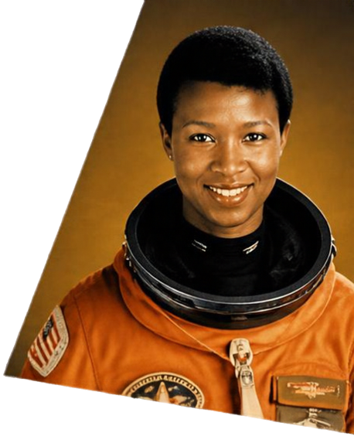
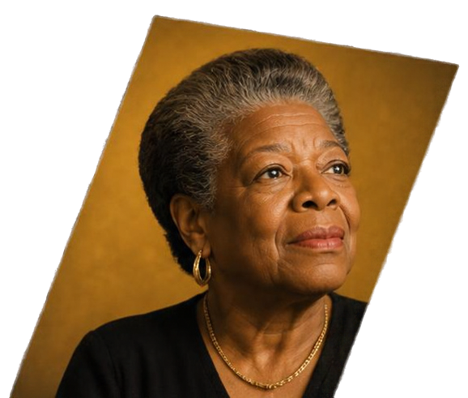
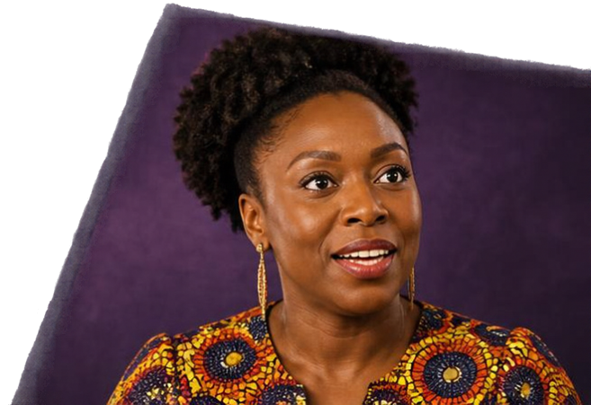

CELEBRATING
BLACK WOMEN
WHO CHANGED
HISTORY
Honouring courage, creativity and leadership
TFD 1

Slide 2


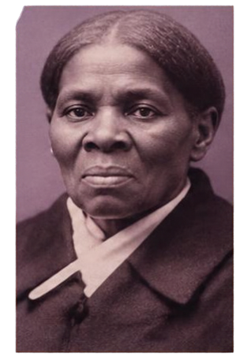
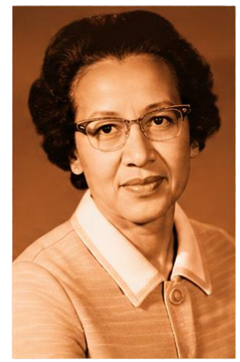
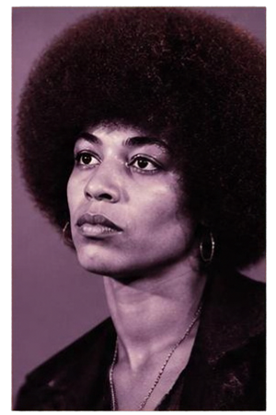
WHO ARE
BLACK WOMEN
AND WHY
CELEBRATE THEM?
Black women are leaders, innovators,
creators and change-makers in every field.
They have overcome barriers and
shaped our communities and world.
HARRIET TUBMAN
KATHERINE JOHNSON
ANGELA DAVIS
Their courage, talent and determination
inspire us today.
Freedom fighter who
risked everything to
help others find
freedom.
Brilliant mathematician whose calculations
helped reach
new frontiers.
Powerful voice for
justice, equality and
human rights.
Their stories deserve to be known,
remembered and celebrated.

Slide 3


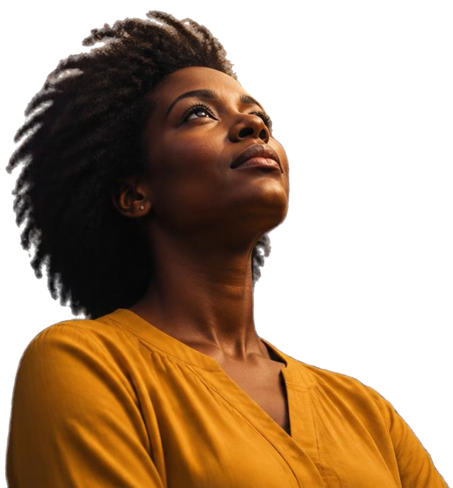
A CHRISTIAN PERSPECTIVE
ON STRENGTH AND JUSTICE
PROVERBS 31:25
“She is clothed with strength and dignity; she can laugh at the days to come.”
Black women live out strength with faith.
They show the world courage in every challenge.
They stand for justice and lift others with love.
Faith empowers. History honours. God celebrates.

Slide 4



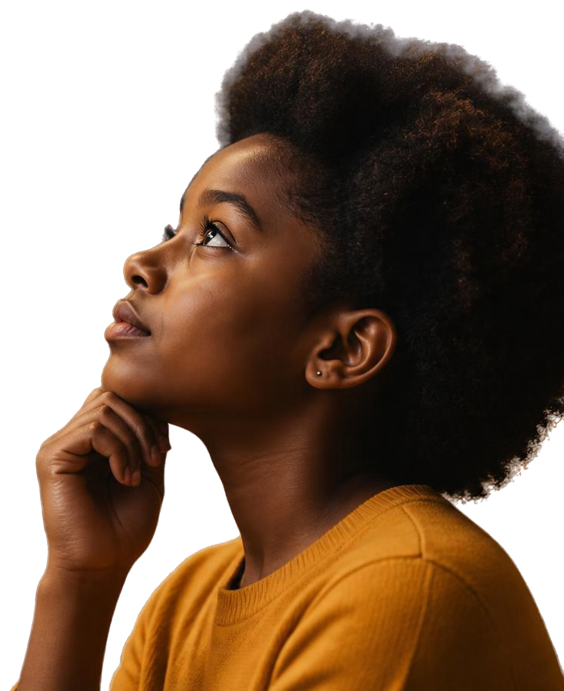




REFLECTION
QUESTIONS
What qualities do you admire most in the Black women we have learned about today?
How do their stories inspire you in your own life?
Why is it important to celebrate diversity and equality?
How can we show respect and support for others in our community?

Slide 5





CHALLENGE &
How can we spread awareness about Black women's contributions?
DISCUSSION
How can we support equality
and justice in school
and beyond?
Think about one Black woman who inspires you.
How can you celebrate her achievements or continue her legacy in your own actions?
What changes can we make at SSSO to be more inclusive every day?

Slide 6


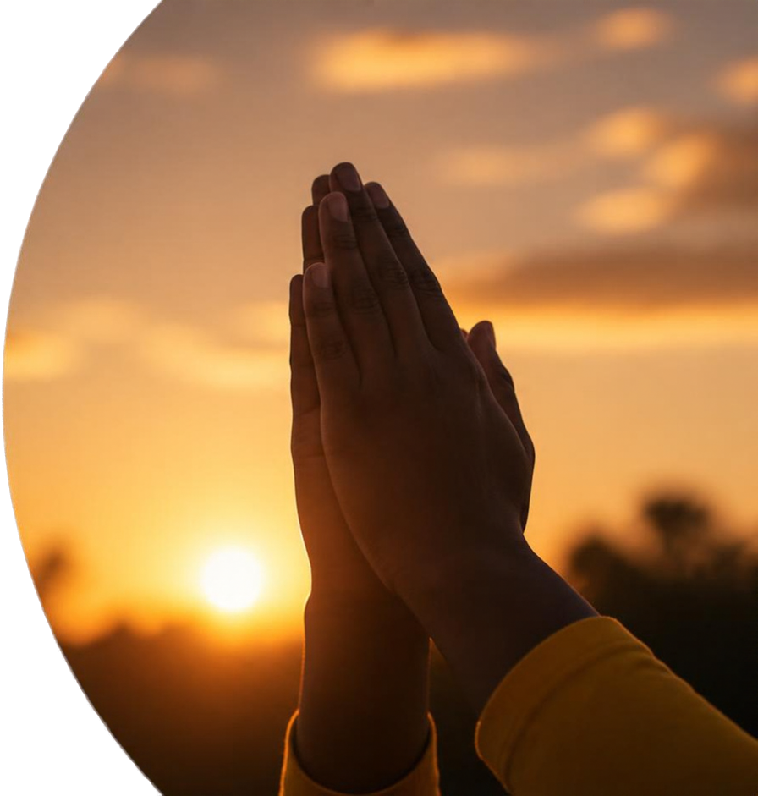
PRAYER
Dear Lord
We thank you for the strength, courage and gifts of Black women.
Inspire us to follow their example
of justice, kindness and hope.
Give us wisdom to celebrate diversity and build unity in our communities.
Help us to be bold, compassionate and committed to creating a better world.
Amen

