Slide 1

INCLUSIVITY AND ANTI-BULLYING
TFTD 1

Slide 2
What does loving your neighbour mean in your school environment? (Being inclusive)
Respecting people's beliefs – Listening to and valuing others, even when their beliefs, cultures, or traditions are different from your own.
Being inclusive – Making sure everyone feels welcomed, accepted, and included in activities, conversations, and friendships.
Showing kindness and empathy – Thinking about how others feel and offering support when needed.
Treating everyone with dignity and respect – Recognising that every person is valuable and deserves to be treated fairly.
Challenging exclusion and bullying – Standing up for others and helping to create a safe and welcoming school community.

Slide 3
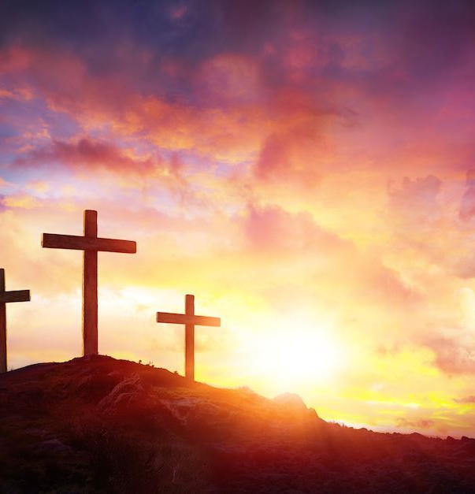
THE CHRISTIAN PERSPECTIVE
Jesus tells us to love our neighbour as ourselves in Mark 12:31
Our neighbour is not just the person who lives next door to us it is everyone around us. It is our classmates, friends, teachers, family members and even people who are different from us.
People may have a different background, culture, belief, or sexuality. Loving our neighbour means treating everyone with kindness, respect, and dignity.
Jesus showed love to all kinds of people, and He calls us to do the same.

Slide 4
LET'S REFLECT
What does loving your neighbour mean in your school environment?
How can we make people feel welcomed and accepted even if they are different from us?
How can we show respect to people whose beliefs and identities may be different from our own?
What is one practical way you can show love and respect to others this week?

Slide 5

CHALLENGE
What is more important being accepted by others or accepting others?

Slide 6
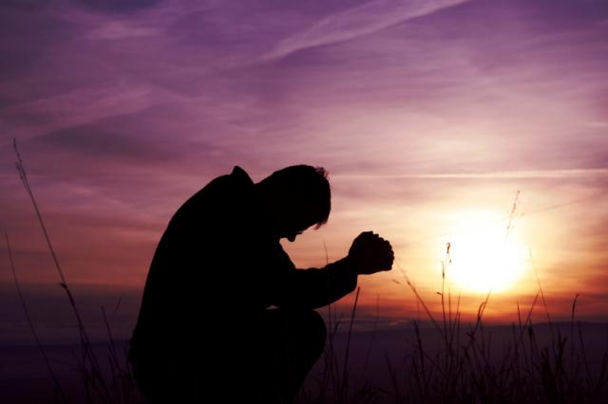
PRAYER
Heavenly Father,
Thank You for the gift of each person in our school community. Help us to see others through Your eyes and to treat everyone with kindness, patience, and respect. When we have the opportunity to help someone, give us generous hearts and willing hands. Help us to notice those who may be feeling lonely, excluded, or hurt, and inspire us to be a source of friendship and encouragement. May our words build others up, and may our actions reflect Your love each day. Amen.

