Slide 1


WINDRUSH
TFTD 4

Slide 2
What can we learn from the experiences of the Windrush generation and refugees?
The experiences of the Windrush Generation and refugees teach us many important lessons about courage, resilience, and compassion.
Courage – Both the Windrush Generation and refugees often left familiar places behind and faced uncertainty in order to build a safer or better future.
Resilience – Despite challenges such as discrimination, separation from family, language barriers, or starting over in a new country, many persevered and made valuable contributions to society.
Hospitality – Their stories remind us of the importance of welcoming newcomers and helping people feel accepted and valued.
Respect for Human Dignity – Every person deserves to be treated with kindness and respect, regardless of where they come from.
Justice and Equality – We can learn the importance of challenging prejudice, discrimination, and unfair treatment.
Gratitude – The contributions of migrants and refugees enrich communities through their skills, cultures, experiences, and perspectives.

Slide 3

THE CHRISTIAN PERSPECTIVE
Christians are called to welcome and care for others, especially those who may be vulnerable or in need. The Bible teaches:
"The foreigner residing among you must be treated as your native-born. Love them as yourself." (Leviticus 19:34)
By learning from the experiences of the Windrush Generation and refugees, we are encouraged to build communities where everyone feels welcomed, respected, and able to flourish.

Slide 4
LET'S REFLECT
What can we learn about courage from the experiences of the Windrush Generation and refugees?
What challenges did the Windrush Generation and refugees face when arriving in a new country?
Why is it important to welcome and support people who are new to our communities?
How do the stories of the Windrush Generation and refugees help us understand the importance of treating everyone with dignity and respect?
What is one thing you can do to make someone feel welcomed, valued, and included?

Slide 5

CHALLENGE
If you had to leave your home suddenly and start a new life in another country, what would you hope people would do to help you feel safe, welcomed, and valued?

Slide 6
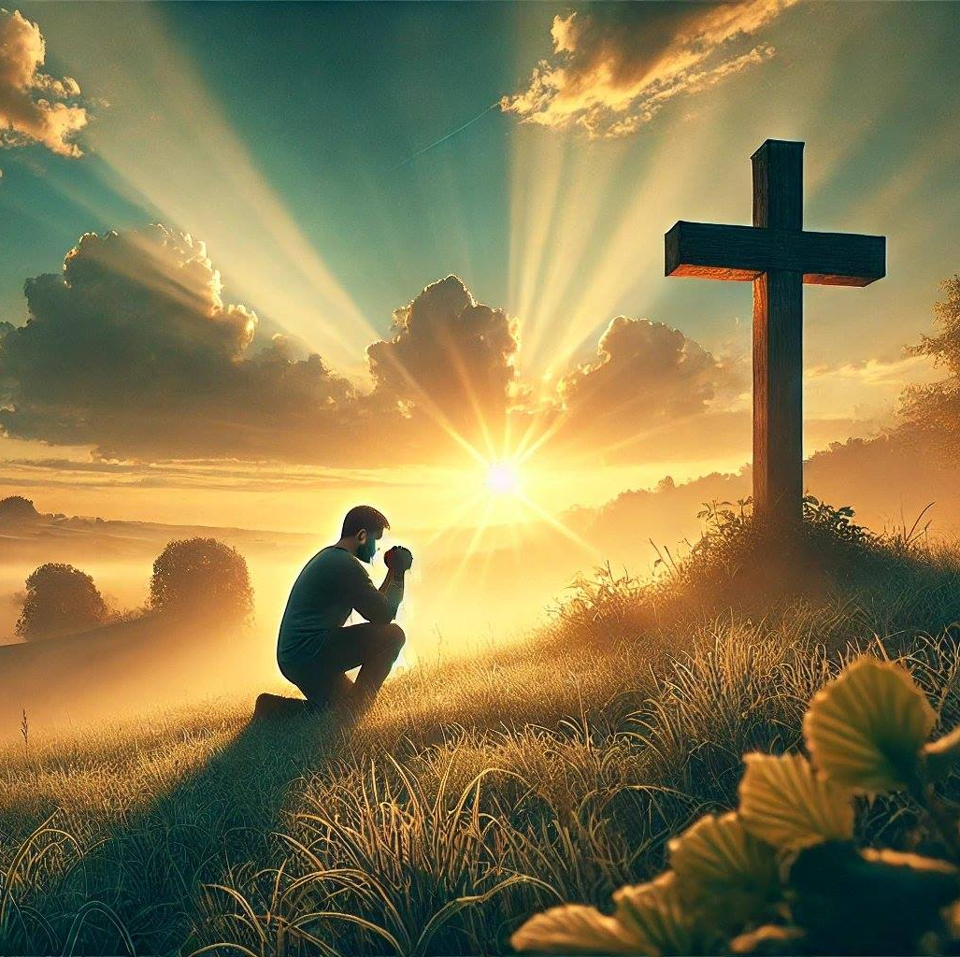
PRAYER
Heavenly Father,
We thank You for the courage and resilience of the Windrush Generation and refugees around the world. We remember the challenges they have faced and the hope they have shown in building new lives.
Help us to welcome others with kindness and compassion. Teach us to see every person as Your child, deserving of love, respect, and dignity.
Open our hearts to those who are new, lonely, or in need of support. Give us the courage to stand against prejudice and unfair treatment and help us to build communities where everyone feels safe, valued, and included.
May we follow Your example by showing hospitality to strangers and care for those who need our help. Amen.

