Slide 1
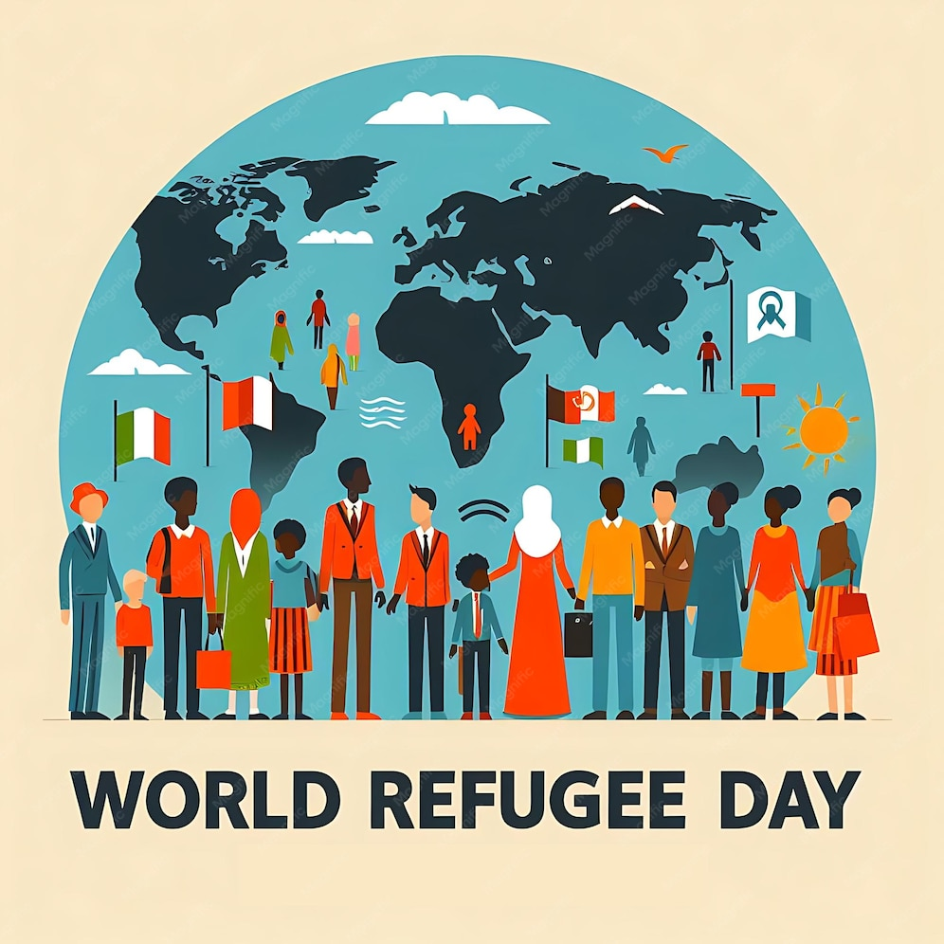
WINDRUSH AND REFUGEE DAY
TFTD 3

Slide 2
REFUGEE DAY
What is World Refugee Day?
World Refugee Day is an international day designated by the United Nations to honour refugees around the globe. It falls each year on 20 June and honours the strength and courage of people who have been forced to flee their home country to escape conflict or persecution.
Why is World Refugee Day important?
World Refugee Day shines a light on the rights, needs and dreams of refugees, helping to mobilize political will and resources so refugees can not only survive but thrive. While it is important to protect and improve the lives of refugees every single day, international days like World Refugee Day help to focus global attention on the plight of those fleeing conflict or persecution. Many activities held on World Refugee Day create opportunities to support refugees.

Slide 3
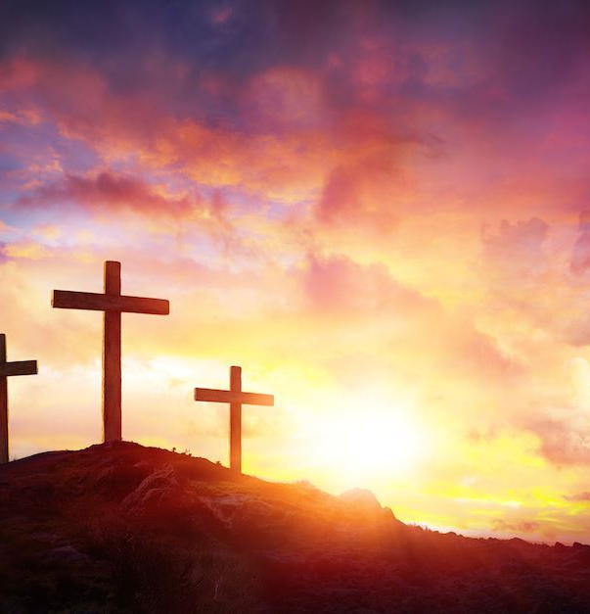
THE CHRISTIAN PERSPECTIVE
The story of Mary, Joseph, and the infant Jesus fleeing to Egypt is found in Matthew 2:13–15:
"An angel of the Lord appeared to Joseph in a dream. 'Get up,' he said, 'take the child and his mother and escape to Egypt. Stay there until I tell you, for Herod is going to search for the child to kill him.' So he got up, took the child and his mother during the night and left for Egypt." (Matthew 2:13–14)
The story of Mary, Joseph, and the infant Jesus fleeing to Egypt reminds Christians that even Jesus experienced displacement and uncertainty. The Holy Family did not leave their home by choice; they fled because their lives were in danger. They had to travel to a foreign country, rely on the kindness of others, and live away from their home until it was safe to return.
This story helps Christians understand that refugees are not simply statistics or news headlines—they are people and families who often face fear, loss, and uncertainty. Like the Holy Family, many refugees today are forced to leave behind their homes, communities, possessions, and sometimes loved ones in search of safety.

Slide 4
LET'S REFLECT
What is a refugee, and why might someone be forced to leave their home?
What challenges do refugees face when they arrive in a new country?
How might it feel to leave behind your home, possessions, friends, and family?
What are some hopes and fears a refugee might have when starting a new life?
Why is it important to learn about the experiences of refugees?

Slide 5

CHALLENGE
What can we learn from refugees about courage, resilience, and hope?

Slide 6
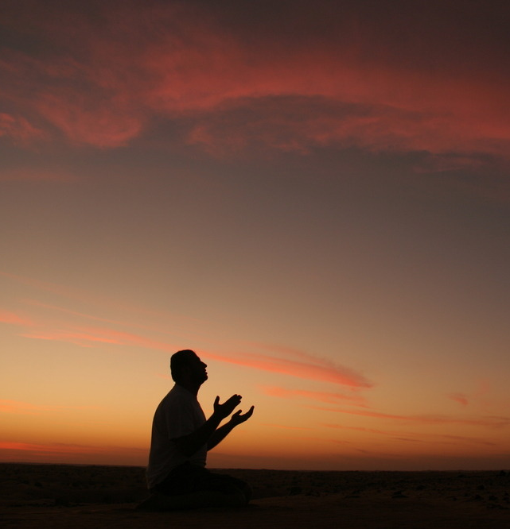
PRAYER
Heavenly Father,
We pray for all refugees around the world who have been forced to leave their homes because of war, violence, persecution, or disaster. Be with those who are afraid, lonely, or uncertain about the future. Give them strength, comfort, and hope. Protect families who have been separated and guide those who are searching for safety and peace. Help us to follow the example of Jesus by welcoming strangers with compassion and kindness. Open our hearts to those in need and teach us to recognise the dignity and value of every person. May we work for a world where justice, peace, and understanding flourish, and where all people can live without fear. Amen.

