Slide 1

WINDRUSH AND REFUGEE DAY
TFTD 2

Slide 2
IMPACT AND CHALLENGES
Their impact
The Windrush generation had a profound influence on British society:
Helped rebuild the economy and public services
Contributed to the development of modern multicultural Britain
Enriched British culture with Caribbean music, food, language, and traditions
Challenges they faced
Despite their contributions, many experienced:
Racism and discrimination
Poor housing and job opportunities
Later, serious legal issues during the Windrush scandal (2010s), when some were wrongly detained or threatened with deportation due to documentation problems

Slide 3
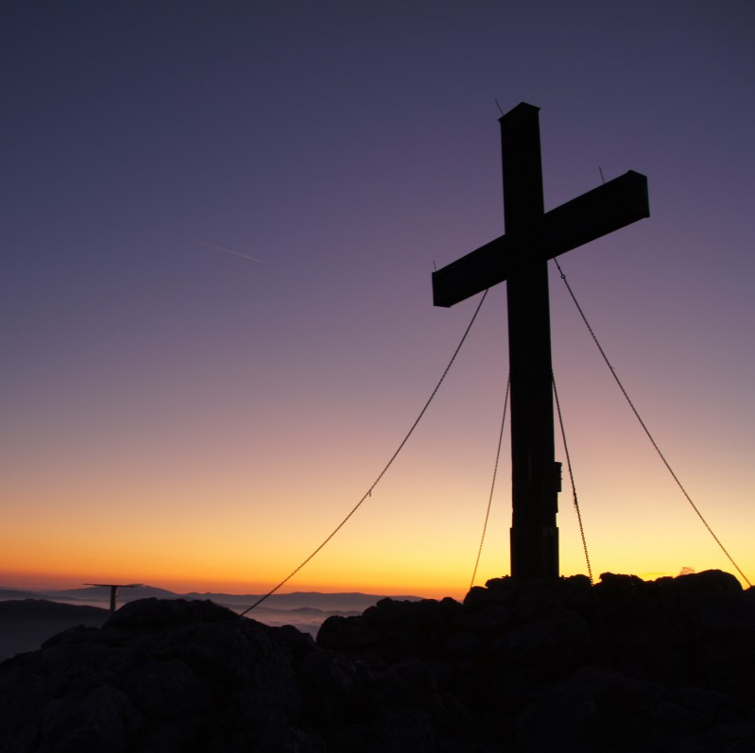
THE CHRISTIAN PERSPECTIVE
The Windrush generation answered Britain's call in a time of need. Hebrews 13:2 reminds us that welcoming strangers is not merely an act of courtesy but a spiritual responsibility. The contributions of the Windrush generation demonstrate that those who arrive as strangers often become neighbours, friends, leaders, and blessings to the communities that receive them.

Slide 4
LET'S REFLECT
In what ways did the Windrush Generation contribute to British society?
How have their contributions helped shape modern Britain?
Why is it important to recognise and celebrate the achievements of the Windrush Generation?
What might Britain be like today without the contributions of the Windrush Generation?
How did their experiences help pave the way for future generations?

Slide 5

CHALLENGE
What responsibilities do we have to challenge discrimination and support people who may feel excluded?

Slide 6

PRAYER
Heavenly Father,
We thank You for the courage, resilience, and contributions of the Windrush Generation. We remember the challenges they faced and the determination they showed in building new lives and strengthening their communities. Help us to learn from their example of perseverance and hope. Teach us to welcome others with kindness, respect, and understanding, and to stand against prejudice and injustice wherever we encounter it. May we recognise the dignity and worth of every person and work together to create a society where everyone feels valued, included, and at home. Guide us to be people who show compassion to strangers and gratitude for those who have helped shape our communities. Amen.

