Slide 1
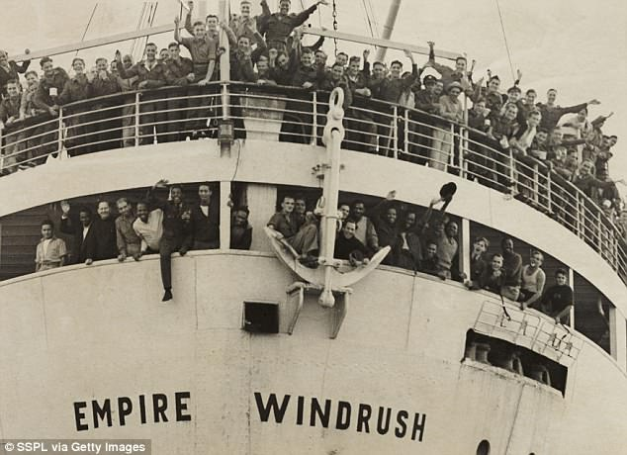
WINDRUSH AND REFUGEE DAY
TFTD 1

Slide 2
Who were the Windrush generation?
Who are the Windrush generation?
The Windrush generation refers to a group of people who migrated to the United Kingdom from Caribbean countries between 1948 and the early 1970s. They were invited to help rebuild Britain after World War II.
Origins of the name
The term comes from the ship HMT Empire Windrush, which arrived in June 1948 at Tilbury Docks carrying over 800 passengers from the Caribbean—many from Jamaica.
Who they were
Mostly people from Caribbean nations such as Jamaica, Trinidad and Tobago, and Barbados
Citizens of the British Empire (later Commonwealth), so they had the legal right to live and work in the UK
Many were young men and women seeking better opportunities, though families later joined them

Slide 3
THE CHRISTIAN PERSPECTIVE
Do not forget to show hospitality to strangers…Hebrews 13:2
Hebrews 13:2 says:
"Do not forget to show hospitality to strangers, for by so doing some people have shown hospitality to angels without knowing it."
In the context of the Windrush generation, this verse can be understood as a call to welcome newcomers with dignity, kindness, and respect. The men, women, and children who arrived from the Caribbean came to Britain to help rebuild the nation, work in its hospitals, transport systems, and industries. They were, in a sense, "strangers" arriving in a new land.

Slide 4
LET'S REFLECT
Who were the Windrush Generation, and why did they come to Britain?
How were these newcomers received?
Did society recognize their value and humanity?
What does it mean to be hospitable to strangers?
Why do you think some people find it difficult to welcome newcomers?
Why is the story of the Windrush Generation important to learn about today?

Slide 5
CHALLENGE
Why is the story of the Windrush Generation important to learn about today?

Slide 6
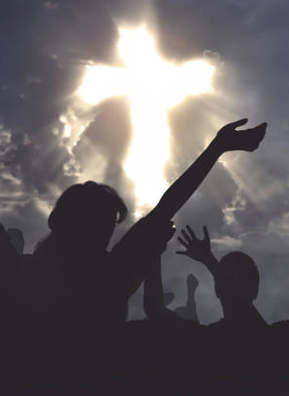
PRAYER
Heavenly Father,
We thank You for the courage of the Windrush Generation and for all people who leave familiar places to build new lives.
Help us to welcome strangers with kindness, respect, and understanding. Teach us to see the value and dignity in every person, regardless of where they come from or what they look like.
Forgive us when we exclude others or fail to show hospitality. Give us hearts that are open, hands that are helpful, and words that bring encouragement. May we learn from the experiences of the Windrush Generation and work to build communities where everyone feels safe, valued, and at home. Amen.

