Slide 1

Preparation
TFTD 2

Slide 2
WHY IS PREPARATION IMPORTANT?
Preparation is important because it helps us become organized, confident, and successful in our studies and daily responsibilities. When we prepare well, we understand lessons better, complete work on time, and reduce stress during exams. Preparation also teaches valuable life skills such as discipline, responsibility, patience, and good time management.

Slide 3

THE CHRISTIAN PERSPECTIVE
Book of Proverbs 21:5 teaches us that success does not usually happen by chance; it comes through careful planning, patience, and consistent hard work. The scripture encourages students to be diligent by preparing ahead of time, managing their responsibilities wisely, and staying focused on their goals. It also teaches the value of discipline, showing that people who work steadily and responsibly are more likely to experience positive results and opportunities in life. At the same time, the verse warns against rushing, laziness, and poor planning, because these habits can lead to mistakes, stress, disappointment, and missed opportunities. Overall, the scripture teaches students to develop good habits, think about the future, and trust that faithful effort and preparation will bring rewarding results.

Slide 4
LET'S REFLECT
Am I preparing carefully for my schoolwork and future goals?
How can I become more diligent and disciplined in my daily life?
What habits do I need to change to avoid rushing or procrastinating?
How does good preparation help me grow academically and spiritually?
In what ways can I use my talents and opportunities wisely?

Slide 5

CHALLENGE
Think about how you'd create a timetable for the week

Slide 6
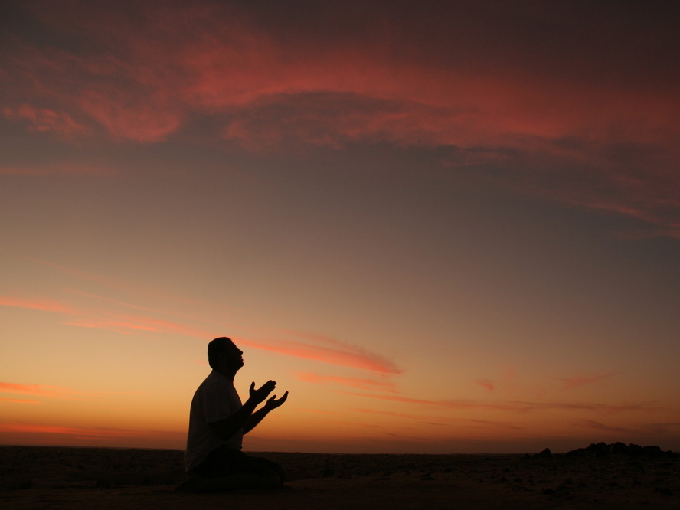
PRAYER
Heavenly Father,
Thank You for the gifts and opportunities You have given me. Help me to be diligent, disciplined, and wise in everything I do. Teach me to prepare well, manage my time responsibly, and avoid laziness or rushing through my work. Give me strength to stay focused on my goals and to honour You through my attitude toward learning and preparation. Amen.

