Slide 1

Preparation
TFTD 1

Slide 2
What does it mean to be prepared as a student?
Academic preparation: completing homework, revising lessons, reading ahead, organizing notes, and studying for tests.
Class preparation: bringing the correct books or equipment, arriving on time, and understanding the day’s tasks.
Exam preparation: making revision schedules, practicing past papers, and reviewing key topics.
Personal preparation: developing skills such as time management, discipline, communication, and problem-solving.
Future preparation: preparing for higher education, careers, or adult life through subject choices, extracurricular activities, and career planning.

Slide 3
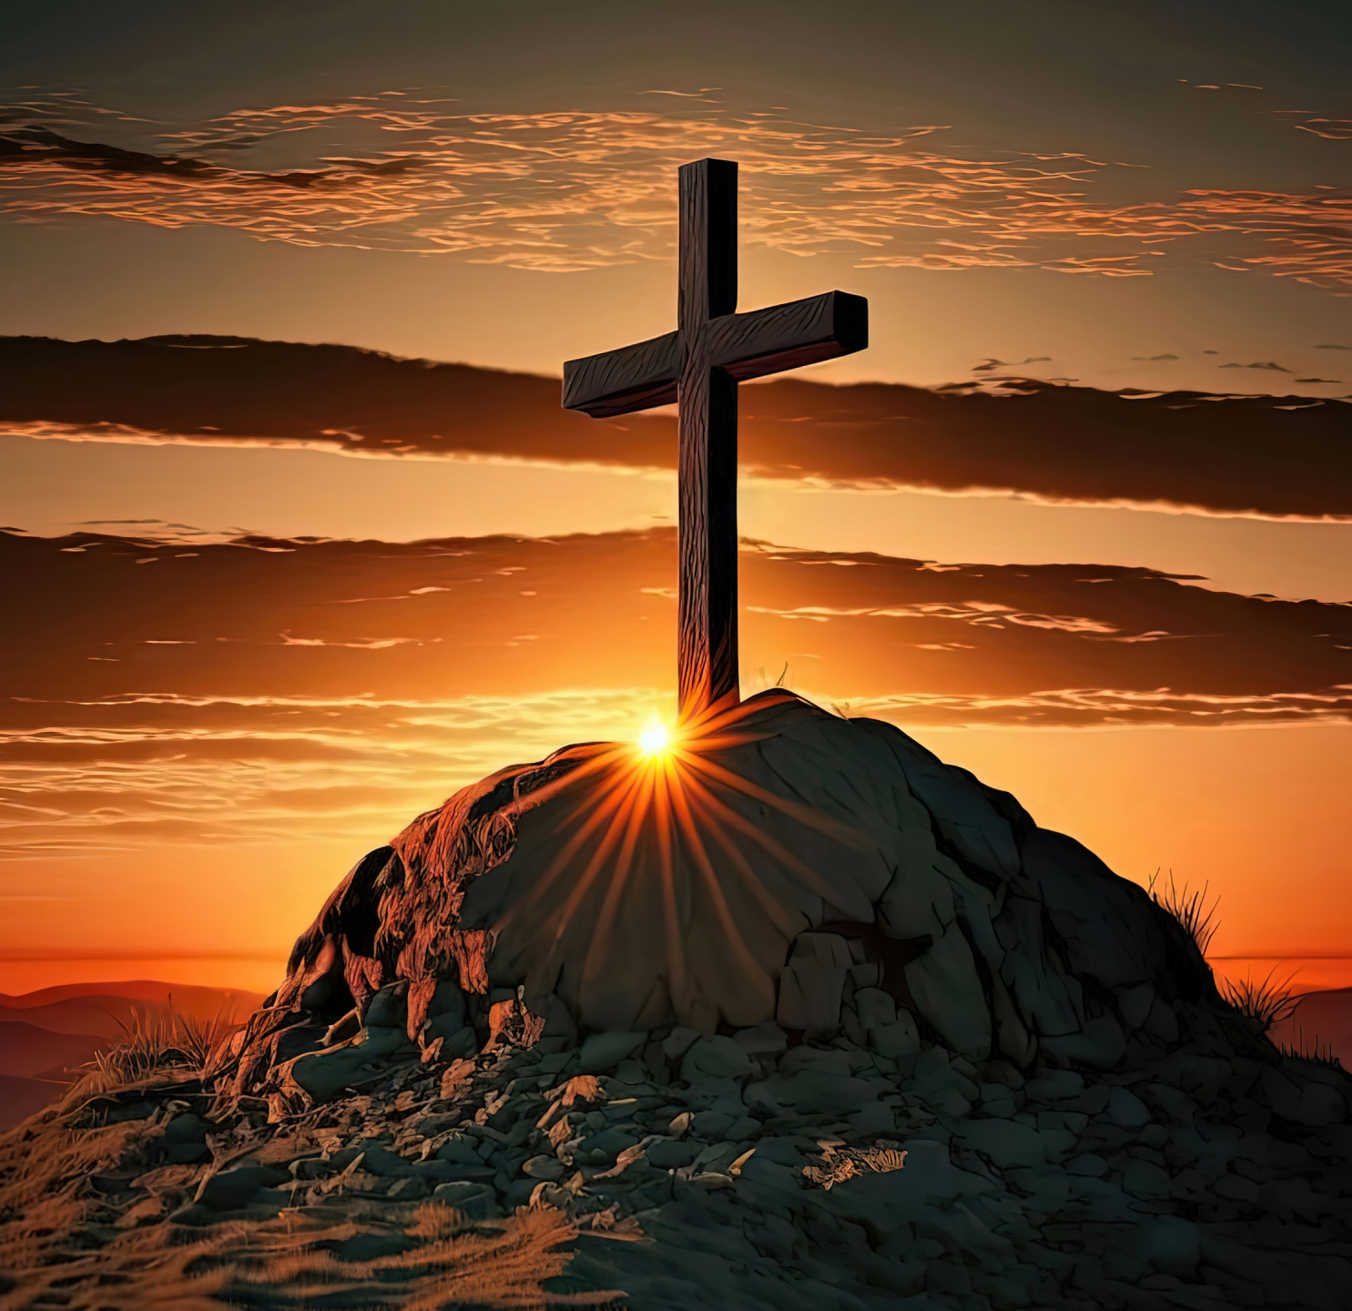
THE CHRISTIAN PERSPECTIVE
Proverbs 21:5 says "The plans of the diligent are surely to abundance, and everyone hurrying about, surely to poverty." This teaches us that those who prepare carefully and work diligently are more likely to succeed in life. The verse shows that planning ahead, studying regularly, managing time wisely, and putting consistent effort into schoolwork can lead to good results, confidence, and future opportunities. In contrast, rushing, procrastinating, or doing things without proper preparation can lead to poor performance and disappointment. This scripture encourages secondary school students to develop discipline, patience, and responsible habits so they can achieve their goals successfully.

Slide 4
LET'S REFLECT
Am I using my time wisely to prepare for school and my future?
What distractions are preventing me from being diligent in my studies?
Do I plan ahead for assignments and exams, or do I rush at the last minute?
How can I develop better habits of discipline and responsibility?
In what ways can I honour God through my attitude toward learning and preparation?

Slide 5
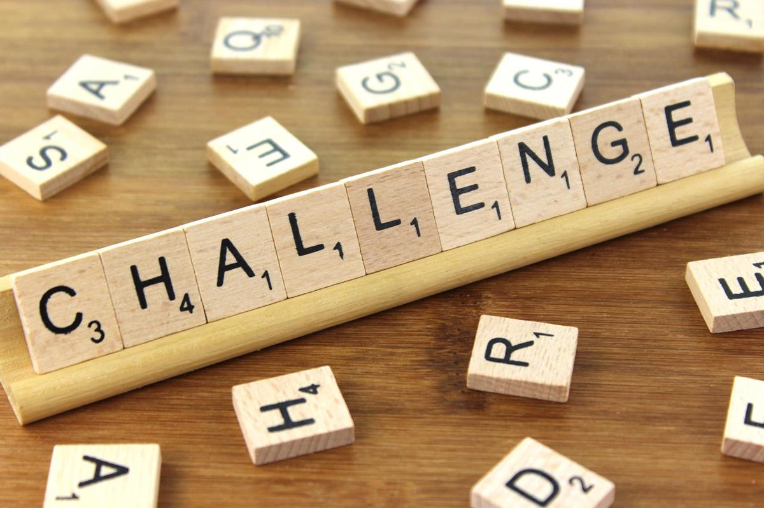
CHALLENGE
If my current study habits continue, where will they lead me in the future?

Slide 6
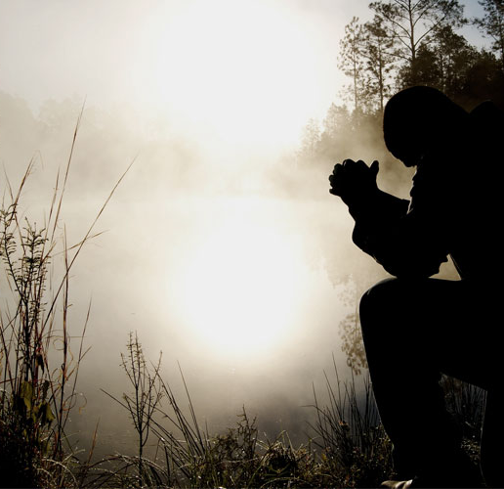
PRAYER
Heavenly Father,
Please help me to be diligent, disciplined, and responsible in my studies. Teach me to plan wisely, work hard, and avoid laziness or rushing through my work. Give me wisdom, strength, and patience so that I can use my abilities well and succeed in a way that honours you. Amen.

