Slide 1
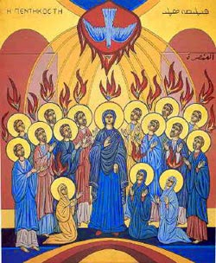
PENTECOST
TFTD 2

Slide 2
Why is Pentecost significant to Christians?
Pentecost is significant to Christians because it is often called the “birthday of the Church.” Before Pentecost, the disciples were fearful and uncertain after Jesus’ death and ascension. According to Acts chapter 2, the coming of the Holy Spirit gave them courage and confidence to share Jesus’ teachings openly.
After receiving the Holy Spirit, the disciples began preaching to people from many different nations and backgrounds. Thousands of people chose to follow the Christian faith, and communities of believers started to form. Christians believe this marked the beginning of the Church’s mission to spread messages of faith, hope, love, and unity around the world.

Slide 3
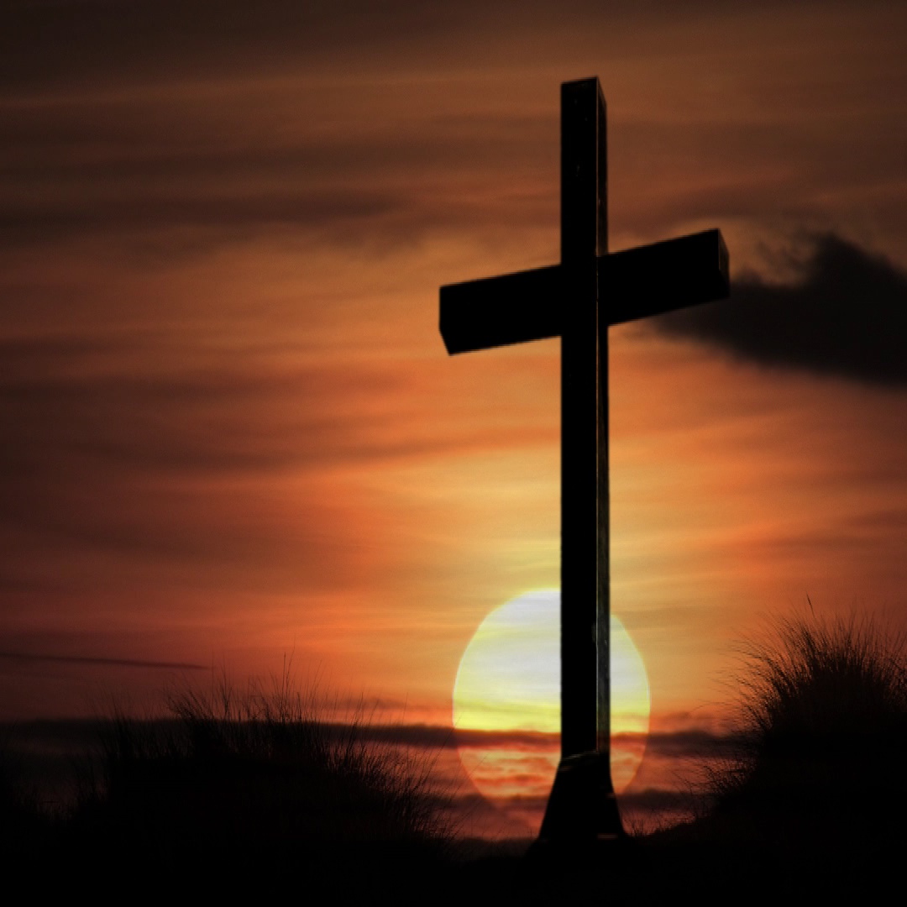
THE CHRISTIAN PERSPECTIVE
A verse often linked to the disciples receiving courage after Pentecost is from Acts:
“Then Peter stood up with the Eleven, raised his voice and addressed the crowd…”
Acts 2:14
From a Christian perspective, Acts 2:14 is important because it shows how the Holy Spirit transformed the disciples. Before Pentecost, the disciples were frightened and unsure of what to do after Jesus’ crucifixion and ascension. Peter himself had previously denied knowing Jesus out of fear.
Christians believe that when the Holy Spirit came at Pentecost, it gave the disciples courage, strength, and confidence to continue Jesus’ mission. In Acts 2:14, Peter “stood up” and spoke boldly to a large crowd, showing that he was no longer afraid. Christians see this as evidence that the Holy Spirit empowers ordinary people to live out their faith and speak truthfully even in difficult situations.
This verse is also significant because Peter’s speech led many people to become followers of Christianity, which Christians believe marked the beginning of the Church. From a Christian viewpoint, Pentecost demonstrates that God’s Spirit can change fear into courage and unite people through faith.

Slide 4
LET'S REFLECT
Why do you think the disciples were afraid before Pentecost?
How did the Holy Spirit give the disciples courage to speak publicly?
What does Peter’s speech at Pentecost teach Christians about bravery and faith?
Can courage mean more than being fearless? Why or why not?
When might someone need courage to stand up for what is right today?
How can people encourage others who are struggling with fear or self-doubt?
How can speaking kindly and honestly require courage?
How can the message of Pentecost inspire people to act with confidence and compassion in everyday life?

Slide 5
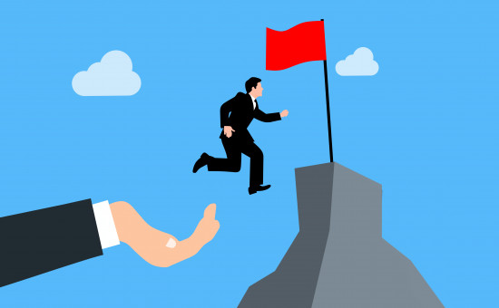
CHALLENGE
The disciples found courage through the Holy Spirit at Pentecost where do you find courage?

Slide 6
PRAYER
Heavenly Father,
Thank You for the courage You gave the disciples at Pentecost through the Holy Spirit.
Help us when we feel afraid or unsure of ourselves.
Give us strength to speak up for what is right
and kindness when we listen to others.
Teach us to stand with people who feel left out or ignored,
and to use our words to bring hope, fairness, and understanding.
Guide us to act with courage in our everyday lives
so we can help build a more caring and inclusive world. Amen.

