Slide 1
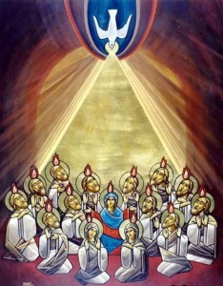
PENTECOST
TFTD 3

Slide 2
Pentecost: The Holy Spirit as Helper
Pentecost is important because Christians believe it shows the Holy Spirit coming to the disciples to help them.
The Holy Spirit gave them courage when they were afraid, helping them to speak about their faith boldly. It also guided them in what to say and helped people from different nations understand their message.
For Christians, Pentecost shows that the Holy Spirit continues to be a helper today by giving strength, guidance, and confidence in their faith.

Slide 3
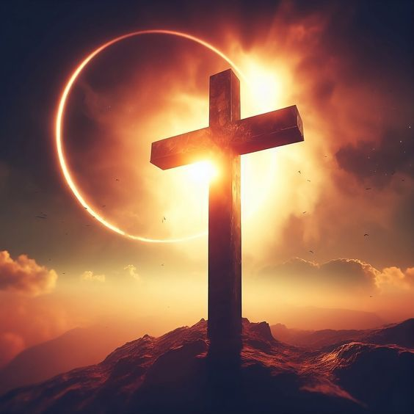
THE CHRISTIAN PERSPECTIVE
Pentecost is significant to Christians because it is the moment when the disciples were filled with the Holy Spirit, as described in Acts 2.
Jesus taught about the Holy Spirit before Pentecost in the Gospel of John, saying it was better for him to leave so that the “Comforter” (the Holy Spirit) could come:
“But very truly I tell you, it is for your good that I am going away. Unless I go away, the Advocate will not come to you; but if I go, I will send him to you.” — John 16:7
Christians believe this shows that the Holy Spirit is not just a one-time gift, but an ongoing presence in the lives of believers.
As a helper, the Holy Spirit is understood to guide Christians in their decisions, give them strength when they feel weak or afraid, and provide comfort during difficult times. Christians also believe the Holy Spirit helps them understand God’s teachings, pray, and live in a way that reflects their faith.
Because of this, many Christians see the Holy Spirit as a counsellor, friend, and constant support in daily life, helping them to grow in faith and live with courage, love, and purpose.

Slide 4
LET'S REFLECT
What does it mean for someone to feel “supported” or “guided” in life?
Why might people describe a spiritual presence as a “helper” or “comforter”?
How can moments of fear or uncertainty change how people act or speak?
How can people support others in a way that is respectful of different beliefs?
How can stories about transformation (like fear becoming courage) be meaningful to many different people?

Slide 5
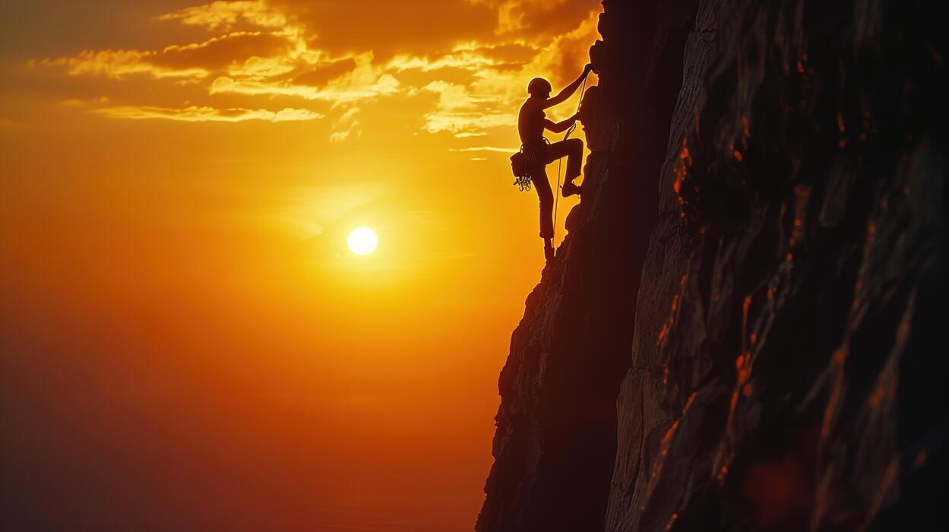
CHALLENGE
What might it look like for someone to feel guided in making good decisions in everyday life?

Slide 6
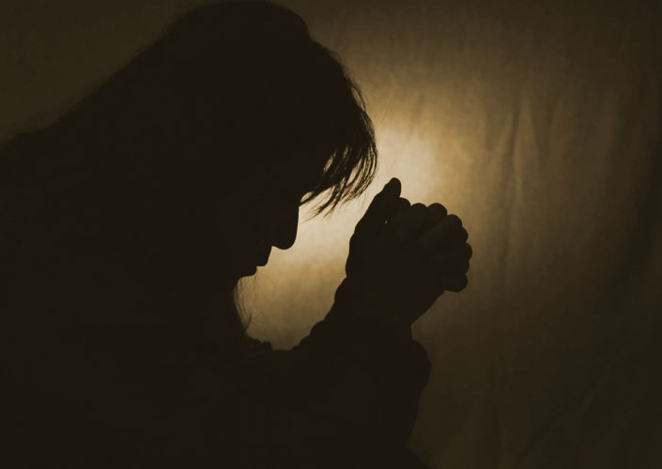
PRAYER
Heavenly Father,
Thank You for the gift of Pentecost and the coming of the Holy Spirit.
Thank You that You do not leave us alone, but send the Holy Spirit to guide, comfort, and strengthen us.
Help us to trust in our faith when we feel unsure or afraid. Remind us that Your Spirit is with us as a helper in all that we do.
Give us courage to follow what is right, and wisdom to make good choices in our lives. Amen.

