Slide 1
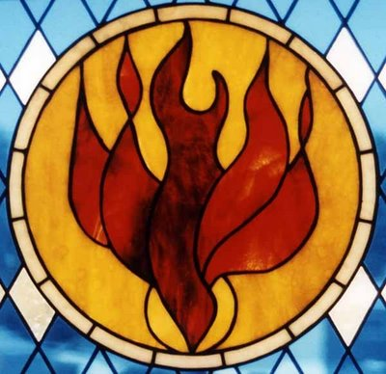
PENTECOST
TFTD 4

Slide 2
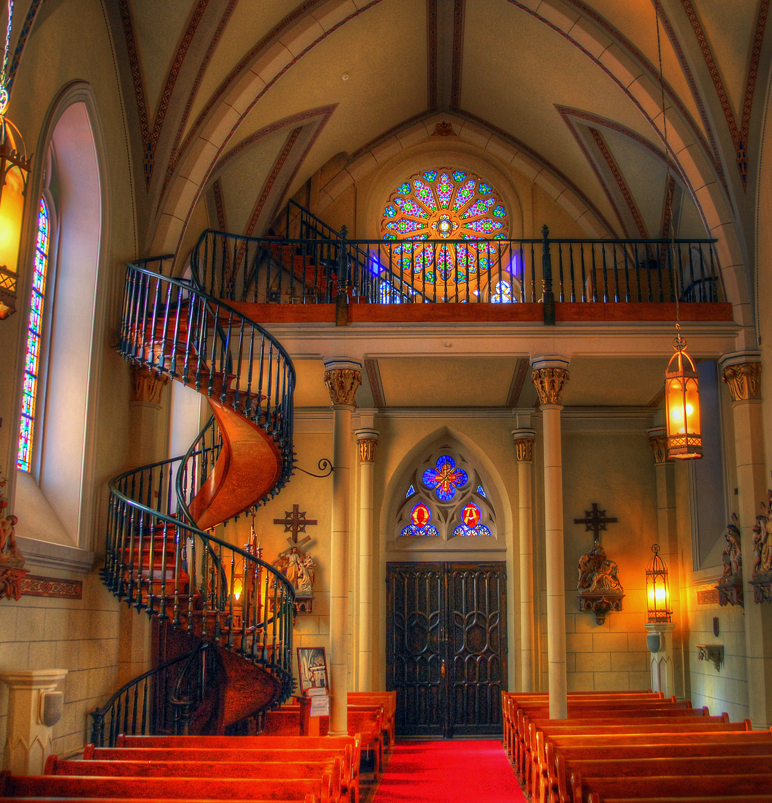
How is Pentecost celebrated?
Pentecost is celebrated in the Church of England as a major festival that marks the coming of the Holy Spirit and the “birthday of the Church.”
During services, churches often use red decorations and vestments because red symbolises the Holy Spirit and the “tongues of fire” described in Acts 2. Many churches also display red flowers or banners to emphasise this theme.
Special Bible readings and sermons focus on the story of Pentecost, especially how the Holy Spirit gave the disciples courage and enabled people from different nations to understand the message. This highlights themes of unity, mission, and the Holy Spirit as a helper and guide.
Some churches may also include prayers for the Holy Spirit to strengthen and guide believers today. In certain places, Pentecost is linked with confirmations or renewal of faith, where people publicly affirm their Christian beliefs.

Slide 3
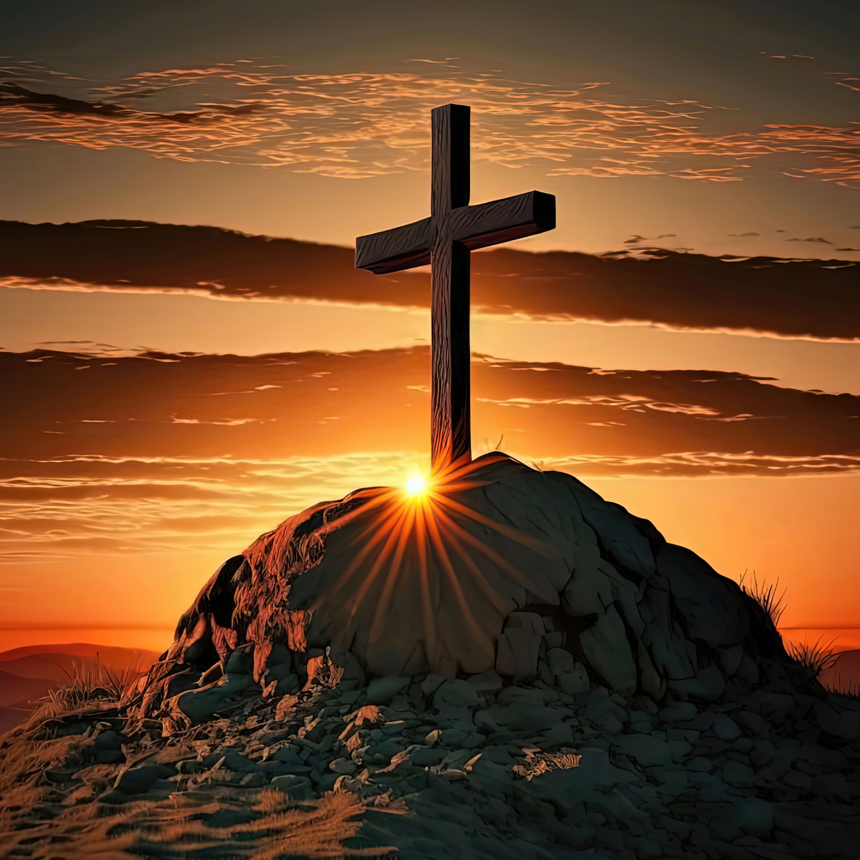
THE CHRISTIAN PERSPECTIVE
From a Christian perspective, Pentecost is seen as the moment when Christianity truly begins its mission in the world.
Based on Acts 2, Christians believe that:
The Holy Spirit empowered the disciples, turning them from fearful followers into bold witnesses of Jesus.
This change was not just personal, but the start of the Church’s mission to spread the Gospel to all nations.
The ability for people from different languages and cultures to understand the message shows that Christianity is meant to be universal, not limited to one group.
The Holy Spirit continues to guide the Church, meaning Christianity is seen as an active, living faith rather than just a set of teachings from the past.

Slide 4
LETS REFLECT
How does Pentecost show the beginning of the Church’s mission in the world?
In what ways were the disciples changed after receiving the Holy Spirit?
Why is it important to Christians that the message at Pentecost was understood by many different nations?
How does Pentecost help Christians understand the Church as a global community?
What does it mean for the Holy Spirit to guide the Church today as well as in the past?
How can Christians live out the “mission” that began at Pentecost in everyday life?

Slide 5
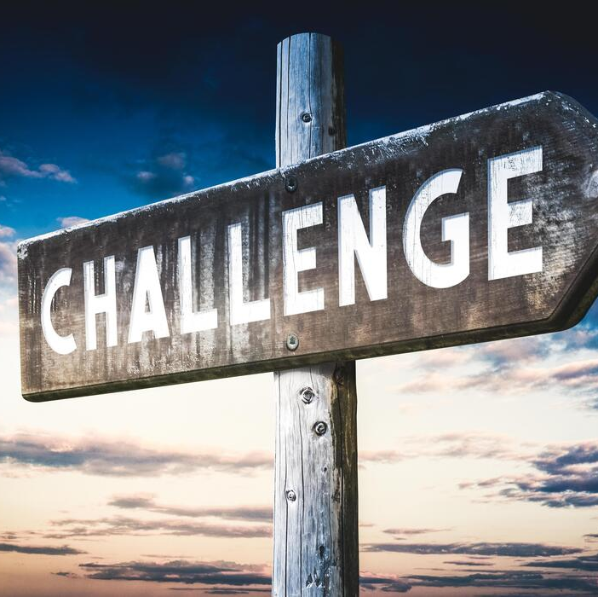
CHALLENGE
What qualities do you think the disciples needed to start spreading their faith after Pentecost?

Slide 6
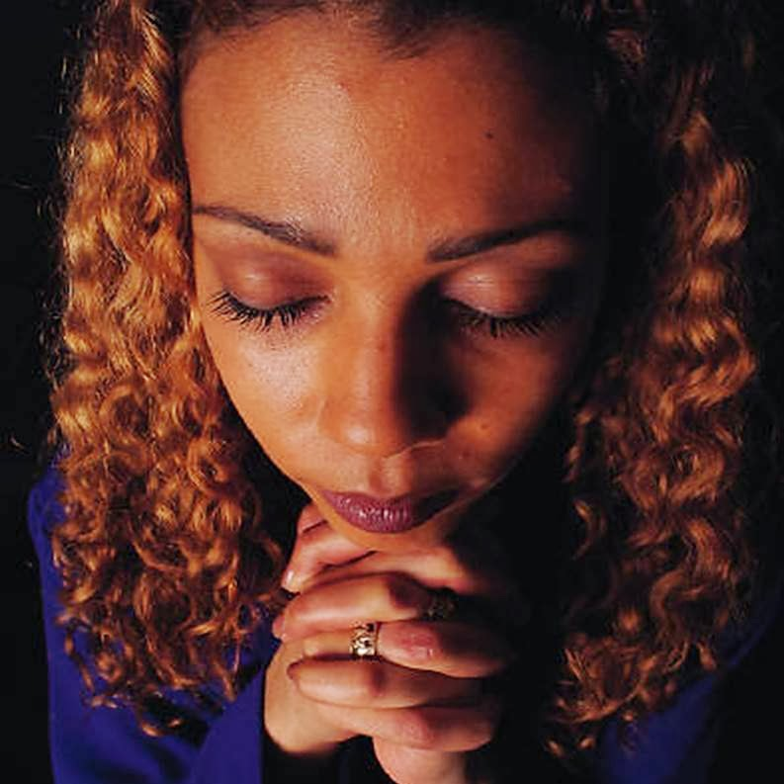
PRAYER
Heavenly Father,
Thank You for the gift of Pentecost and the coming of the Holy Spirit.
Thank You that You give courage to the fearful, direction to the uncertain, and purpose to those who follow You.
Help us to be open to Your guidance, and to live with the same courage and faith as the first disciples.
Teach us to share kindness, understanding, and hope with others, and to work for unity in our communities and in the world. Amen.

