Slide 1
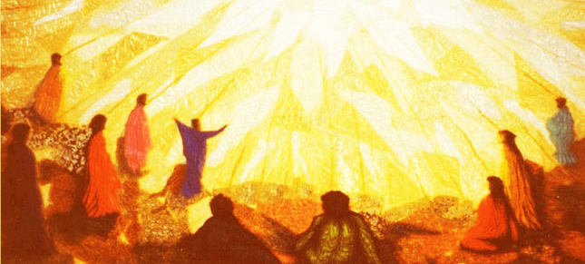
PENTECOST
TFTD 1

Slide 2
What is Pentecost?
Pentecost marks the moment the Holy Spirit came to the first followers of Jesus, as described in the Bible in the book of Acts (Acts 2)
Christians believe that at Pentecost:
The Holy Spirit came like wind and fire
The disciples were given courage and confidence
People from many different nations could understand them, symbolising unity and inclusion
It is celebrated 50 days after Easter Sunday (the word “Pentecost” comes from the Greek word meaning “fiftieth”).

Slide 3
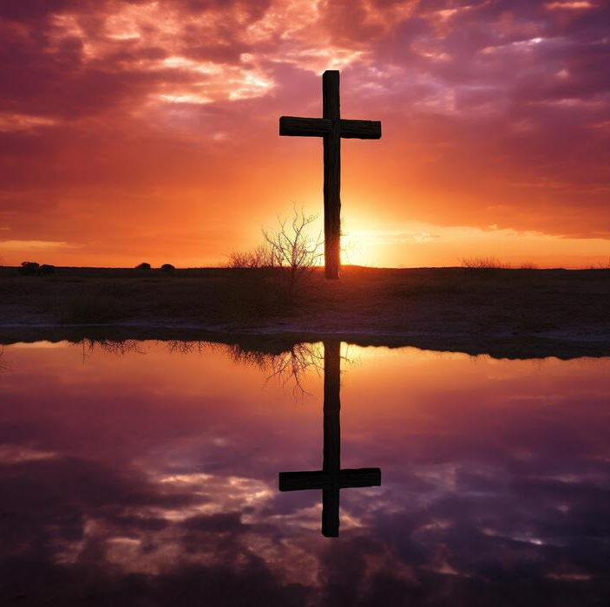
THE CHRISTIAN PERSPECTIVE
Acts 2:3–4
“They saw what seemed to be tongues of fire… All of them were filled with the Holy Spirit…”
From a Christian perspective, Pentecost is the moment when God gave the disciples the Holy Spirit, filling them with courage, strength, and confidence to share the message of Jesus with others.
In Acts 2:3–4, the “tongues of fire” symbolise the presence and power of God resting on each person individually, showing that the Holy Spirit was for everyone, not just a select few. Christians believe the Holy Spirit continues to guide, comfort, and strengthen people today.
Pentecost is also seen as a celebration of unity and inclusion, because people from many different nations were able to understand the disciples speaking in their own languages. Christians often view this as a sign that God’s message is for all people.

Slide 4
LET'S REFLECT
What does the Pentecost story teach about listening to and understanding people who are different from us?
How can communities create spaces where everyone feels welcomed, valued, and heard?
Why do you think the disciples spoke in many languages instead of just one?
What might “unity” look like in a world with many cultures, beliefs, and experiences?
Pentecost brought people together across differences — what barriers still separate people today?
What role can kindness, empathy, and understanding play in building stronger communities?

Slide 5
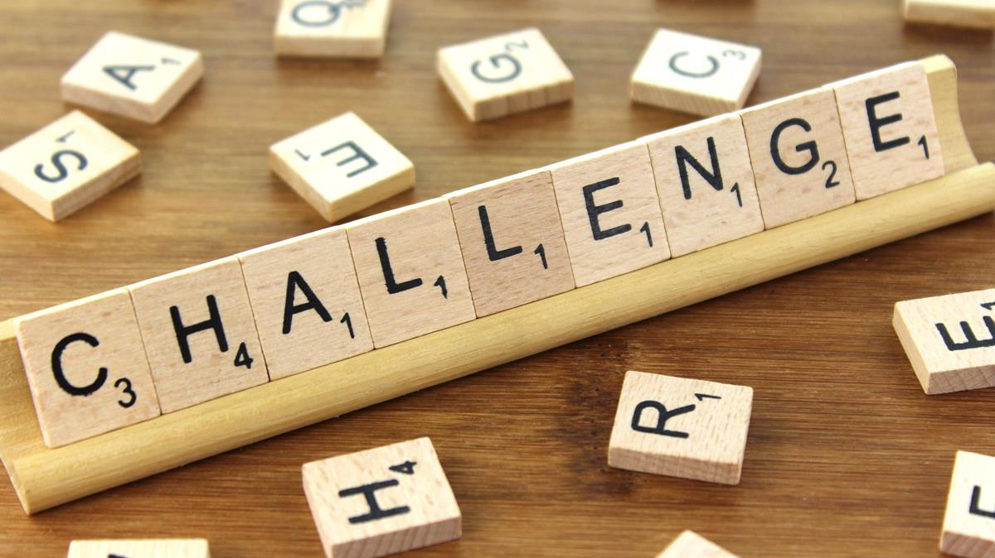
CHALLENGE
If Pentecost celebrates people understanding one another across languages and cultures, what stops us from truly listening to people whose experiences or beliefs are different from our own?

Slide 6
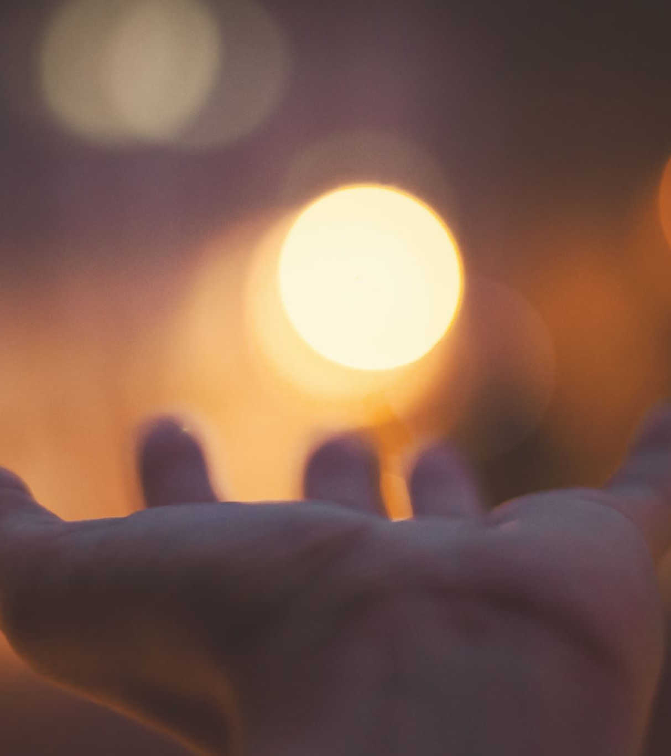
PRAYER
Loving God,
Thank You for the gift of the Holy Spirit at Pentecost.
Fill us with courage when we are afraid, wisdom when we are uncertain, and compassion when others feel left out.
Help us to bring unity where there is division and understanding where there is misunderstanding. May we use our words and actions to share hope, peace, and love with others. Guide us to live with confidence and faith each day. Amen.

