Slide 1
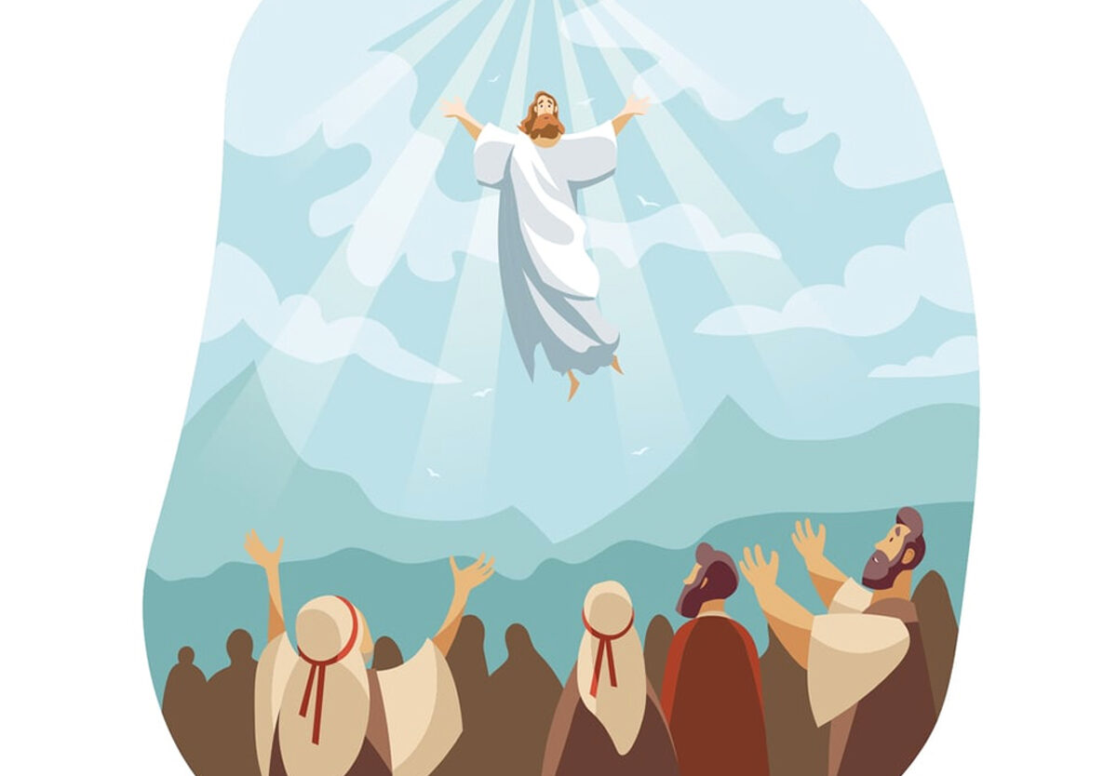
ASCENSION DAY
TFTD 4

Slide 2
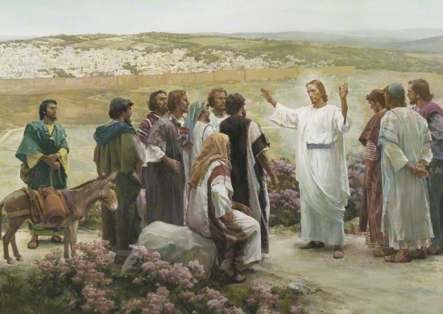
ASCENSION DAY BRINGS JOY TO DISCIPLES
Why the Disciples Felt Joy
After Jesus Christ ascended to heaven, the disciples were not left in fear or sadness.
Jesus promised to always be with them through the Holy Spirit.
The disciples understood that Jesus had completed His mission on Earth and returned to God.
They felt hope, peace, and confidence to continue spreading His teachings.

Slide 3
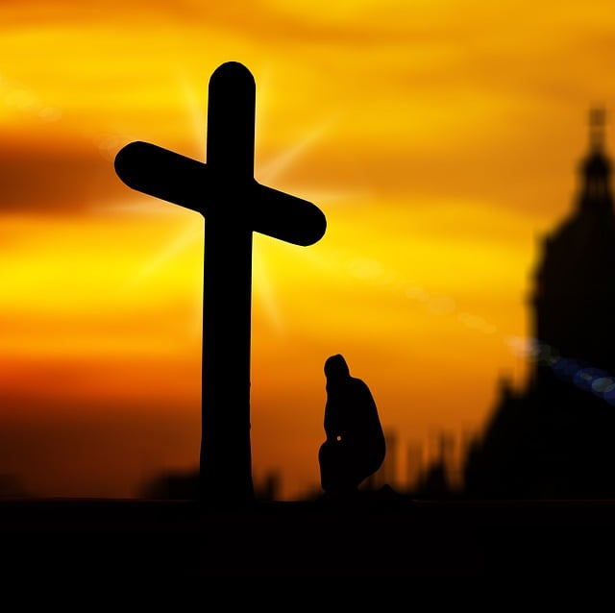
THE CHRISTIAN PERSPECTIVE
“Then they worshipped him and returned to Jerusalem with great joy.” — Luke 24:52
This verse shows that the disciples trusted Jesus’ promise even after He left them physically. Instead of feeling abandoned, they were filled with joy because they believed Jesus was still with them spiritually. Their joy came from hope, faith, and the understanding that they now had an important mission to continue His work.

Slide 4
REFLECTION QUESTIONS
Why do you think the disciples felt joy instead of sadness after Jesus ascended?
Why do you think the disciples felt joy instead of sadness after Jesus ascended?
How can faith help people feel hopeful during difficult times?
What does Ascension Day teach us about trusting God’s promises?
How can we continue Jesus’ mission in our everyday lives?

Slide 5

CHALLENGE
How can people find hope, purpose, and joy during times of change or uncertainty?

Slide 6
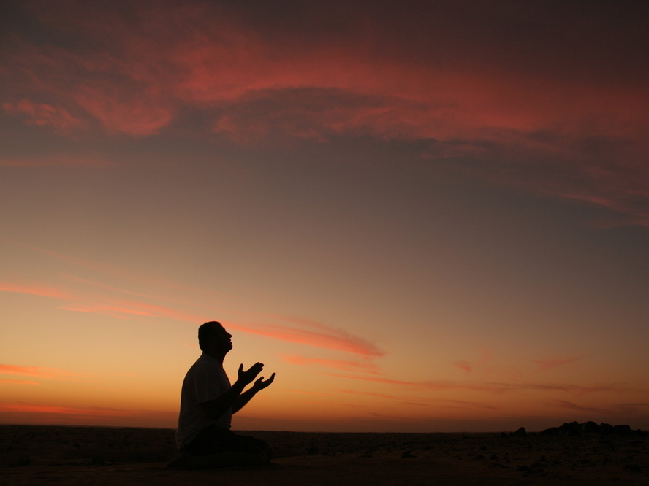
PRAYER
Heavenly Father,
Thank You for the joy and hope of Ascension Day.
Help us to trust in Your promises and share Your love with others.
Fill our hearts with faith, courage, and peace. Amen.

