Slide 1
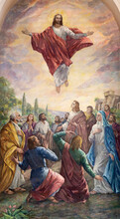
ASCENSION DAY
TFTD 3

Slide 2
Why is it significant to Christians?
Ascension serves as a reminder of Jesus’ second coming. Acts 1:11 promises that Jesus will return to earth one day in the same way he left it, but this time coming to restore, renew, and redeem for good.
Ascension Day reminds Christians that Jesus Christ did not simply leave the earth, but was exalted to a place of authority and continues to be present in a different way. It marks the completion of his earthly mission and points believers toward hope his ongoing intercession, the promise of eternal life, and the assurance of his return. This day encourages faith, joy, and confidence in God’s greater plan

Slide 3
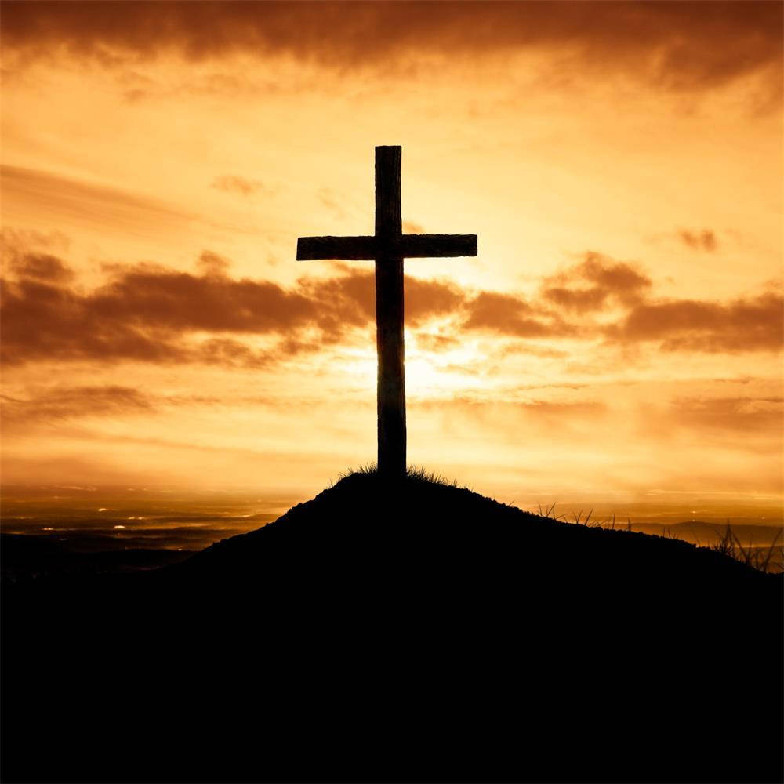
THE CHRISTIAN PERSPECTIVE
From a Christian perspective, the Ascension is closely linked with the promise of Jesus’ return, as described in Acts 1:11. Christians believe that although Jesus left the earth, he will come again to bring God’s final restoration of creation. The Ascension therefore is not only about Jesus being taken into heaven, but also about expectation and anticipation of what is still to come. It encourages believers to live with hope, trusting that history is moving towards a future where God’s purposes will be fully completed.

Slide 4
LET'S REFLECT
How might believing in a future return or renewal change the way someone lives now?
Why do you think ideas about the “end of the story” matter to people?
What do you think the disciples felt when they saw Jesus “taken up before their very eyes” (Acts 1:9)?
What does the Ascension suggest about Jesus’ role after leaving earth?
What do you think it means to live with a sense of “hope for the future”?

Slide 5

CHALLENGE
If the Ascension marks both Jesus’ absence and his promised return, how might Christians balance waiting for the future with living faithfully in the present?

Slide 6

PRAYER
Heavenly Father,
Thank you for the hope and meaning that many people find in their beliefs about the future. Help us to think deeply about what it means to live with purpose, to care for others, and to look ahead with hope. In times of uncertainty, guide us to seek understanding, compassion, and peace.

