Slide 1
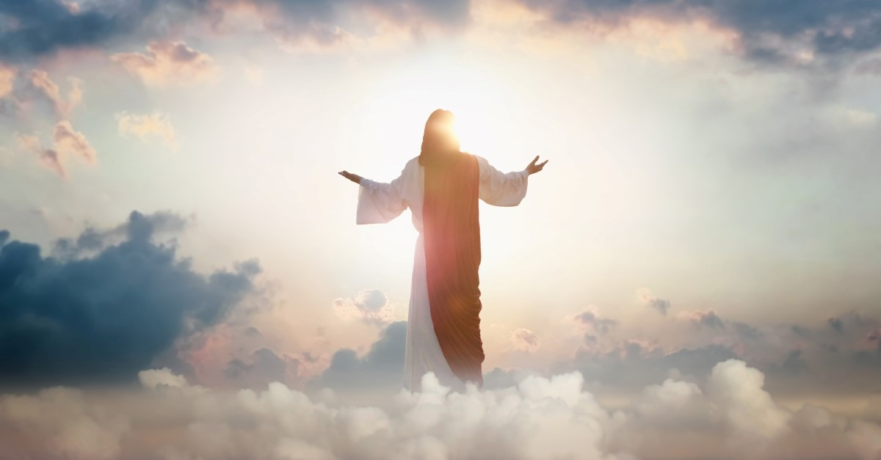
ASCENSION DAY
TFTD 2

Slide 2
Why is it significant to Christians?
Jesus’ ascension is more than something that’s simply to be remembered. It also offers us a future hope, even more than 2,000 years later. Now that he is in heaven, the Bible promises that Jesus is interceding and advocating for us (Rom 8:34, Heb 7:25) before God. He is still humanity’s representative, even now.
The ascension also gives us a taste of our own resurrected life in heaven. We, like Jesus, will get to spend our eternal lives in the presence of God (and what a wonderful thing that will be)

Slide 3

THE CHRISTIAN PERSPECTIVE
From a Christian perspective, the ascension is not only something to remember but a source of ongoing hope. Christians believe that, as described in passages like Romans 8:34 and Hebrews 7:25, Jesus is now in heaven interceding for humanity and continuing to represent them before God. It also points to the promise of eternal life, giving believers hope that they too will one day share in a restored life in God’s presence.

Slide 4
LET'S REFLECT
What does the idea of Jesus speaking on behalf of others mean to you?
Why might people find comfort in believing they are not alone or forgotten?
How does the idea of hope for the future influence how people live today?
What do you think “eternal life” or being in God’s presence might mean?
How can this belief encourage people during difficult times?

Slide 5

CHALLENGE
If Jesus is no longer physically present, why do you think belief in him continues to be meaningful for so many people today?

Slide 6
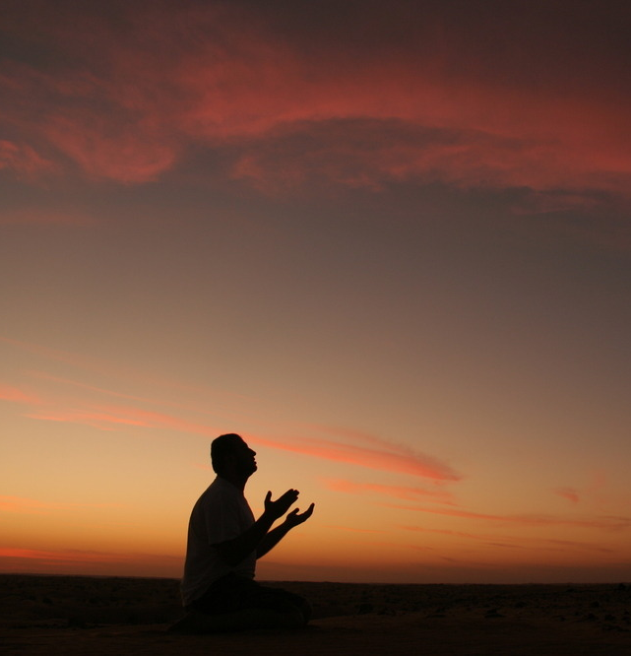
PRAYER
Heavenly Father,
Thank you for the hope that many people find in the belief that they are known, cared for, and not alone. Help us to live with kindness, compassion, and a sense of purpose each day. In times of difficulty, give us hope for the future and the strength to support one another. Amen.

