Slide 1
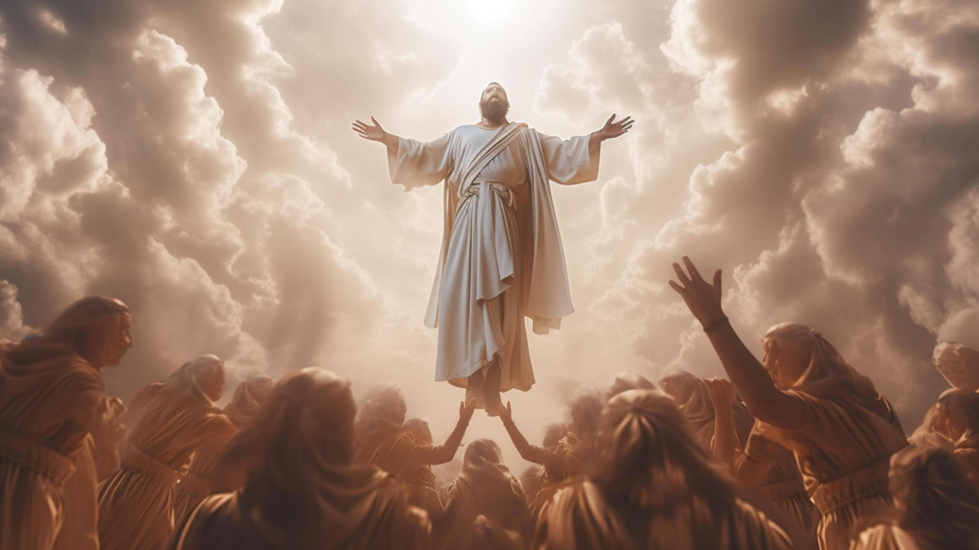
ASCENSION DAY
TFTD 1

Slide 2
What is Ascension Day?
Ascension Day is a Christian holiday that celebrates the ascension of Jesus into heaven as told in Acts 1 and Luke 24:50-53:
When Jesus had led them out to the vicinity of Bethany, he lifted up his hands and blessed them. While he was blessing them, he left them and was taken up into heaven. Then they worshiped him and returned to Jerusalem with great joy. And they stayed continually at the temple, praising God.
Jesus’ ascension is a significant part of both the story of the Bible and how we understand Jesus’ deity. His ascension marks the end of his time on earth, bringing to a close his earthly mission, while setting the stage for the coming of the Holy Spirit just a few days later.
Jesus’ return to heaven also exalts him, reminding us that Jesus is more than just a man. He is also God, and his ascension seats him at the right hand of God the Father and establishes his divine authority and kingship over heaven and earth.

Slide 3
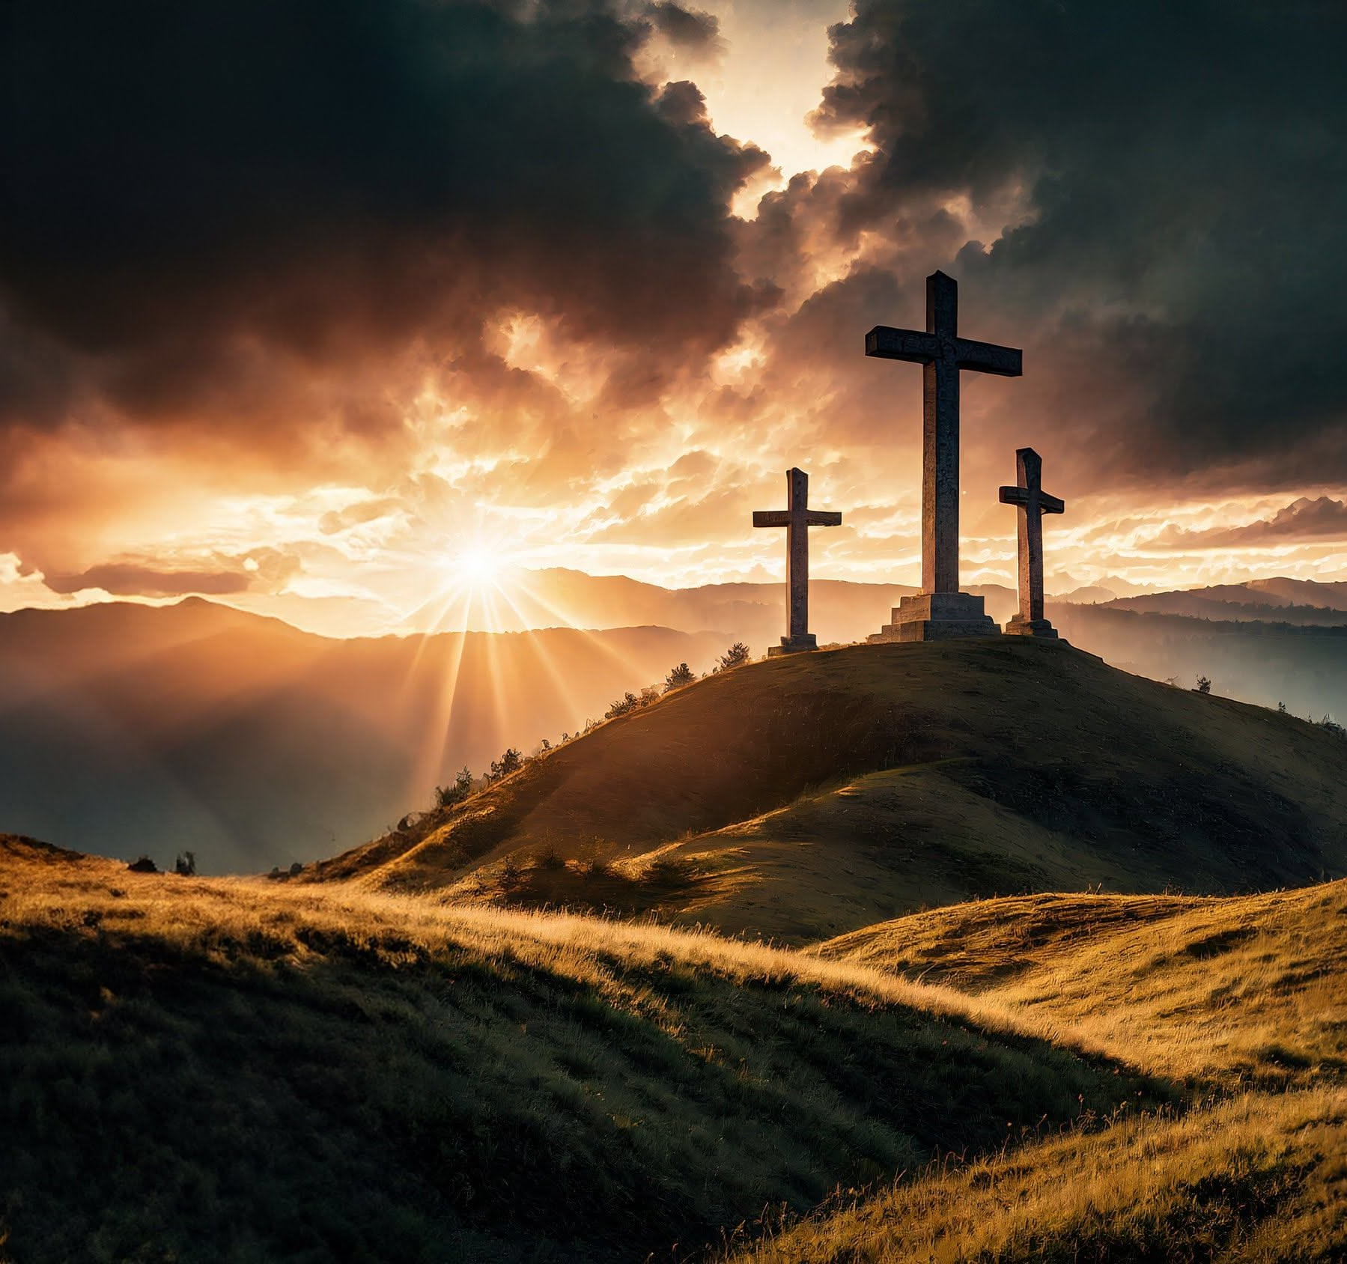
THE CHRISTIAN PERSPECTIVE
From a Christian perspective, Acts 1:9 (“He was taken up before their very eyes…”) describes Jesus’ ascension as a real event witnessed by his followers. It marks the end of his time on earth and his return to heaven, where Christians believe he is exalted and shares in God’s authority. The ascension also points to a new chapter, where Jesus is no longer physically present but remains with believers through the Holy Spirit.

Slide 4
LET'S REFLECT
What do you think the idea of “ascending” or moving on to something greater represents?
Why might this moment have been important for Jesus’ followers?
What values (e.g. hope, trust, purpose) can people take from this story, regardless of belief?
The disciples responded with joy—what do you think gave them that sense of hope?
How can we support each other in times of change or uncertainty?

Slide 5

CHALLENGE
How do people today find hope or meaning when someone important is no longer physically present?
PROMPT : THINK ABOUT IMPORTANT FIGURES IN HISTORY, CELEBRITIES THAT HAVE PASSED

Slide 6
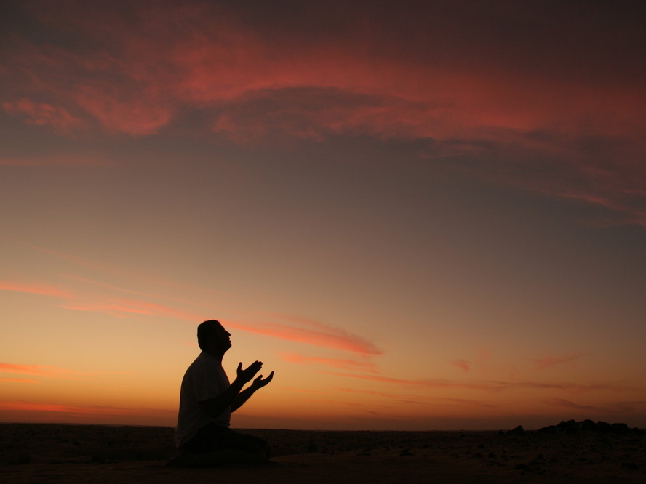
PRAYER
Heavenly Father,
Thank you for moments that inspire hope, reflection, and a sense of purpose. As we think about this story, help us to consider what it means to live with kindness, courage, and compassion. Be with us in times of change, and guide us to support one another and to grow as individuals. Amen.

