Slide 1
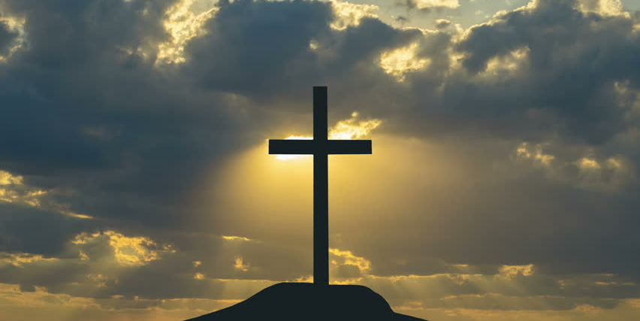

Easter: The Passion and The Promise
TFTD 1

Slide 2

WHY DO CHRISITANS CELEBRATE EASTER?
Christians celebrate Easter because it marks the resurrection of Jesus Christ, which is the belief that Jesus rose from the dead after being crucified.
What Christians Believe:
According to the Bible, Jesus Christ was crucified on Good Friday and died on the cross. Three days later, on Easter Sunday, he rose from the dead. Christians believe this showed that:
Jesus is the Son of God
Death and sin were defeated
People can have forgiveness and new life through him
This event is described in the Gospels, such as the Gospel of Matthew and Gospel of Luke.

Slide 3
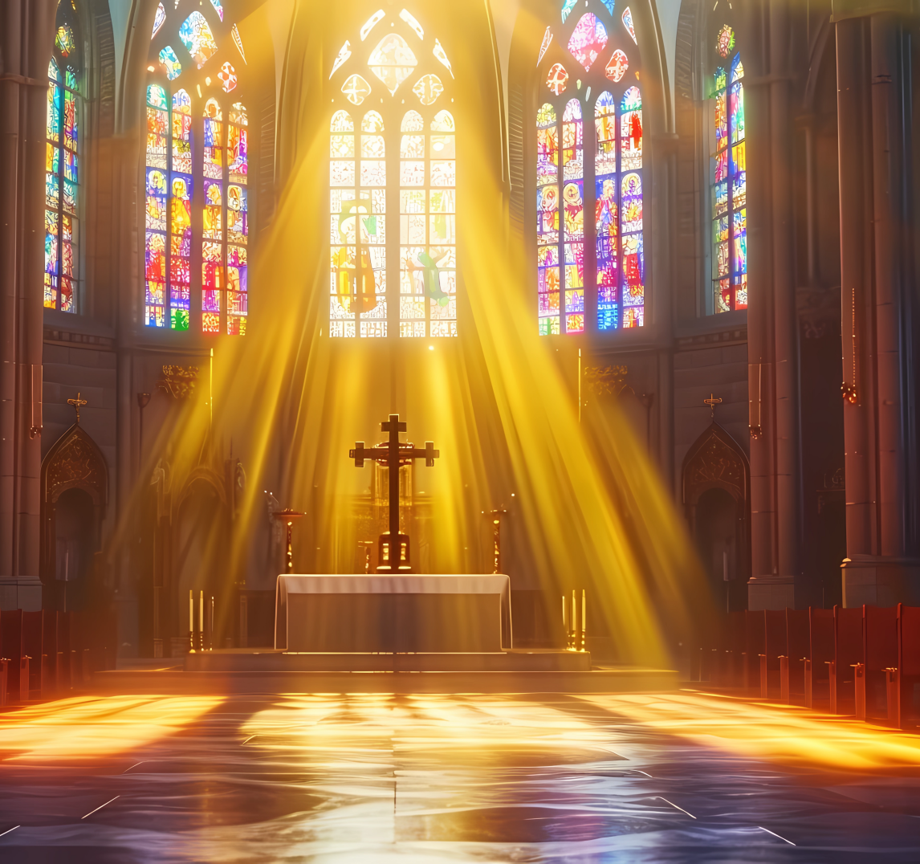
THE CHRISTIAN PERSPECTIVE
But Christ has indeed been raised from the dead, the first fruits of those who have fallen asleep. For since death came through a man, the resurrection of the dead comes also through a man. For as in Adam all die, so in Christ all will be made alive.
1 Corinthians 15:20-22
Because of the resurrection Christians have a solid foundation for hope it’s grounded in something that has already happened, not just something hoped for. Just as Christ was raised, believers can trust that their own struggles, losses, and even death are not the end. Easter hope is the assurance that new life always follows—even after the darkest moments.

Slide 4
LET'S REFLECT
Why is Easter significant to Christians?
What does Easter mean to me personally, beyond traditions and celebrations?
How do I understand the idea of resurrection or new life in my own context?
In what ways do I see hope emerging after difficult seasons in my life?
What does the resurrection say about hopeless situations?

Slide 5

CHALLENGE
What would it look like in my life if I truly believed that renewal, hope, and fresh beginnings are always possible—even after loss, failure, or difficult seasons?

Slide 6
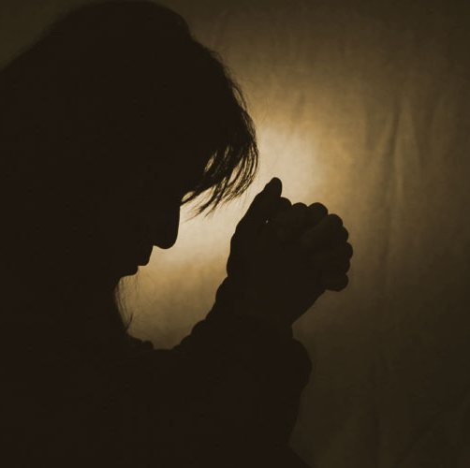
PRAYER
Heavenly Father,
Thank You for the hope of Easter and the victory won through Jesus Christ. Thank You that through His resurrection, death is not the end and new life is possible. Help us to live as people of hope to trust You in difficult moments, to let go of fear and sin, and to walk in the new life You have given us. Renew our hearts, strengthen our faith, and guide us to reflect Your love to others each day. May the truth of Easter shape how we live, today and always. Amen.

