Slide 1
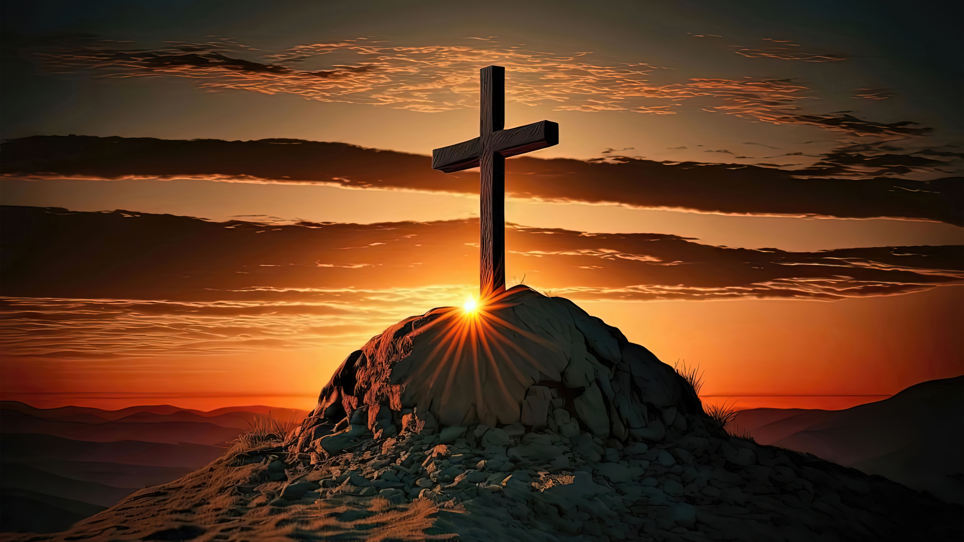
Easter: The Passion and The Promise
TFTD 1

Slide 2
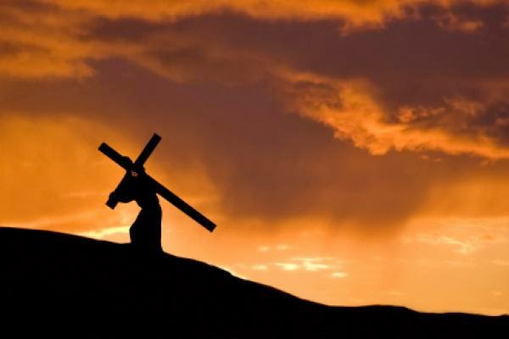
What do Christians mean by 'Good Friday?'
Good Friday was the day of Jesus' crucifixion
Christians see it as “good” for a few key reasons:
Sacrifice for sin: Jesus’ death is understood as an act of love, taking on the consequences of human sin so people can be forgiven.
Restored relationship with God: It represents a way for humanity to be reconciled with God.
Part of a bigger story: Good Friday isn’t the end—it's followed by Easter Sunday, when Christians believe Jesus rose from the dead.
The deeper meaning
Good Friday shows that even in suffering and darkness, something meaningful and hopeful can emerge. It’s a day of reflection, gratitude, and solemn remembrance—but also one that points forward to hope.

Slide 3
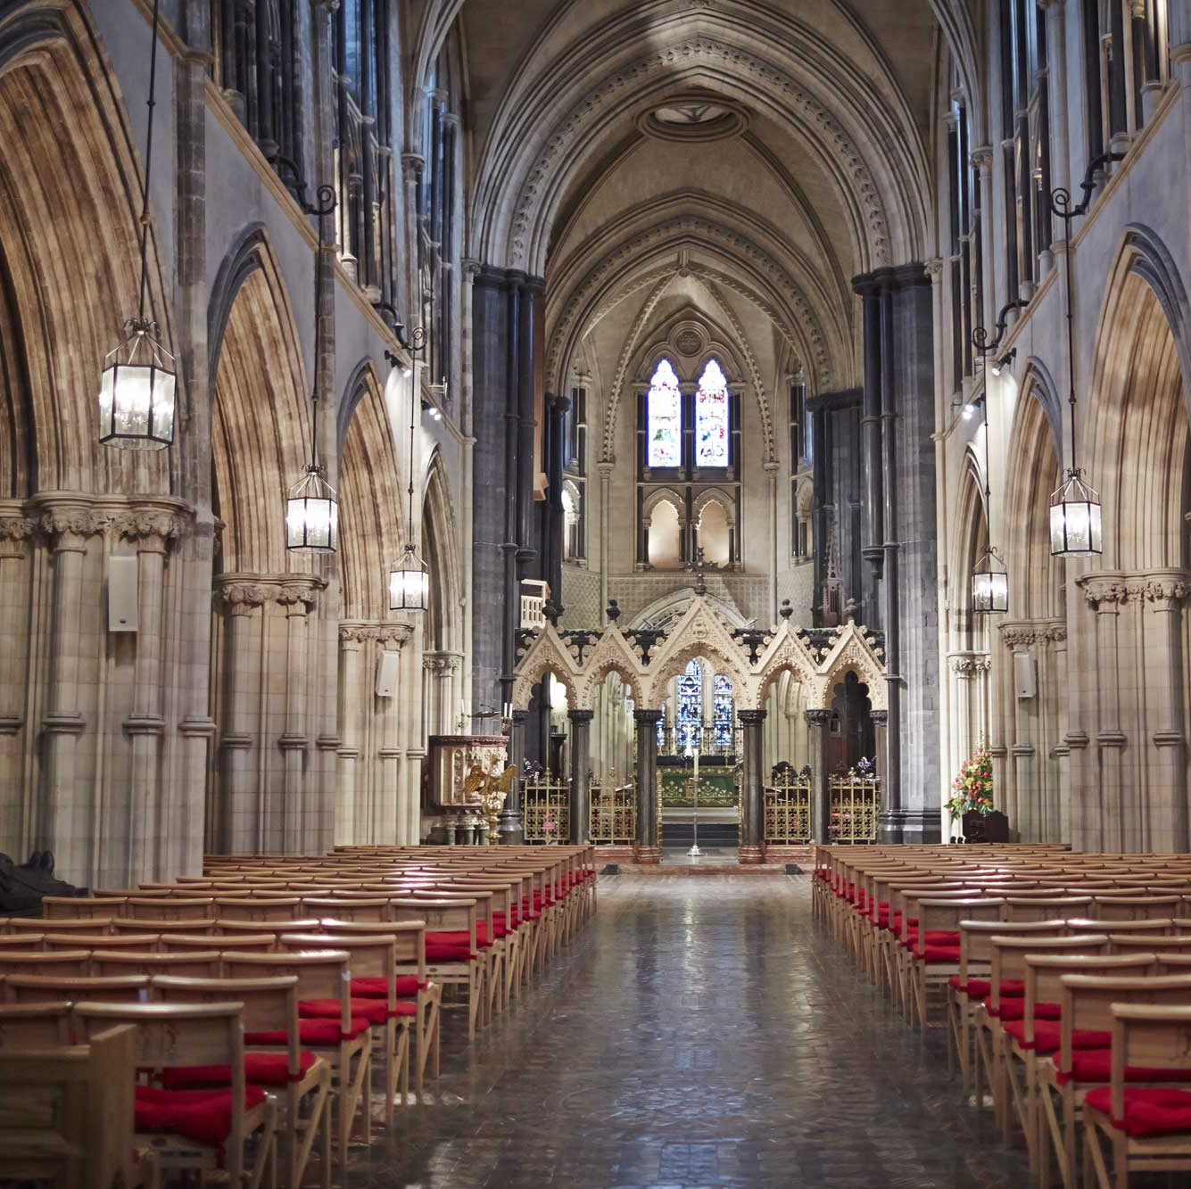
THE CHRISITAN PERSPECTIVE
Isaiah 53:5 says:
“But he was pierced for our transgressions… by his wounds we are healed.”
On Good Friday, Christians reflect on the crucifixion of Jesus Christ, seeing this verse fulfilled in that event. Jesus’ physical suffering—the wounds of the cross—reflects the prophecy of being “pierced… wounds.” His death is understood as a sacrificial act, taking the place of humanity and bearing the weight of sin. The “healing” described in the verse points to the forgiveness, restoration, and new life made possible through His death.
Why it matters
This verse helps explain why Good Friday is called “good.” What appeared as suffering and defeat was, in reality, an act of love that brings hope and healing.
Isaiah 53:5 reminds Christians that Jesus’ suffering was not meaningless. It was purposeful, offering restoration, forgiveness, and the promise of new life for all who believe.

Slide 4
LET'S REFLECT
How do I respond to the idea of someone sacrificing themselves for others?
What emotions does the story of the cross stir in me—and why?
What does Good Friday teach me about love in action?
How can I show sacrificial love in my daily life?
Where can I hold onto hope, even when things feel heavy or uncertain?

Slide 5

CHALLENGE
When have I experienced a “Good Friday” moment 'a time of loss or darkness' and what did I learn from it?

Slide 6
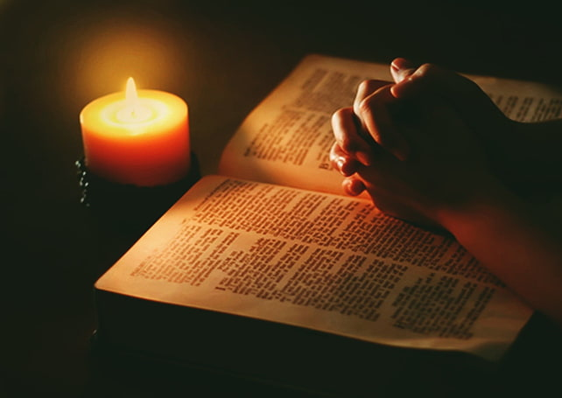
PRAYER
Heavenly Father,
We choose to remember the suffering and sacrifice of Jesus Christ.
Thank You for His love, shown through the cross. Help us to reflect deeply on what this means to recognise our need for forgiveness, to offer grace to others, and to live with compassion and humility.
Be close to us in our struggles and in our pain.
Remind us that even in the darkest moments,
You are present and working for good.
As we remember the cross today, prepare our hearts for the hope to come. Amen.

