Slide 1

Spiritual Development & Flourishing
TFTD 2

Slide 2

What is spiritual development?
Spiritual development is about:
learning who you are
reflecting on what really matters
asking big questions about life, faith, justice and purpose
developing values that guide how you live
It looks different for different people.

Slide 3
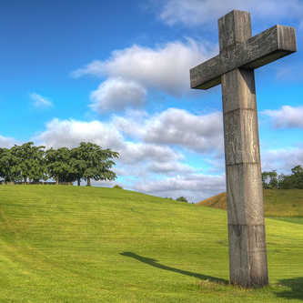
The Christian Perspective
Hebrews 6:1- “Let us go on to maturity, not laying again the foundation…”
This verse teaches us that spiritual growth, like academic growth, requires moving forward rather than repeating the basics. In student life, this means that faith should mature alongside education—students are expected not only to learn rules and beliefs but to apply them responsibly.
Just as students progress from simple lessons to deeper understanding, spiritual maturity shows itself in wise decision-making, self-discipline, integrity, and perseverance through challenges.
The foundation of faith remains important, but true development happens when students build on it by taking ownership of their choices, handling peer pressure thoughtfully, and living out their values in everyday school life.

Slide 4
Let's Reflect
What strengths or values do you see developing in yourself?
What matters most to you right now, and why?
How do you decide what deserves your time, energy, and attention?
What big questions about life, faith, justice, or purpose are you currently thinking about?
When you face uncertainty or difficulty, what helps guide your thinking?
Can you think of a time when your values were tested? How did you respond?

Slide 5

Challenge
What is one area where you feel yourself growing—personally, spiritually, or ethically?
What is one step you could take to continue developing in a way that feels meaningful to you?

Slide 6
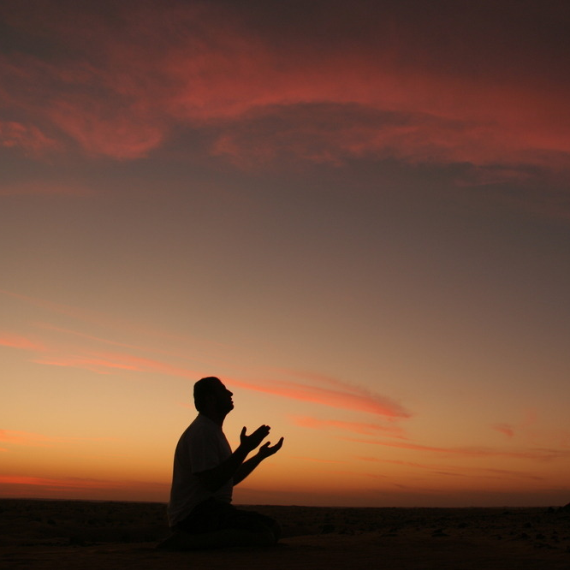
Prayer
Heavenly Father, Help us to grow into who we are meant to be. Give us the courage to learn about ourselves honestly and the wisdom to reflect on what truly matters in life. Guide us as we ask big questions about faith, justice, purpose, and the kind of people we want to become. Shape our values so they guide our choices,
our words, and our actions each day. Remind us that growth looks different for each of us, and that every step forward matters. Help us to keep learning, keep reflecting, and keep moving toward maturity with humility and hope.
Amen.

