Slide 1
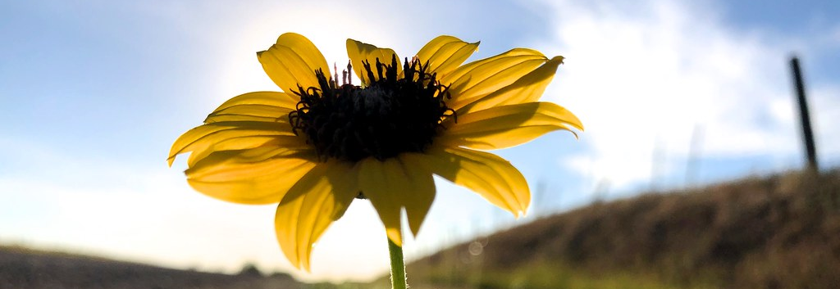
Spiritual Development and Flourishing
TFTD 3

Slide 2

What does it mean to flourish?
To flourish means:
Feeling safe enough to be yourself
Challenged enough to grow
Supported enough to take risks

Slide 3

The Christian Perspective
John 10:10b - “I have come that they may have life and, have it to the full”
This scripture shows that flourishing is more than simply existing or being successful. Jesus describes a full life as one that is rich in meaning, purpose, and wholeness. To flourish means growing into the person you were created to be—living with strong values, healthy relationships, and a sense of direction. It involves inner growth, not just outward achievement, and includes learning, reflecting, making wise choices, and contributing positively to others. A full life is not free from challenges, but it is shaped by hope, purpose, and growth, even in difficult times.

Slide 4
Let's reflect
What challenges are helping you grow right now?
How do you usually respond when something feels difficult or unfamiliar?
In what ways can challenge be a positive part of learning and personal growth?
What kind of support helps you take healthy risks—academically, socially, or personally?
How can you help create an environment where others feel safe, challenged, and supported too?

Slide 5

Challenge
Stretch yourself (Challenged)
Choose one task that pushes you slightly outside your comfort zone —try a harder question, start an assignment early, ask for help, or attempt something new.
Ask for or offer support (Supported)
Reach out to one person this week — a friend, teacher, or family member for encouragement, help, or simply a conversation. Or be that support for someone else.

Slide 6
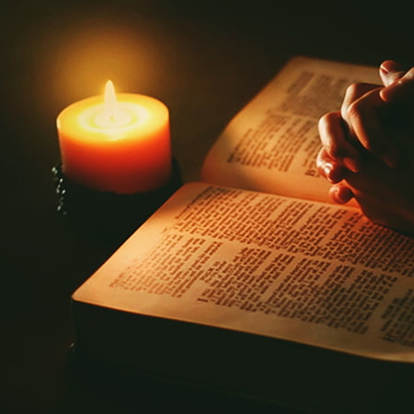
Prayer
Heavenly Father,
Thank you for creating us as we are. Help us to feel safe enough to be ourselves,to be honest, accepted, and valued.
Give us the courage to embrace challenges that help us grow, even when growth feels uncomfortable or uncertain. #Surround us with support people who encourage us, guide us, and walk with us
as we take risks, try new things, and learn from our mistakes. Help us to flourish not by avoiding difficulty,but by growing through it with hope and purpose. Teach us also to create spaces where others feel safe, challenged, and supported.
Amen.

