Slide 1
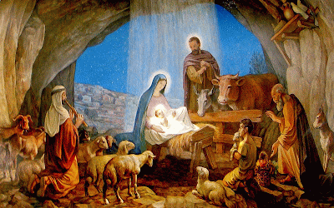
ADVENT: BIRTH OF JESUS
TFTD 2

Slide 2
What does his birth tell us about his character?
In Luke 2:10-13, tells us that the Savior of the world came in the humblest way- wrapped in love, born among the lowly and destined to bring joy, peace and salvation to all.

Slide 3
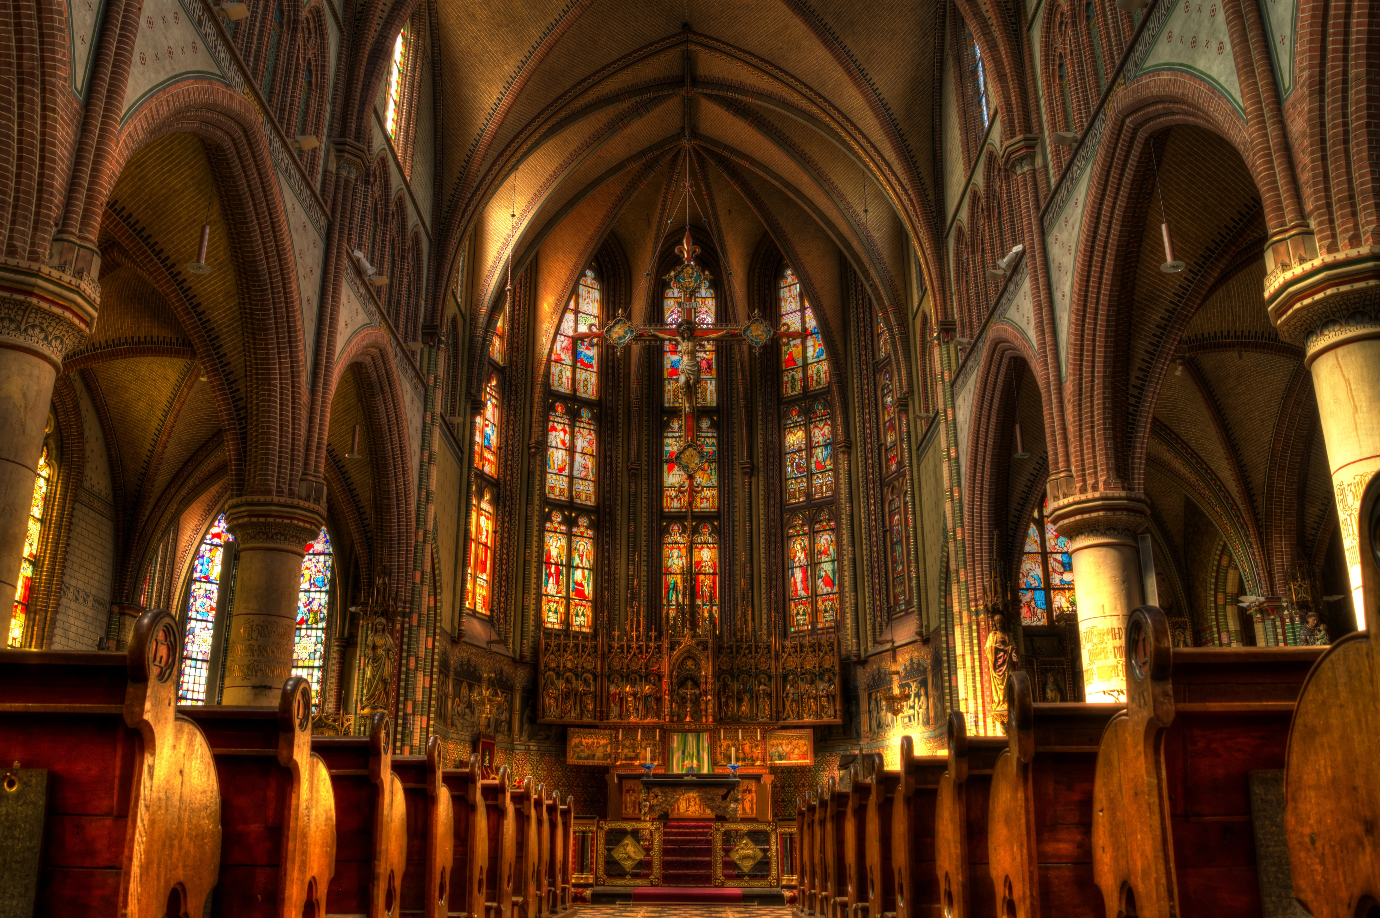
THE CHRISTIAN PERSPECTIVE
Jesus is Humble — “A baby… lying in a manger.”
A manger is a feeding trough—simple, poor, unexpected.
This shows Jesus’ humility:
He didn’t come as a king in a palace.
He came lowly and approachable.
His character is gentle, humble, and close to ordinary people.

Slide 4
LET'S REFLECT
Why might God choose for His Son to be born in a manger instead of a palace?
How does Jesus’ humble birth challenge our ideas about greatness?
What does humility look like in our own lives, inspired by Jesus’ example?
How does the setting of Jesus’ birth show God’s values versus human values?
How does Jesus’ humility at birth connect to how He lived and served later?

Slide 5

LET'S DIG DEEPER
If greatness can begin in a manger, what does that say about the potential hidden in ordinary or overlooked people?
How does this story encourage us to rethink who we admire and why?

Slide 6
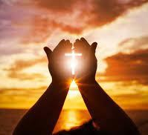
PRAYER
Heavenly Father,
We thank You for the message of Luke 2:10–13, reminding us that the Savior of the world came in the humblest way—wrapped in love, born among the lowly, and bringing joy, peace, and salvation to all. Help us to carry that same humility in our own lives, to welcome others with kindness, and to share Your love with those who feel unnoticed or alone.
May the peace proclaimed by the angels fill our hearts, and may the joy of Jesus’ birth inspire us to bring hope into every place we go. Teach us to see Your greatness in simple moments, and Your glory in acts of compassion. Thank You for sending us a Savior who meets us where we are and leads us into Your light. Amen.

