Slide 1
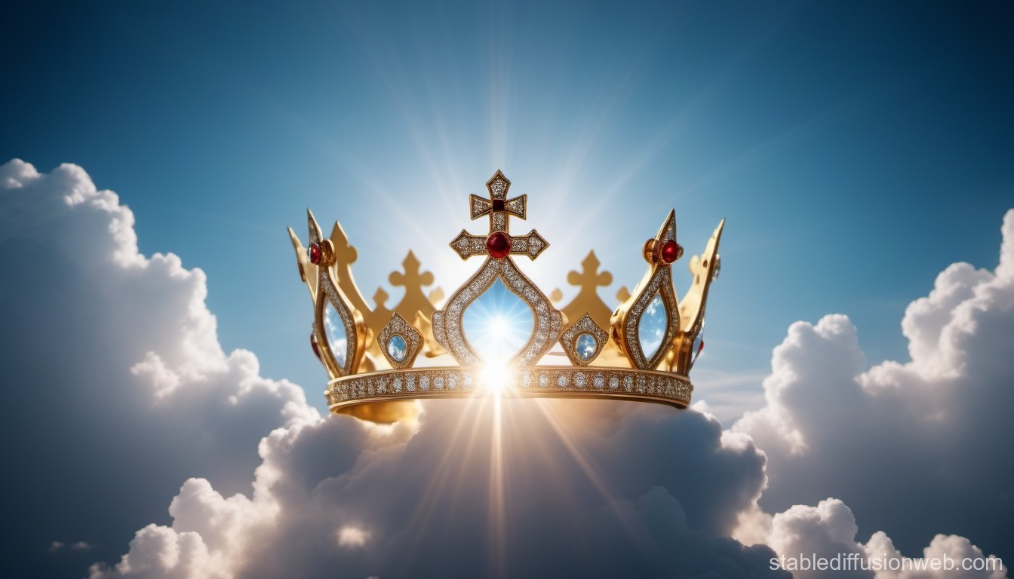
IMAGE OF GOD
TFTD 2

Slide 2
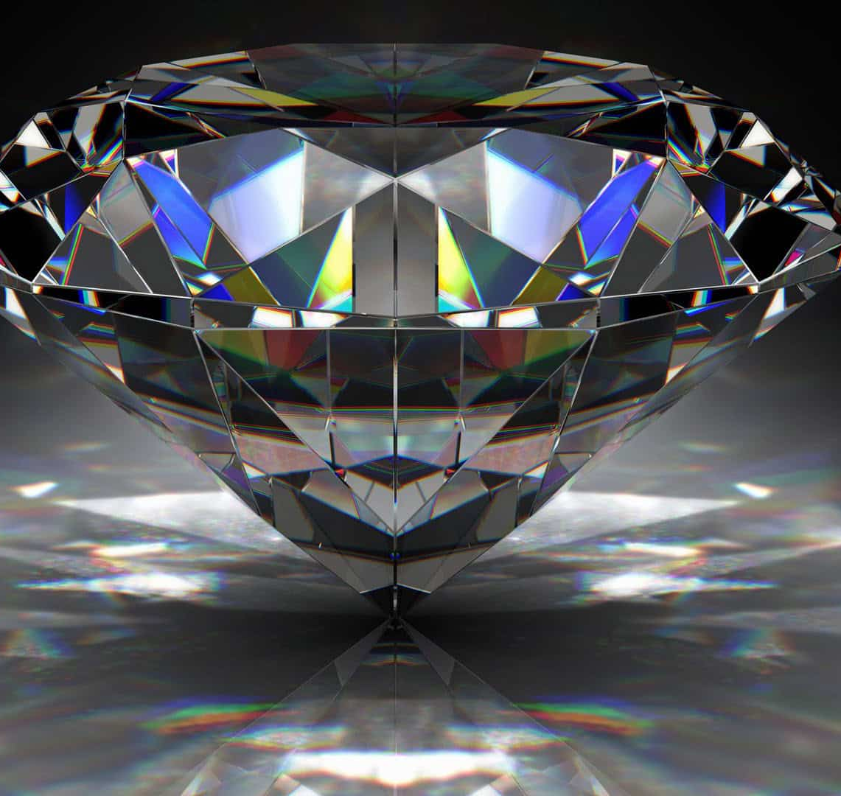
WORTH IN HIS IMAGE
Every person, no matter their background or ability, is valuable because they bear God’s image.
This belief is the foundation of Christian teaching on equality and human rights.

Slide 3
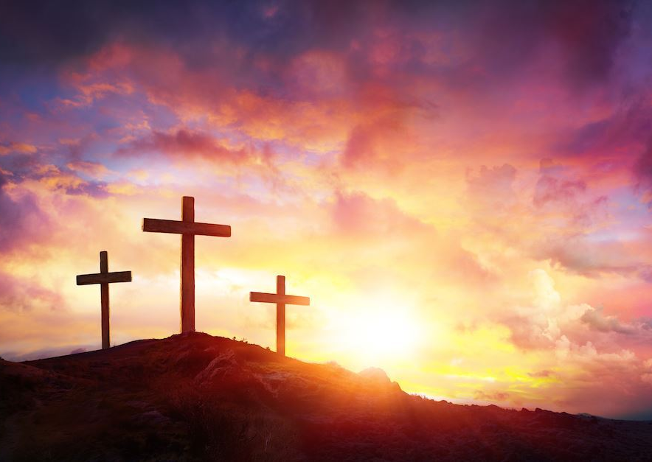
THE CHRISTIAN PERSPECTIVE
"You are fearfully and wonderfully made." – Psalm 139:14
Our value doesn't come from looks, achievements, money, or popularity.
Our worth comes from who made us and what we’re made for.
Every person has a purpose and dignity.

Slide 4
LET'S REFLECT
What small action can I take today to show respect to someone else?
Do I lift people up with my words or bring them down?
Do I treat others as if they are valuable, even if they’re different from me?
What does it mean to truly believe that I have value just as I am?
How can I challenge the idea that some lives are more valuable than others?

Slide 5
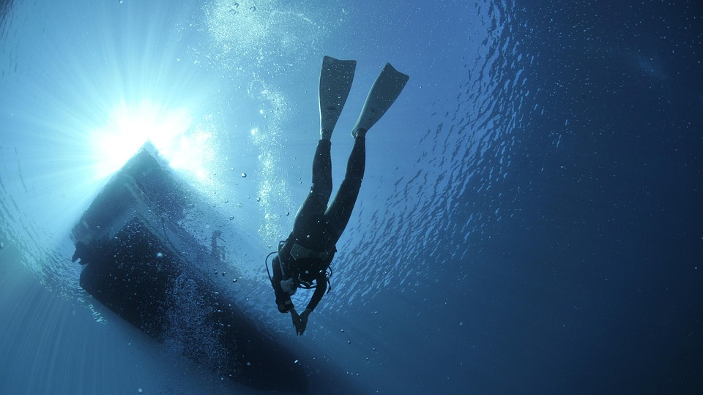
LET'S DIG DEEPER
What kind of community could we build if we treated everyone as someone deeply loved and created with purpose?

Slide 6

PRAYER
Dear God,
Thank you for making each of us in your image.
Help us to see our own value, even when it’s hard to believe.
Help us to recognise the worth in others — in every face, in every voice, in every heart. Give us the courage to treat everyone with kindness, dignity, and love.
Amen

