Slide 1

IMAGE OF GOD
TFTD 1

Slide 2
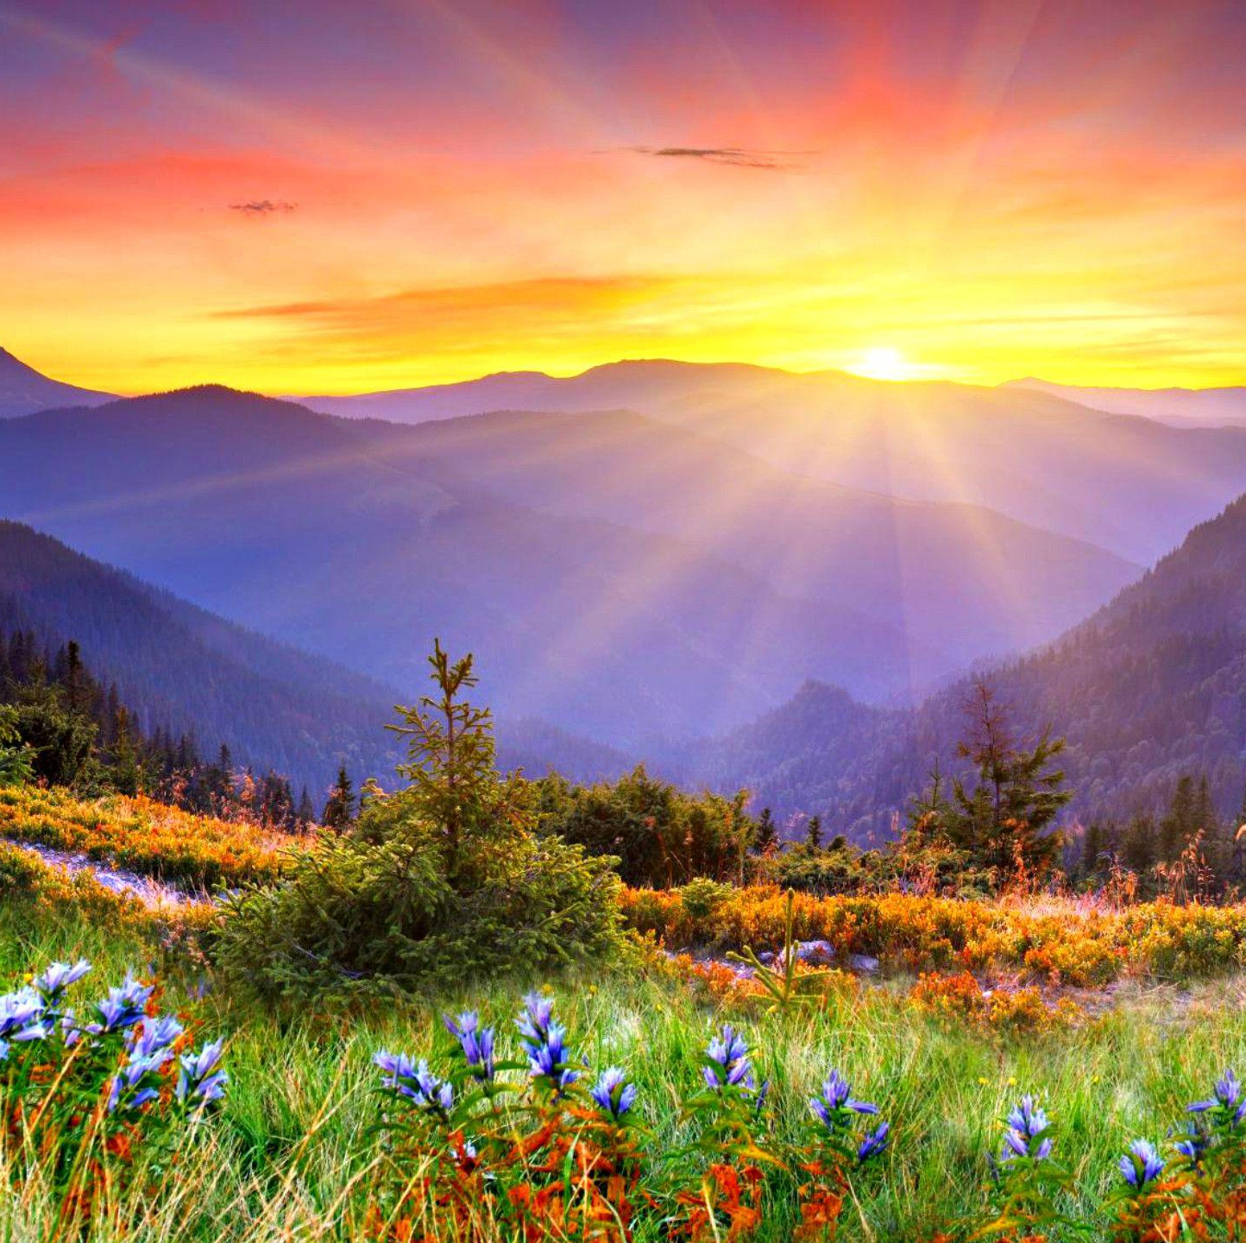
IMAGE OF GOD
What does it mean that every person is made in the image of God?
It doesn’t mean we look like God physically.
It means we reflect God’s nature: love, creativity, reason, kindness, ability to care and connect.
Every person has infinite value, no matter who they are.

Slide 3
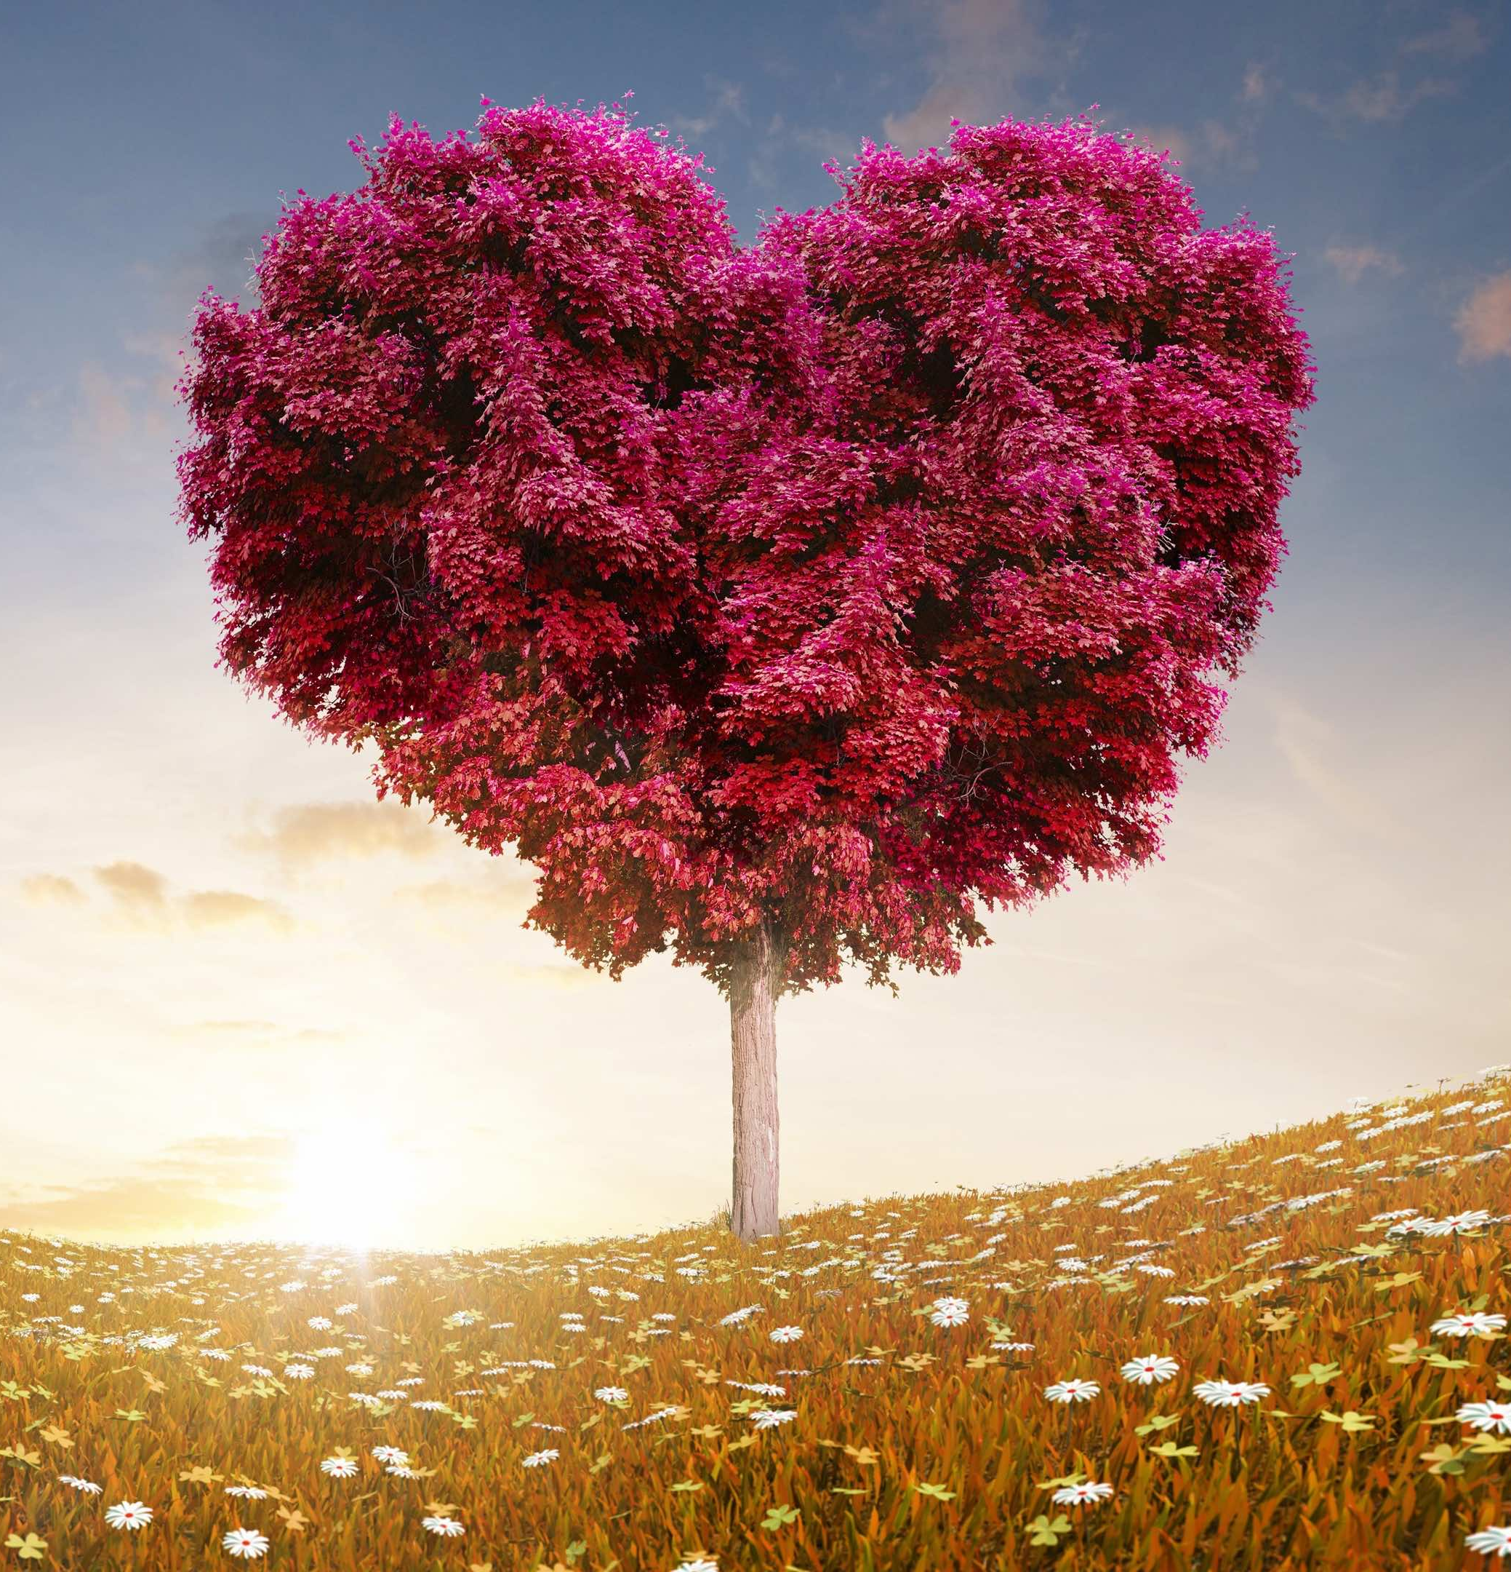
CHARACTERISTICS OF GOD
God’s character means what God is like morally and relationally — the qualities that describe God’s heart, personality, and moral will.
God’s character includes:
Loving / compassionate / merciful- God genuinely cares for creation and acts with kindness.
Just / righteous- God is fair, opposes oppression, and does what is morally right.
Faithful / trustworthy- God keeps promises and does not betray.
Patient / slow to anger- God gives people time to change.
Holy- God is morally pure, set apart from wrongdoing.
Wise- God understands everything perfectly and acts with purpose.
Good- All God’s actions are oriented toward good.

Slide 4
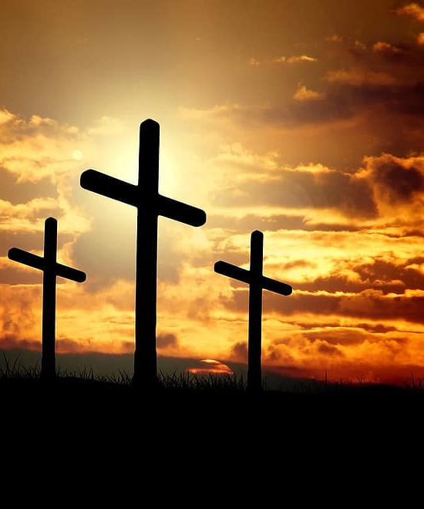
THE CHRISTIAN PERSPECTIVE
The Bible teaches us “So, God created mankind in his own image.”- Genesis 1:2
When we believe we're made in God's image, we learn to respect:
Ourselves – our body, mind, and emotions.
Others – regardless of race, religion, background, ability, or beliefs.
Key message:
If everyone is made in God’s image, no one is "less than."
“So, God created mankind in his own image.”
Genesis 1:2

Slide 5
LET'S DISCUSS
How would I treat myself differently if I believed I’m made in God’s image?”
What’s something unique about me that reflects something of God’s character?
Have I ever forgotten my worth? What helped remind me?
What does it mean to truly believe that I have value just as I am?
Who in my life helps me see my value?

Slide 6
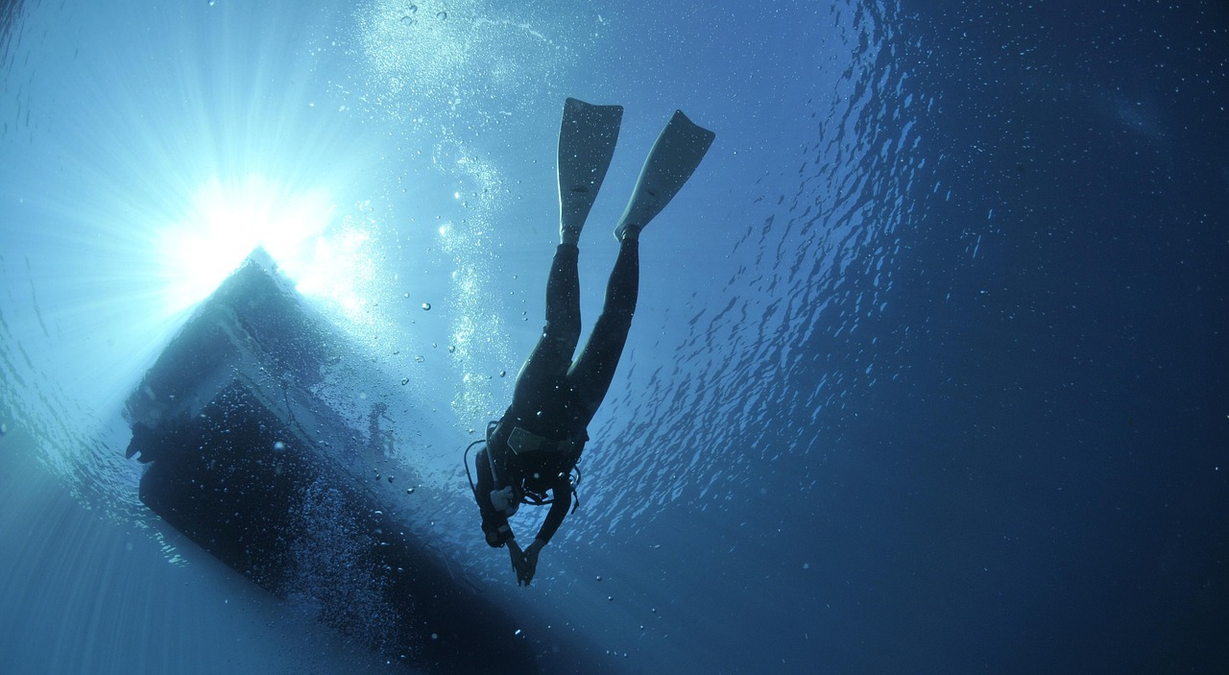
LET'S DIG DEEPER
How would our world change if we treated everyone like they were made in God’s image?”

Slide 7

PRAYER
Dear God, thank you for making each of us in your image. Help us to see the value in ourselves and in every person we meet. Help us to live with kindness, respect, and love. Amen.

