Slide 1
Art Attack – the Y7 Easter competition!
Dear Y7
Although this will feel a bit weird, the Easter holidays have now officially begun!
To keep you interested, thriving and creative, I am setting you a challenge – to RECREATE A PIECE OF ARTWORK using household objects.
Step 1: click on the link and scroll through some of the examples of famous art works that have been recreated, to give you and idea of the concept.
https://www.sadanduseless.com/recreated-art/
Step 2: choose a piece of art that inspires you (there are a few examples on the following slides to get you started, but obviously the Internet is there to help you!).
Step 3: recreate your own version, take a photo and then email it to me at my school email address.
The deadline for entries is Sunday 19th April at 11.59 pm. I cannot wait to see what you come up with! Good luck, and there will be small prizes for the best 3.

Slide 2
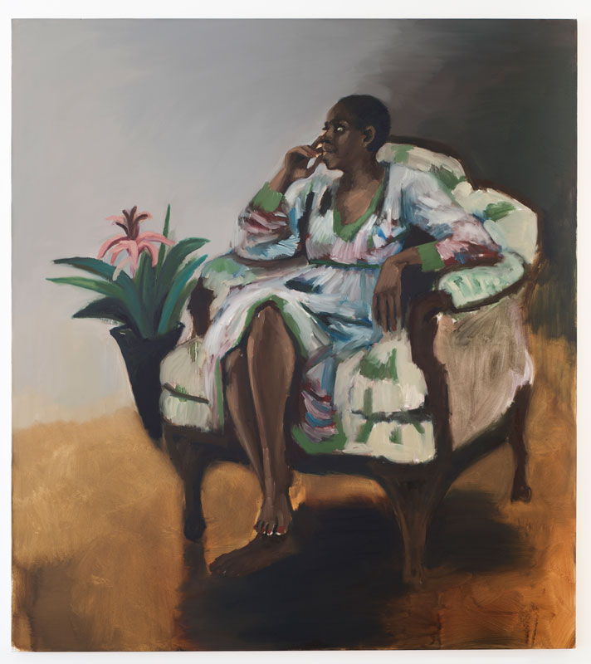
Artist Lynette Yiadom-Boakye
Title 1pm, Mason’s Yard
Date 2014
Medium Oil on Canvas
Dimensions 70 7/8 x 63 3/16 inches

Slide 3
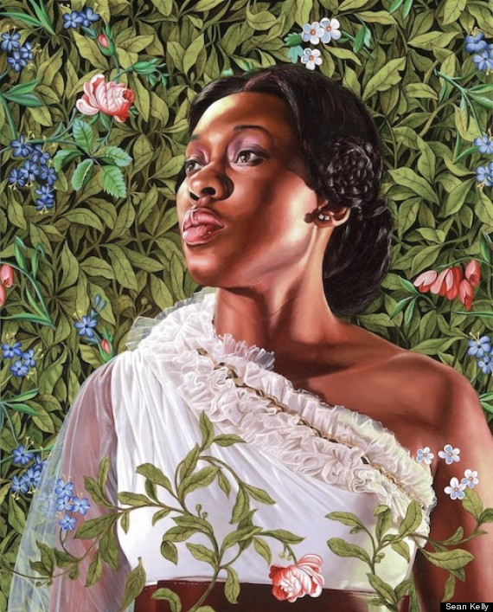
Artist Kehinde Wiley
Title Dacia Carter
Date 2012
Medium Oil on Canvas
Dimensions 30” x 24”

Slide 4
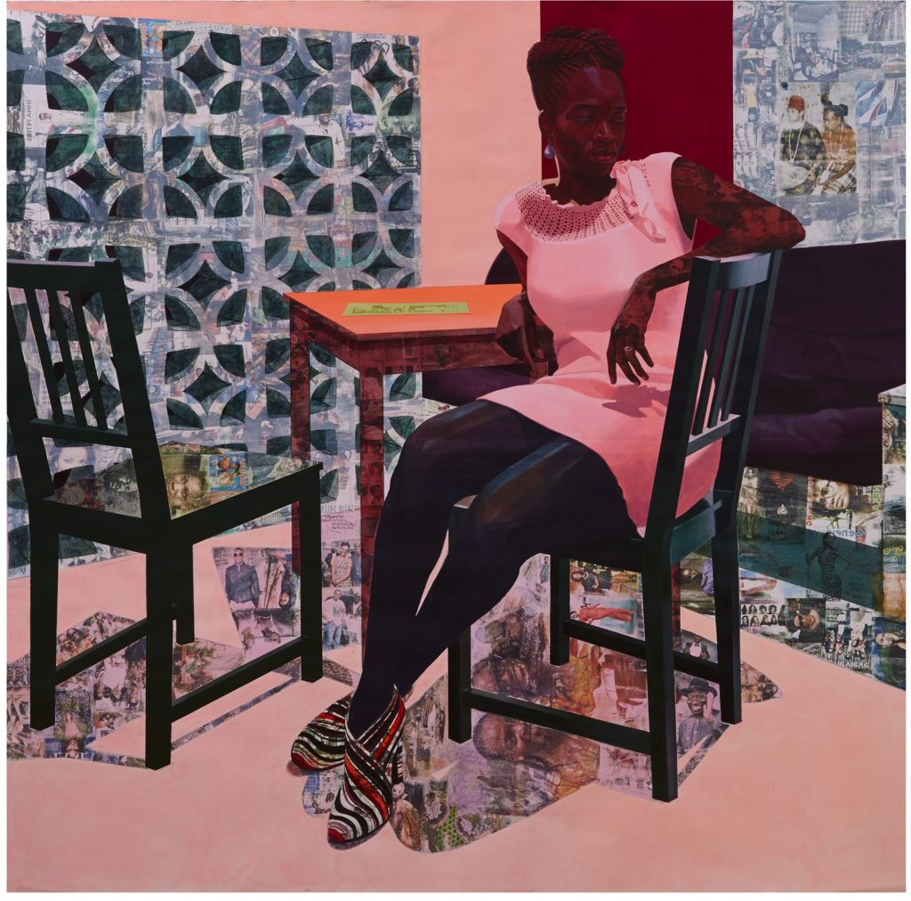
Artist Njideka Akunyili Crosby
Title Predecessors (detail)
Date 2013
Medium Photo-Collage Painting

Slide 5
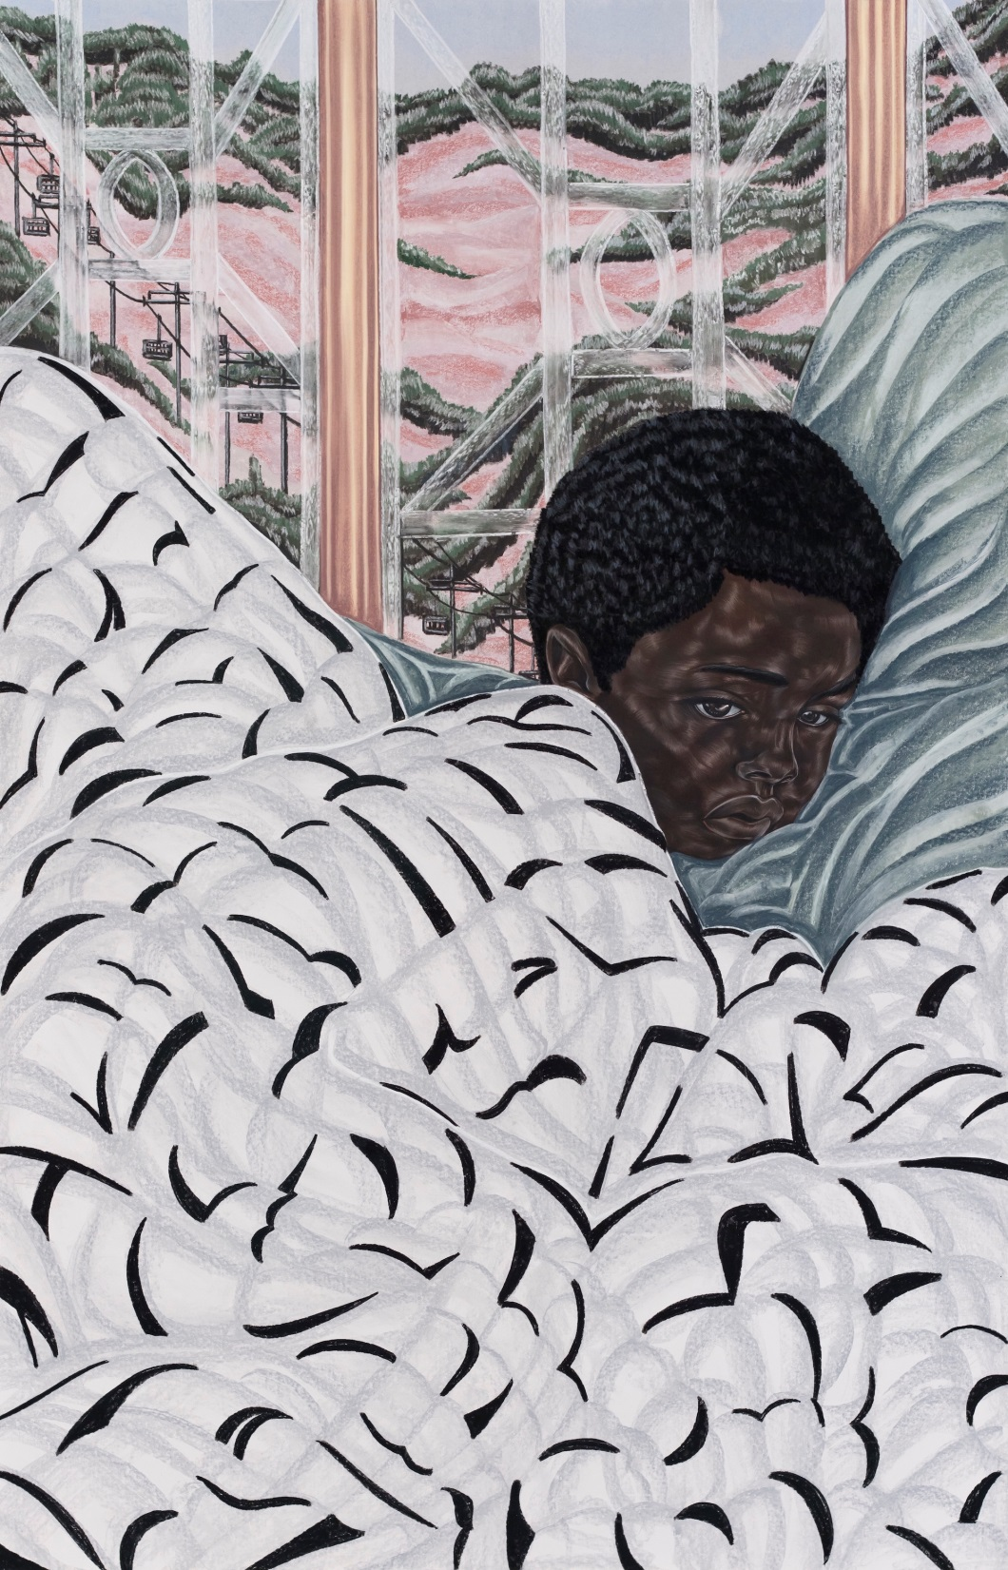
Artist Toyin Ojih Odutola
Title First Night at Boarding School
Date 2017
Medium Charcoal, pastel, and pencil on paper

Slide 6
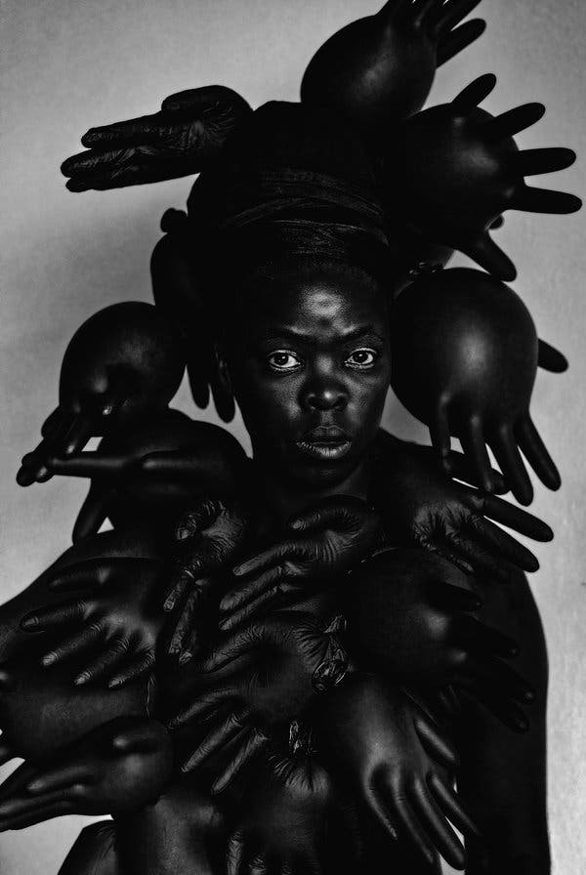
Artist Zanele Muholi
Title Phila I, Parktown, Johannesburg
Date 2016
Medium Photograph

Slide 7
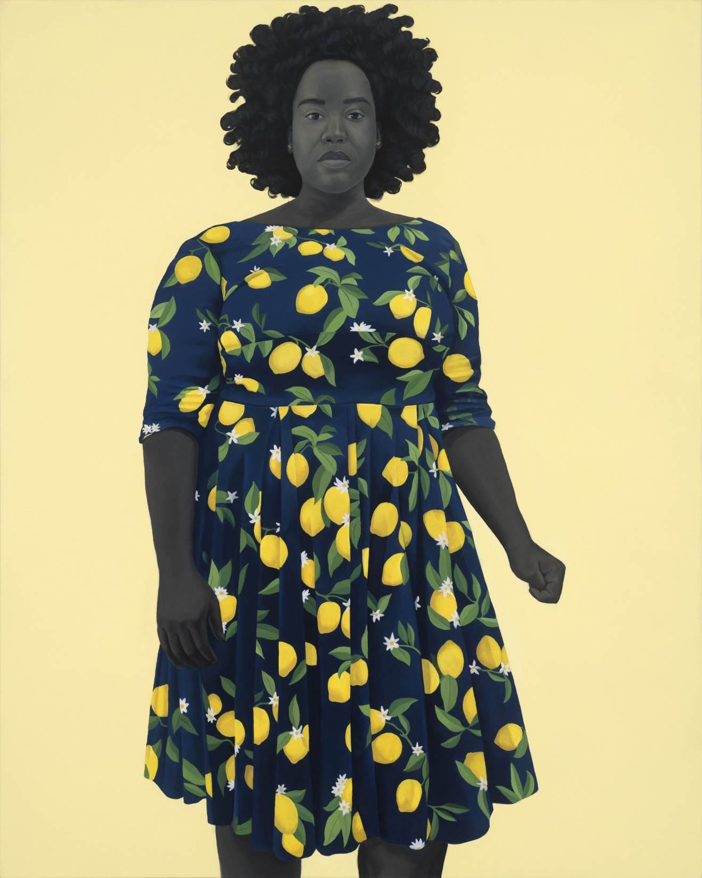
Artist Amy Sherald
Title She Always Believed the Good About Those She Loved
Date 2018
Medium Oil on Canvas
Dimensions 54 x 43 inches

Slide 8
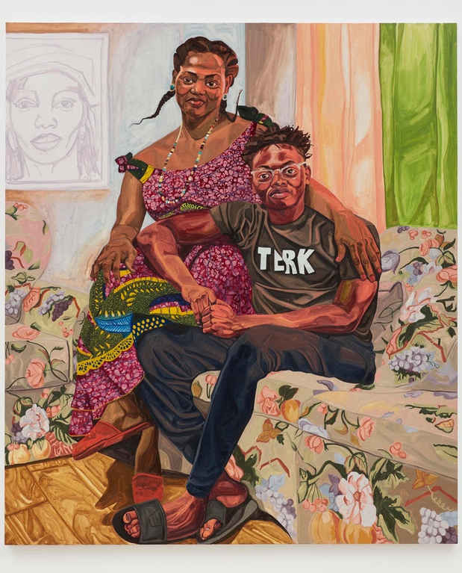
Artist Jordan Casteel
Title Serwaa and Amoakohene
Date 2019
Medium Oil on Canvas
Dimensions 90 x 78 in

Slide 9
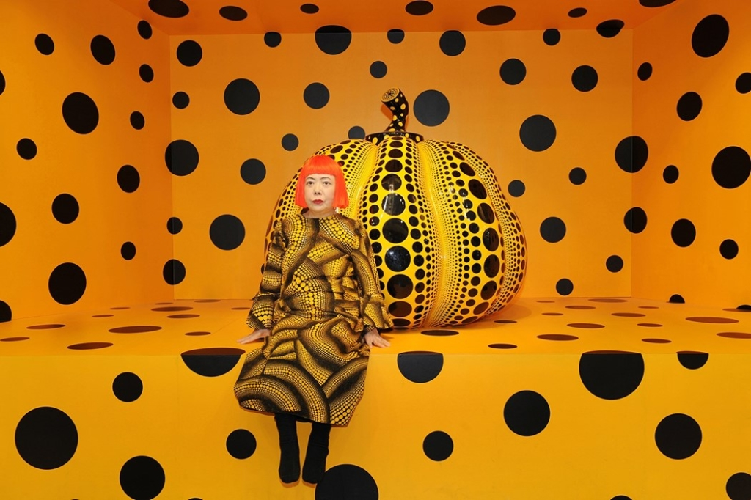
Artist Yayoi Kusama

Slide 10
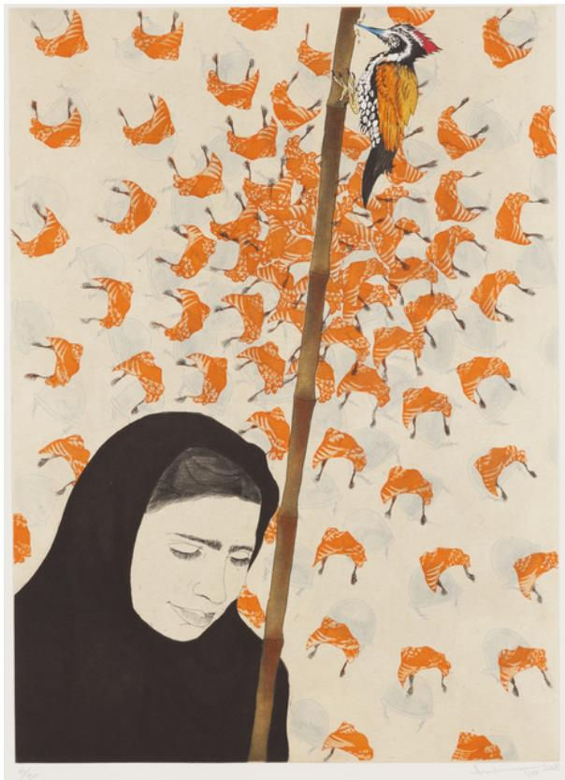
Artist Ambreen Butt
Title Daughter of the East, Plate
Date 2008
Medium Six plate aquatint etching with chine collé, dry point, and spit bite
Dimensions 45.7 × 33 cm

Slide 11
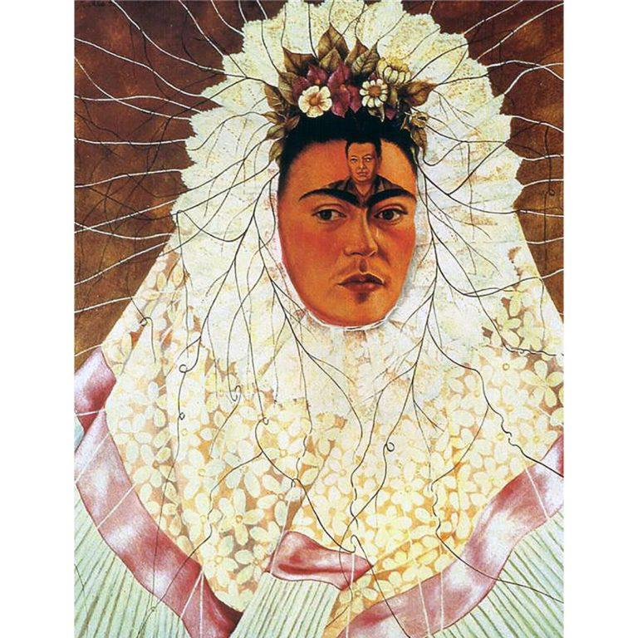
Artist Frida Kahlo
Title Self-Portrait as Tehuana
Date 1943

