Slide 1

Spotlight on:
Apprenticeships
South London Support For Schools

Slide 2
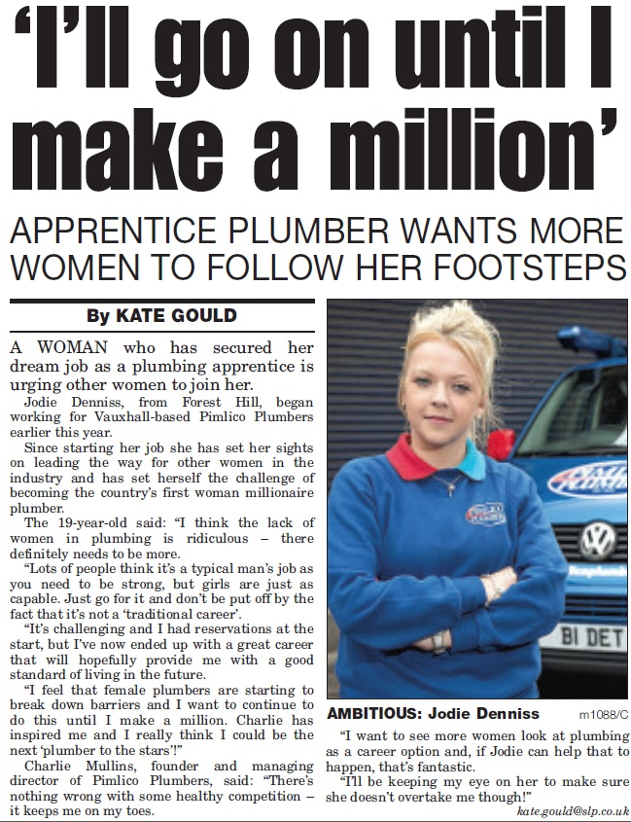
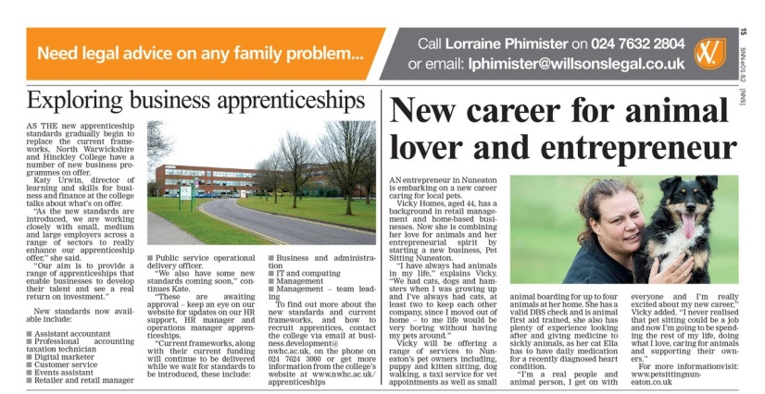
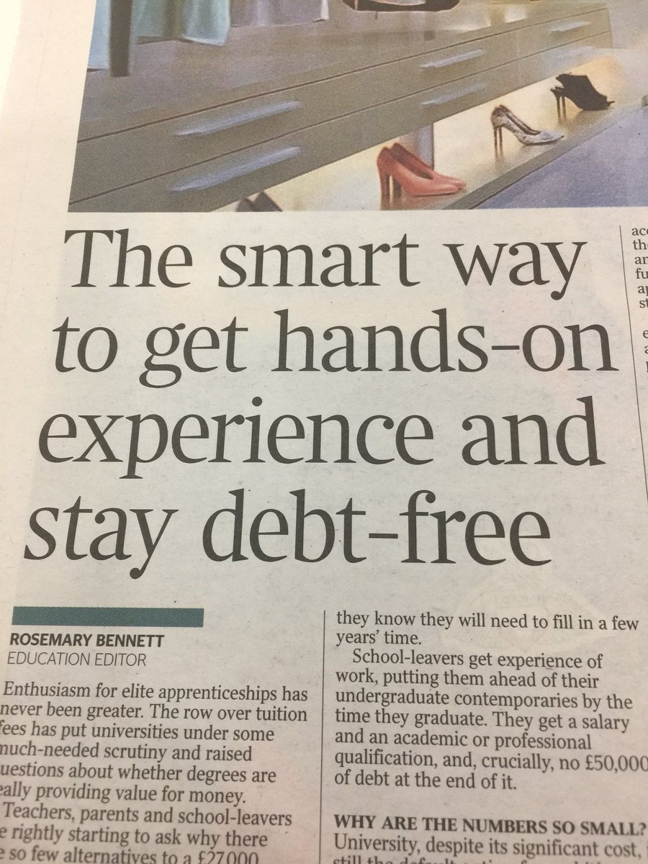
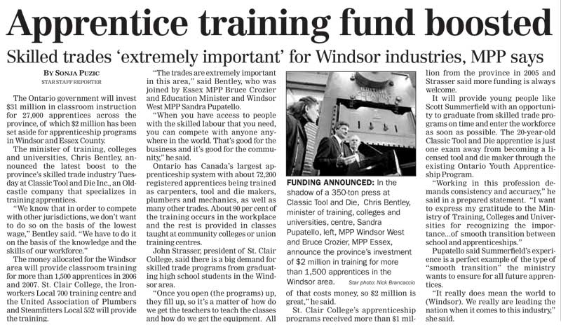

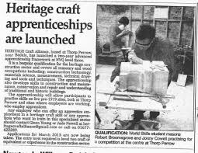
Welcome to the revolution!
The Dodo bird is still extinct…
The Earth still orbits the Sun…
BUT
Apprenticeships HAVE changed

Slide 3
Key Benefits
Earning a salary
Working towards a recognised qualification up to Degree level
Gain job specific skills
Paid holiday and other company perks
Real job with a Real employer

Slide 4
Sectors and occupations with higher or degree apprenticeships
Accounting
Financial Advisory
Aerospace Software Development Engineer
Aviation Operations Manager
Paraplanner
Solicitor
Chartered Surveyor
Civil Engineers
Cyber Intrusion Analyst
Licensed Conveyancer
Nuclear Scientist Engineer
Nurse
Recruitment
Data Analyst
Retail Manager
Dental Practise Manager
Project Manager
Network Engineer
Software Tester

Slide 5
Apprenticeships Available UK
BAE Systems
Royal Bank of Scotland
Virgin Media
JPMorgan
Barclays
Lloyds
Santander
Unilever
National Grid
PwC
Royal Airforce
Ministry of Defence
Gordons
Field fisher
GlaxoSmithKline
Siemens
Balfour Beaty
BMW
John Lewis
and more…!!

Slide 6
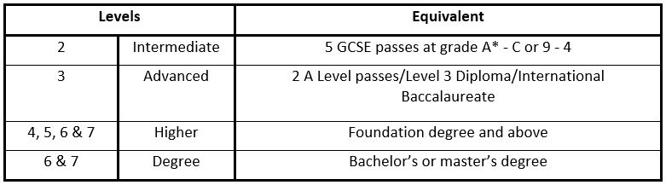
Levels
Intermediate apprenticeships (level 2) Schemes can last anywhere between 12-18 months.
Employers usually look for applicants with two or more GCSEs, including passes in English and ​Maths. An intermediate apprentice will work towards a Level 2 Competency qualification, and a knowledge-based qualification.
These qualifications are equivalent to 5 GCSE passes. ​
​If you do an intermediate apprenticeship you will qualify for an advanced apprenticeship

Slide 7
Advanced apprenticeships (level 3) are designed for career-conscious young people. An advanced apprentice will work on full-time basis in industry, and study towards nationally certified qualifications on the side.
This includes a National Vocational Qualification (level 3), and a knowledge-based qualification. These are equivalent to two A-level passes, and also qualify candidates for higher level apprenticeships. The excitement is real.
The entry requirements for advanced apprenticeships are typically 5 GCSEs (including English and Maths). Employers go absolutely bananas for GCSEs in English and Maths.
Apprenticeship Levels

Slide 8
Higher Apprenticeships
also called level 4/5/6/7 apprenticeships - are schemes for 18-24 year olds. A higher apprenticeship can last anywhere between 3-6 years*, in which an apprentice will combine full-time employment with academic study.
​Employers look for applicants with two or more A levels in subjects that are relevant to the scheme on offer. Advanced apprentices are also eligible!
A higher apprentice will work towards a Level 4 Competency qualification and a knowledge-based qualification - which could include: A Higher National Diploma(HND); A Foundation Degree or Undergraduate Degree
*If continuing to a BA or MA Degree

Slide 9
DEGREE APPRENTICESHIPS
The degree apprenticeship (Level 6 & 7) has been designed to give students the best of both worlds – University and work
Degree apprenticeship candidates work towards a Bachelors or Masters Degree
They get three to six years of professional work experience
All apprentices earn a salary
Apprentices will work for a minimum of 30 hours a week for 30 weeks a year. It’s like a full-time job, but you get the academic benefits of getting a degree-level qualification as well as the on-the-job experience of working in a professional environment

Slide 10


Advantages
Tuition fees paid by the employer and/or government
Students will still have access to full university facilities - Student Union, Sports activities, Libraries etc.
Students will graduate alongside their peers with a cap and gown
You may even be eligible for public transport discounts such as the Apprentice Oyster photo card (London) which offers 30% off certain journeys!
Debt free
Establish strong employer links

Slide 11

Pay Rates

Slide 12
Highest Paid Apprenticeships
By industry (2018/2019)
 | INDUSTRY | AVERAGE SALARY
1 | Accountancy | £17,988
2 | Government/Not for Profit | £17,472
3​​​​​ | Banking/Finance | £20,218
4 | Energy/Utilities | £15,995
5 | Insurance, Asset & Investment Management | £19,034
6 | IT & Consultancy | £18,331
7 | Engineering | £17,440
8 | Business | £17,563
9 | Construction | £16,703
10 | FMCG/Retail | £15,441
11 | Science & Pharmaceuticals | £15,437
12 | Recruitment | £10,660
13 | Law | 16,405
Source: RateMyApprenticeship

Slide 13
Retention
Around 90% of apprentices stay in employment.
71% of apprentices stay with the same employer
Most common reason for changing companies are due to applying for better jobs with more pay and/or responsibility

Slide 14
Availability
https://www.ratemyapprenticeship.co.uk/search?programme=20&show=jobs
https://www.youtube.com/watch?v=keeoHMPiJ2A

Slide 15
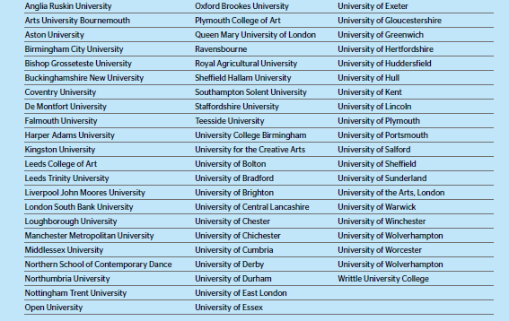
Universities and Higher Education Institutions delivering apprenticeships:
:
… 7 of which are based in London

Slide 16
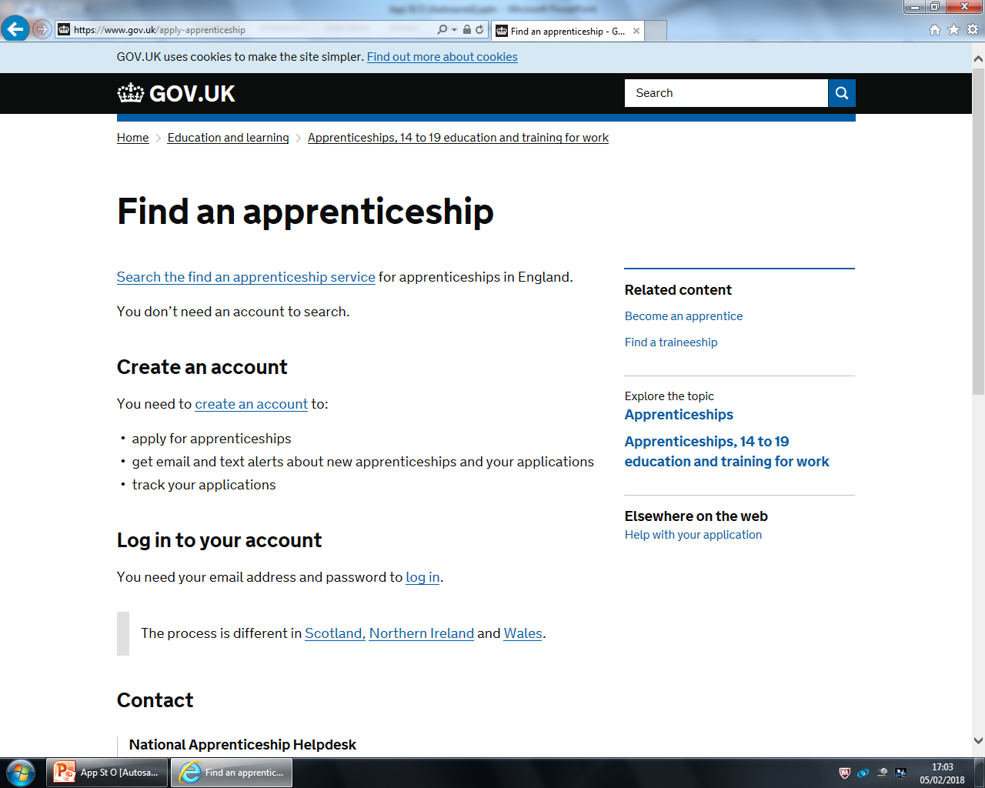
How to find an Apprenticeship
Register with ‘Find an Apprenticeship’
Explore the options on this site
Apply for the jobs that interest you
Set up alerts
Look at the employers website
Make some extra effort! – Contact the company direct, attend open days etc

Slide 17



The process
Smaller employers are more traditional and often entail an application form and a CV (occasionally a Math, English, or IT test online)
Larger employers have more varied recruitments, which can include aptitude tests, video interviews, or participation at an assessment centre
Be ENGAGING.
Be INTERESTED.
Be ENTHUSED.

Slide 18
Statistics
Apprentices are highly employable – 97% of apprentices say their apprenticeship has improved their ability to do their job, and 92% of in-work apprentices said their apprenticeship has had a positive impact on their job and career.
30% of the senior UK managers at Rolls Royce started out at the company as apprentices
Over the past three years, 56,200 people have started a higher or degree apprenticeship.
Up to 28,000 apprenticeship vacancies are available online at any one time.
Over 70 universities and around 200 colleges are approved to deliver higher and degree apprenticeships. This list is growing all the time as new apprenticeships are developed and more employers look to recruit apprentices.

Slide 19
Julie Dunn
Ian Birthwright
and
Angela Jenner
South London Support For Schools

